Slide 1
Pathology for non-pathologists? What defensive genes in plants do
Bruce Levine
Maryland Chapter of the American Chestnut Foundation
Chestnut Chat, July 24, 2020

Slide 2
What we mean by immunity
Very basic innate immunity
Very complex adaptive immunity
Very complex innate immunity
No adaptive immunity (except to RNA viruses at the cellular level)

Slide 3
Genes make the difference between susceptible and resistant
These two plants are genetically identical except that the one with powdery mildew has three defense genes deleted

Slide 4
Two tiers of Defense: Constitutive Defenses
Strong door with drawbridge and portcullis
Thick stone walls
Inaccessible windows
Moat with alligators
wooden spikes

Slide 5
Two tiers of Defense: Induced Defenses (Recognition, Signaling, Defensive Response)
Sentinels
Archers/Soldiers

Slide 6
Tier 1: Constitutive defenses
Cell wall
Cell membrane
nucleus

Slide 7
Constitutive defenses
A tough cell wall made of cellulose, reinforced with other molecules, and maintained by repair enzymes
Cell wall
Cell membrane
nucleus

Slide 8
Constitutive defenses
Secreted structural and anti-microbial chemicals that make plant tissue a hostile environment for microbes
nucleus

Slide 9
Functions of constitutive defense genes
Production and delivery of cell wall components
Production of protective secretions like waxes
Production of anti-microbial compounds

Slide 10
Pathogens are microbes adapted to overcome constitutive defenses
nutrients
pathogen
Constitutive defenses

Slide 11
They don’t really have ladders. But they do have:
nutrients
Special enzymes that degrade protective layers and cell wall components
Toxins that weaken or kill the cell
Specialized growth structures that physically push their way into plant tissue
Constitutive defenses

Slide 12
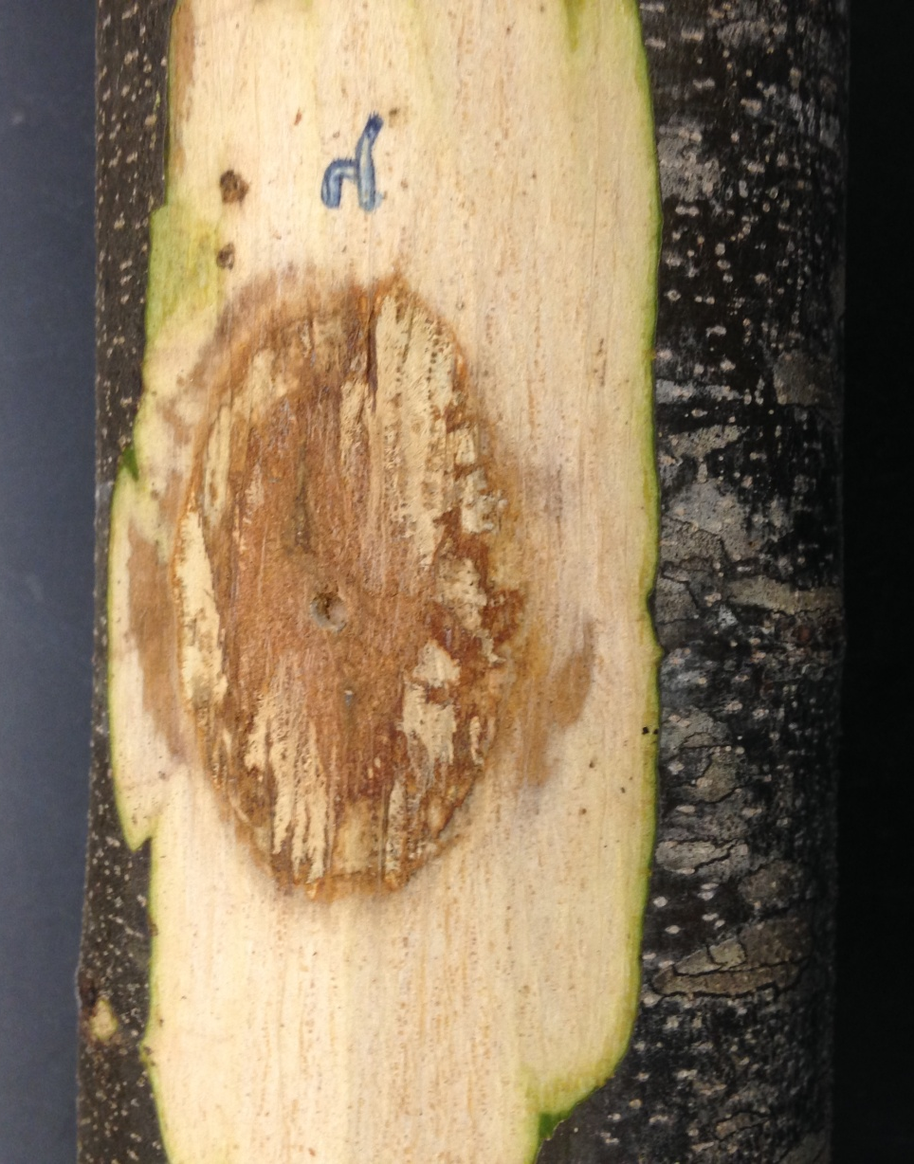
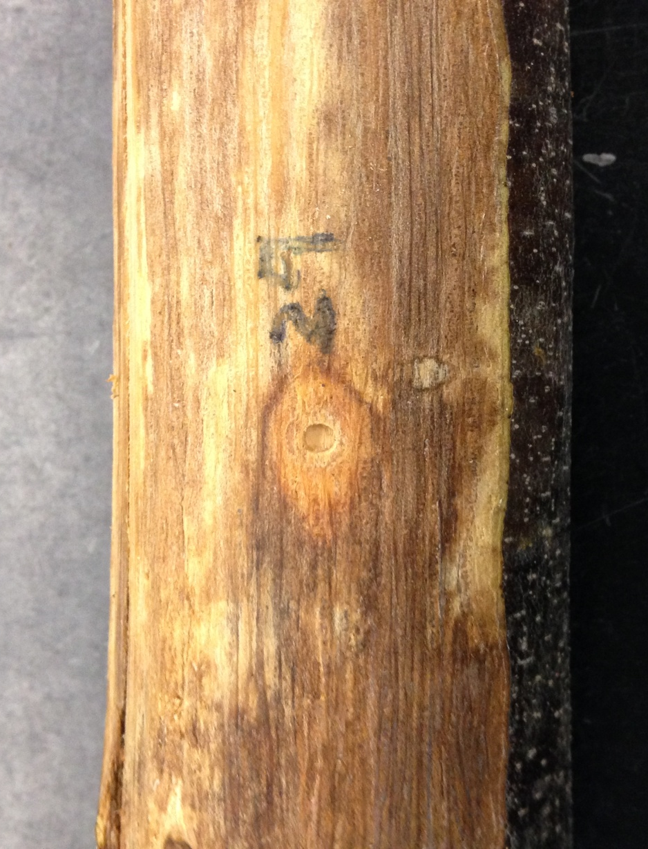
Pathogens rely on host defenses to keep out the competition

Slide 13
Tier 2: Induced Defenses Pattern Triggered Immunity (PTI)
Pattern recognition receptors
nucleus

Slide 14
fungus
oomycete
bacteria
PRRs are sensitive to molecules associated with broad categories of pathogens
damage
nucleus

Slide 15
When triggered by contact with pathogen molecules, they signal the nucleus
nucleus

Slide 16
Nucleus responds by turning off some routine genes and turning on defensive genes involved in:
Cell wall reinforcement
Deposition of tissue
Oxidative burst
Anti-microbial compounds
Signaling to other cells
nucleus

Slide 17
Functions of PTI defense genes
They encode proteins that:
make up the pattern recognition receptors
regulate the defense signaling and gene activation pathways
Participate in defensive responses:
Cell wall reinforcement
Cell division/deposition of callus tissue
Oxidative burst
Production/delivery of anti-microbial chemicals

Slide 18
Pathogens use “effectors” to suppress the defensive response
E
E
E
E
E
E
E
Effectors overcome defenses in various ways:
Weaken the plant (toxicity)
Block recognition
Disrupt signaling
Disrupt the defense response in the nucleus
Disrupt the defense response outside the nucleus
E
E
E
nucleus

Slide 19
Effectors tend to be host-specific
While constitutive defenses are similar across host species, PTI defenses vary a lot
Effectors therefore tend to be specific to molecules found in a narrow range of host species
←Chestnut blight fungus did nothing to the maple tree on left because its effectors are not adapted to maple. (picture taken at 6 months post inoc.)

Slide 20
Tier 3: Effector-Triggered Immunity (ETI): Special receptors detect effectors
E
E
E
E
E
E
E
E
E
Extra- and Intracellular receptors, encoded by “R-genes” detect effectors or their activity. They may block the effector, or signal nucleus
E
nucleus

Slide 21
Effector-triggered immunity (ETI)
E
E
E
E
E
E
E
E
E
Nucleus launches elevated defense response, that can include cell death
E
nucleus

Slide 22
Functions of ETI defense genes
Encode the proteins that make up the R-gene proteins (receptors, decoys)
Regulate the defense signaling and gene activation pathways
Defensive response to:
Elevate PTI-like responses
Trigger of cell death (sometimes)

Slide 23
Chinese chestnut seems to have superior constitutive defenses in the bark
American (left) and Chinese (right) chestnut bark medium 11 days after inoculation with the same fungus. Growth on Chinese medium is more restricted, and fruiting bodies have not yet formed. (Photo: Bruce Levine)

Slide 24
Both Chinese and American show a PTI-like callus response, but
Effective on Chinese Overwhelmed on American

Slide 25
Is Chinese PTI superior to American?
Not necessarily.
American can produce a strong callus response to other pathogens.
Here is an American about 4 months after being inoculated with Pestalotiopsis fungus

Slide 26
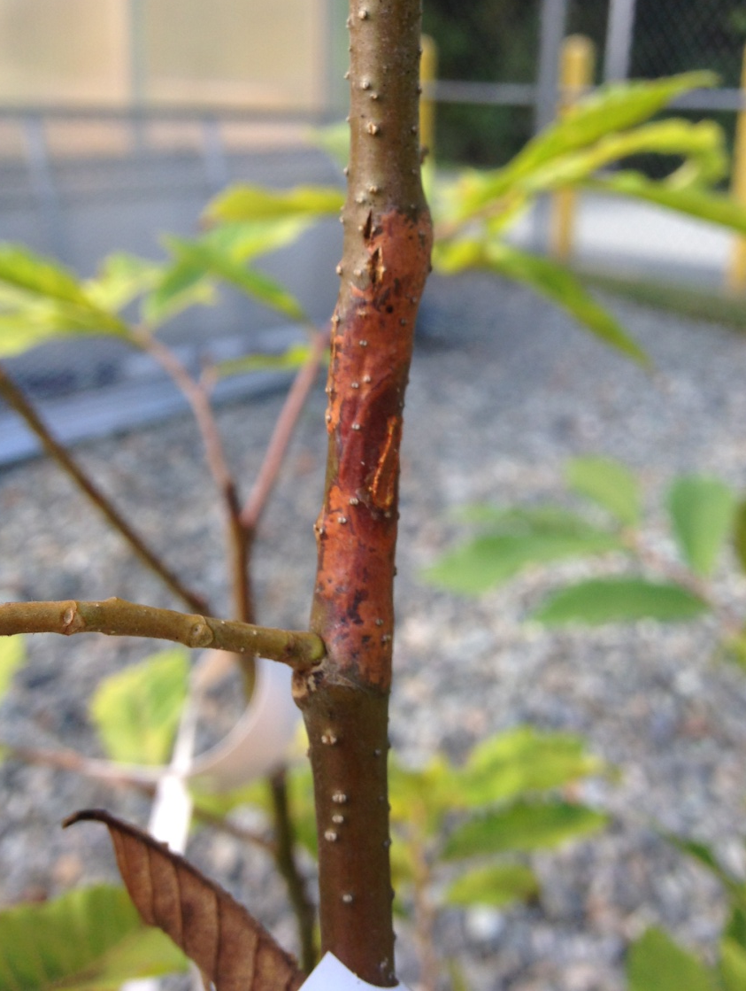
ETI is likely an important part of Chinese resistance
SSA on Chinese SSA on American

