Slide 1
Castanea Sativa (and hybrids) cultivar nut photos
By J.M.Nave
February 2021

Slide 2
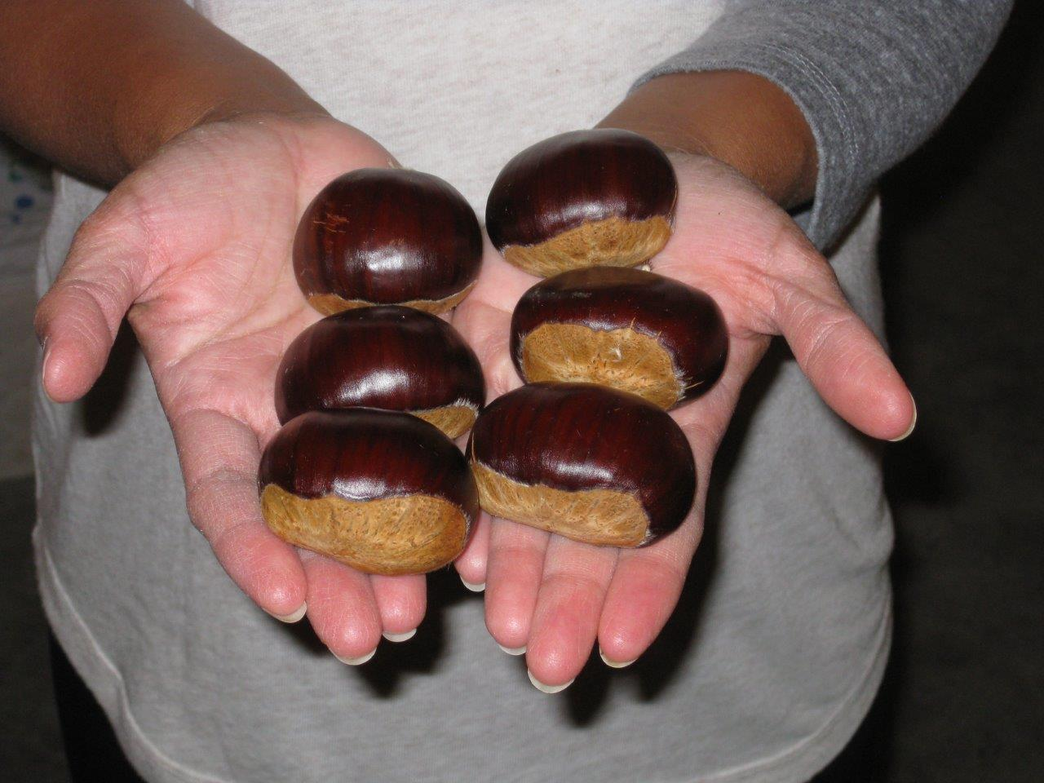
Bergantz
A Sativa/crenata hybrid from California

Slide 3
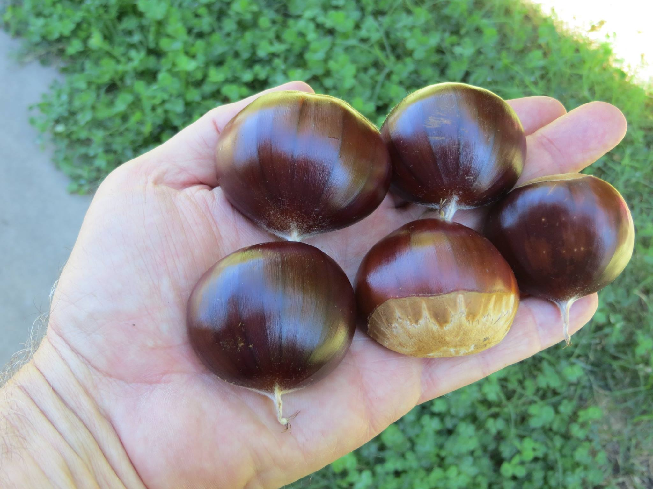
Big Euro
Mollissima/crenata/sativa/dentata hybrid grown out by JMN

Slide 4
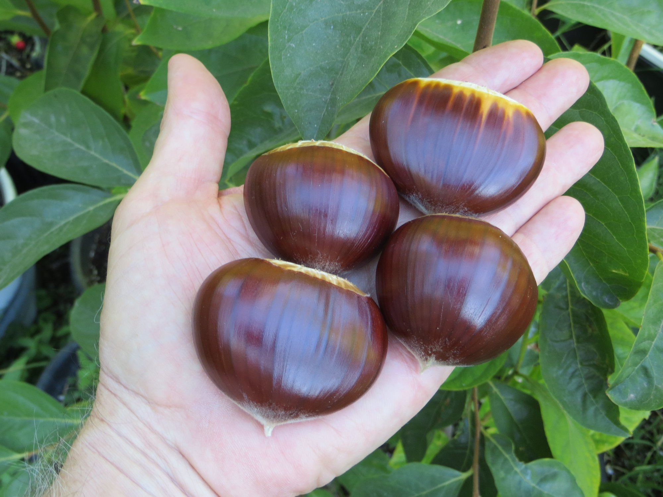
Bouche de Betizac
Sativa/crenata hybrid from France

Slide 5
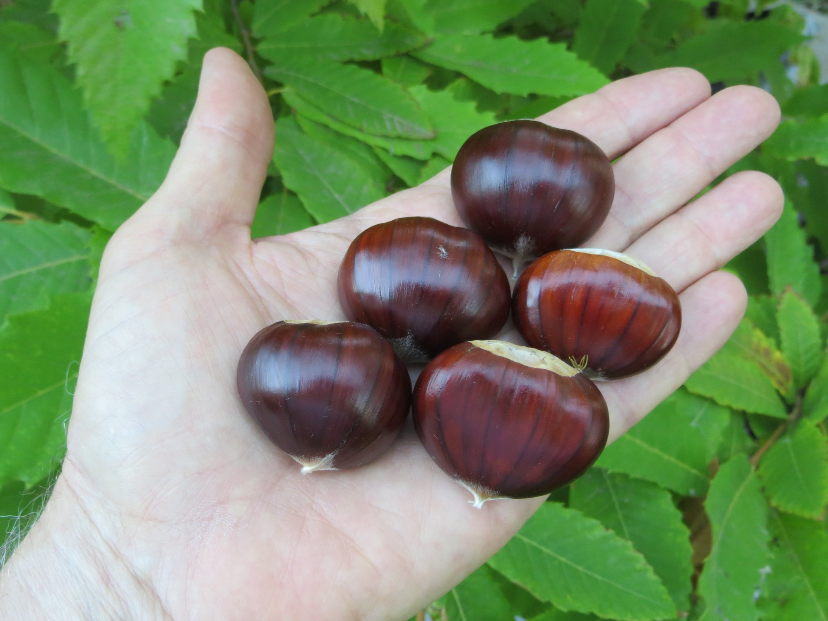
Boitano/Fife/Black Pearl
Seedling grown out by Angelo Boitano in Fife, WA

Slide 6
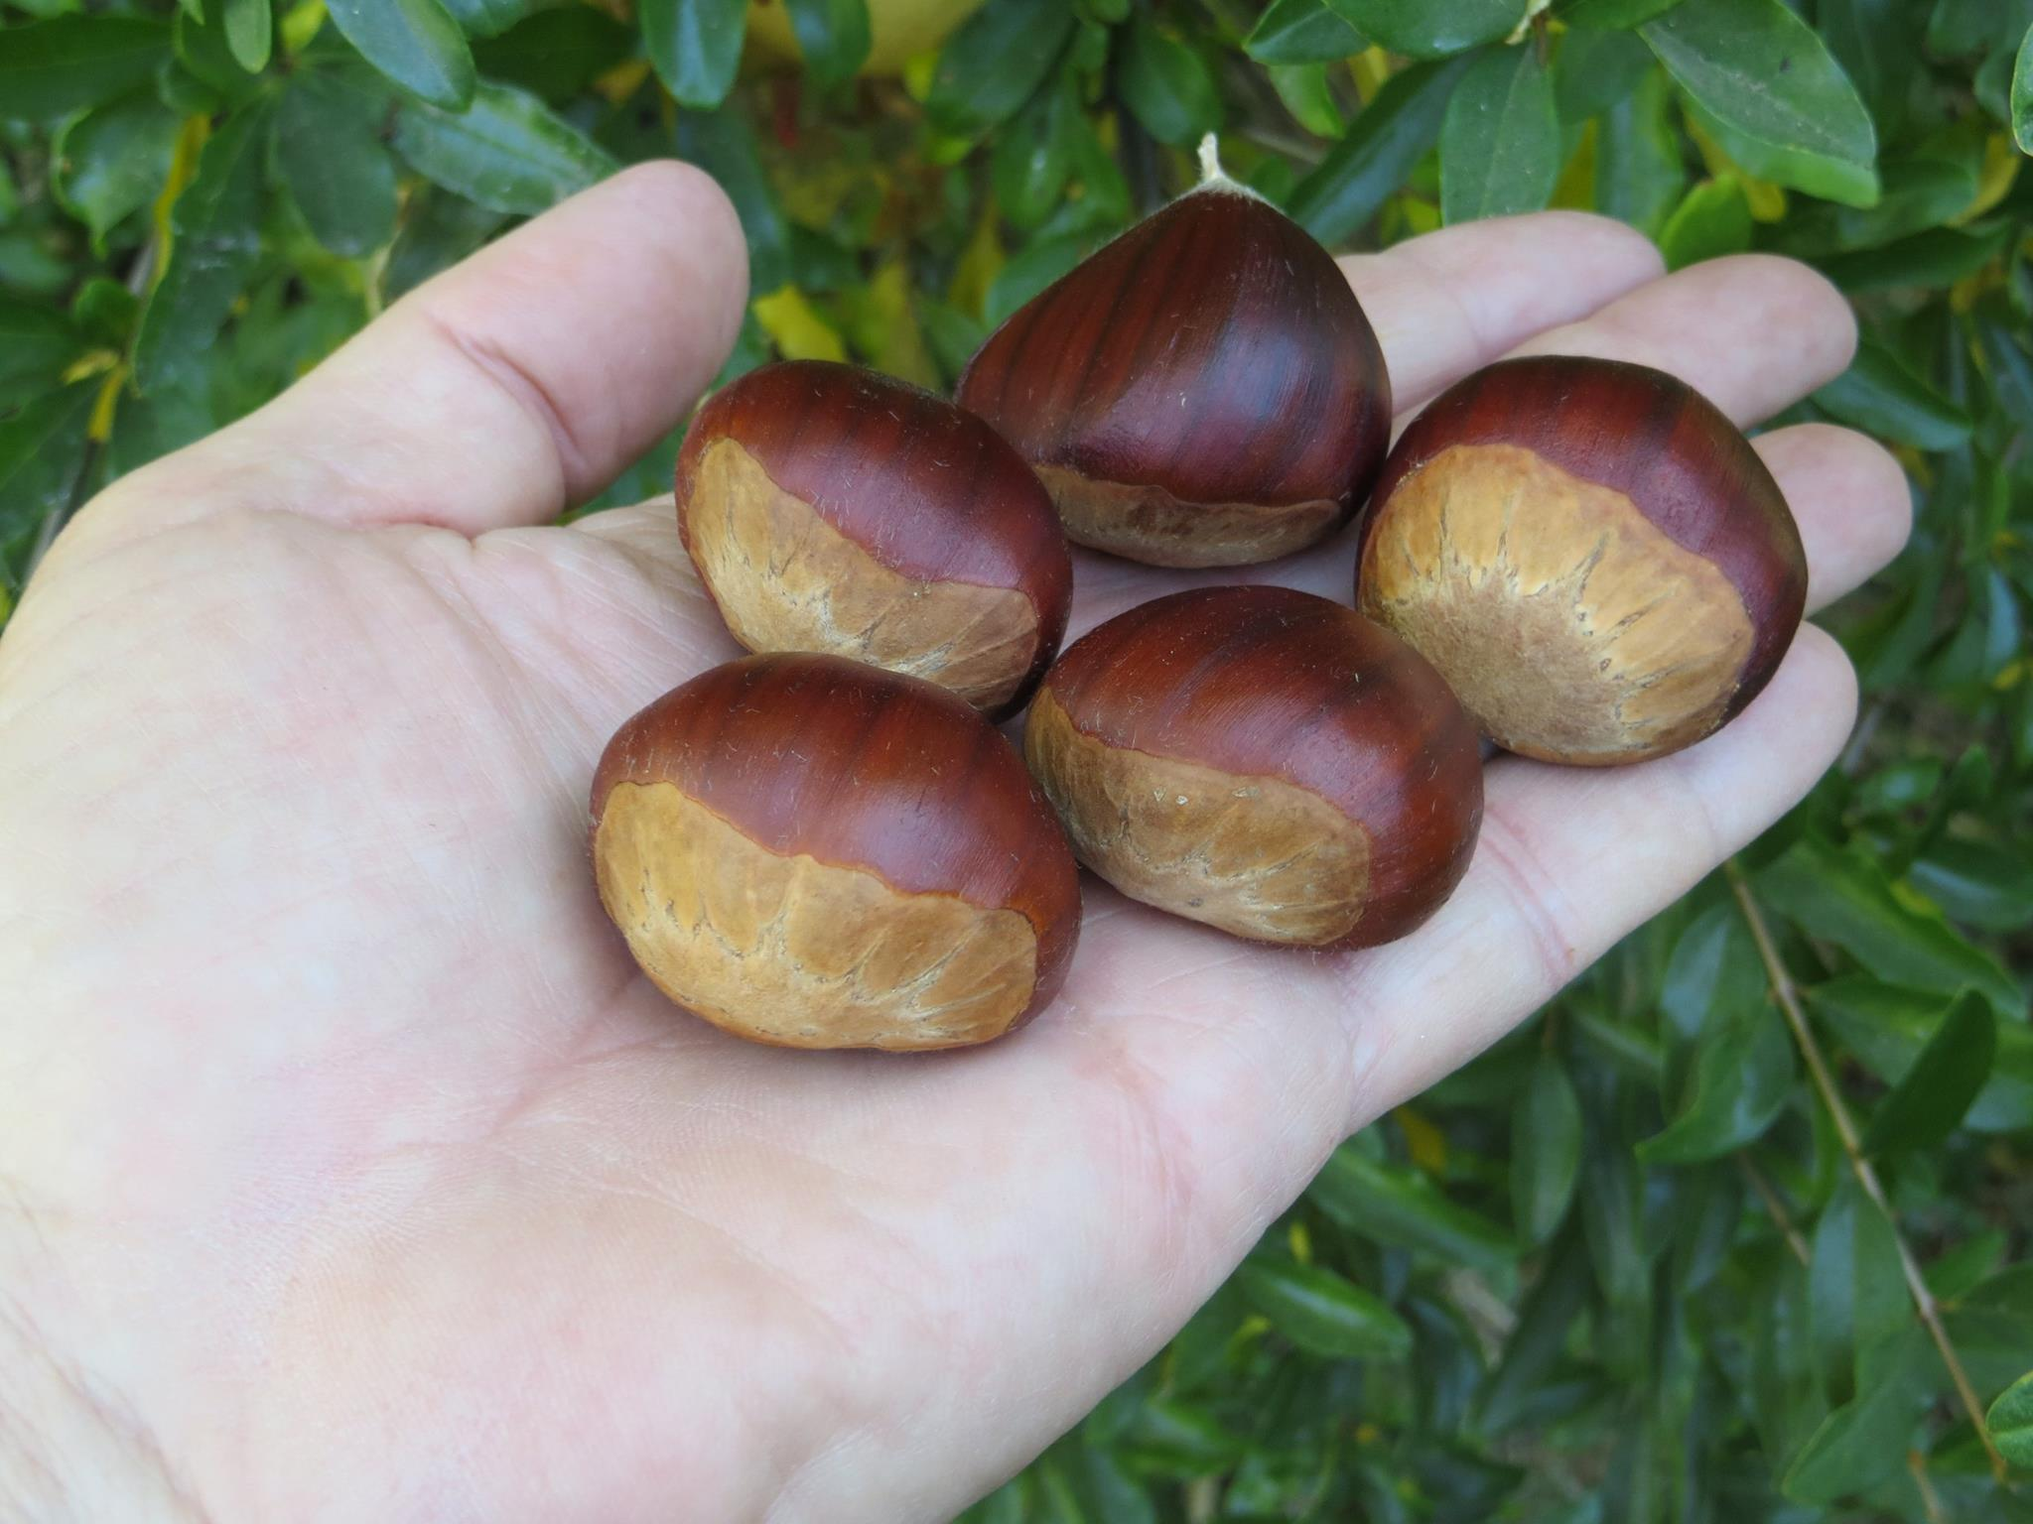
Burbank Stump Sprout
Complex hybrid from Sebastopol, California

Slide 7
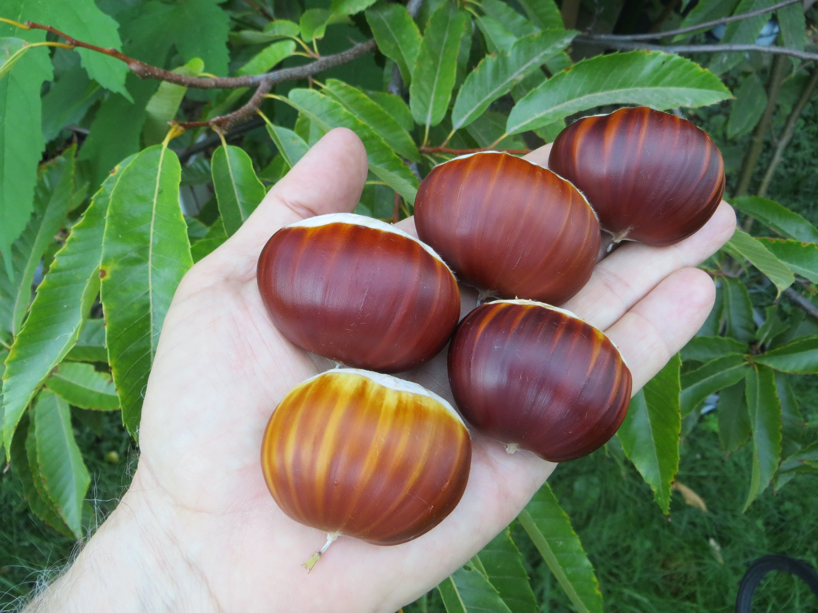
Gillet
Sativa/crenata hybrid from California

Slide 8
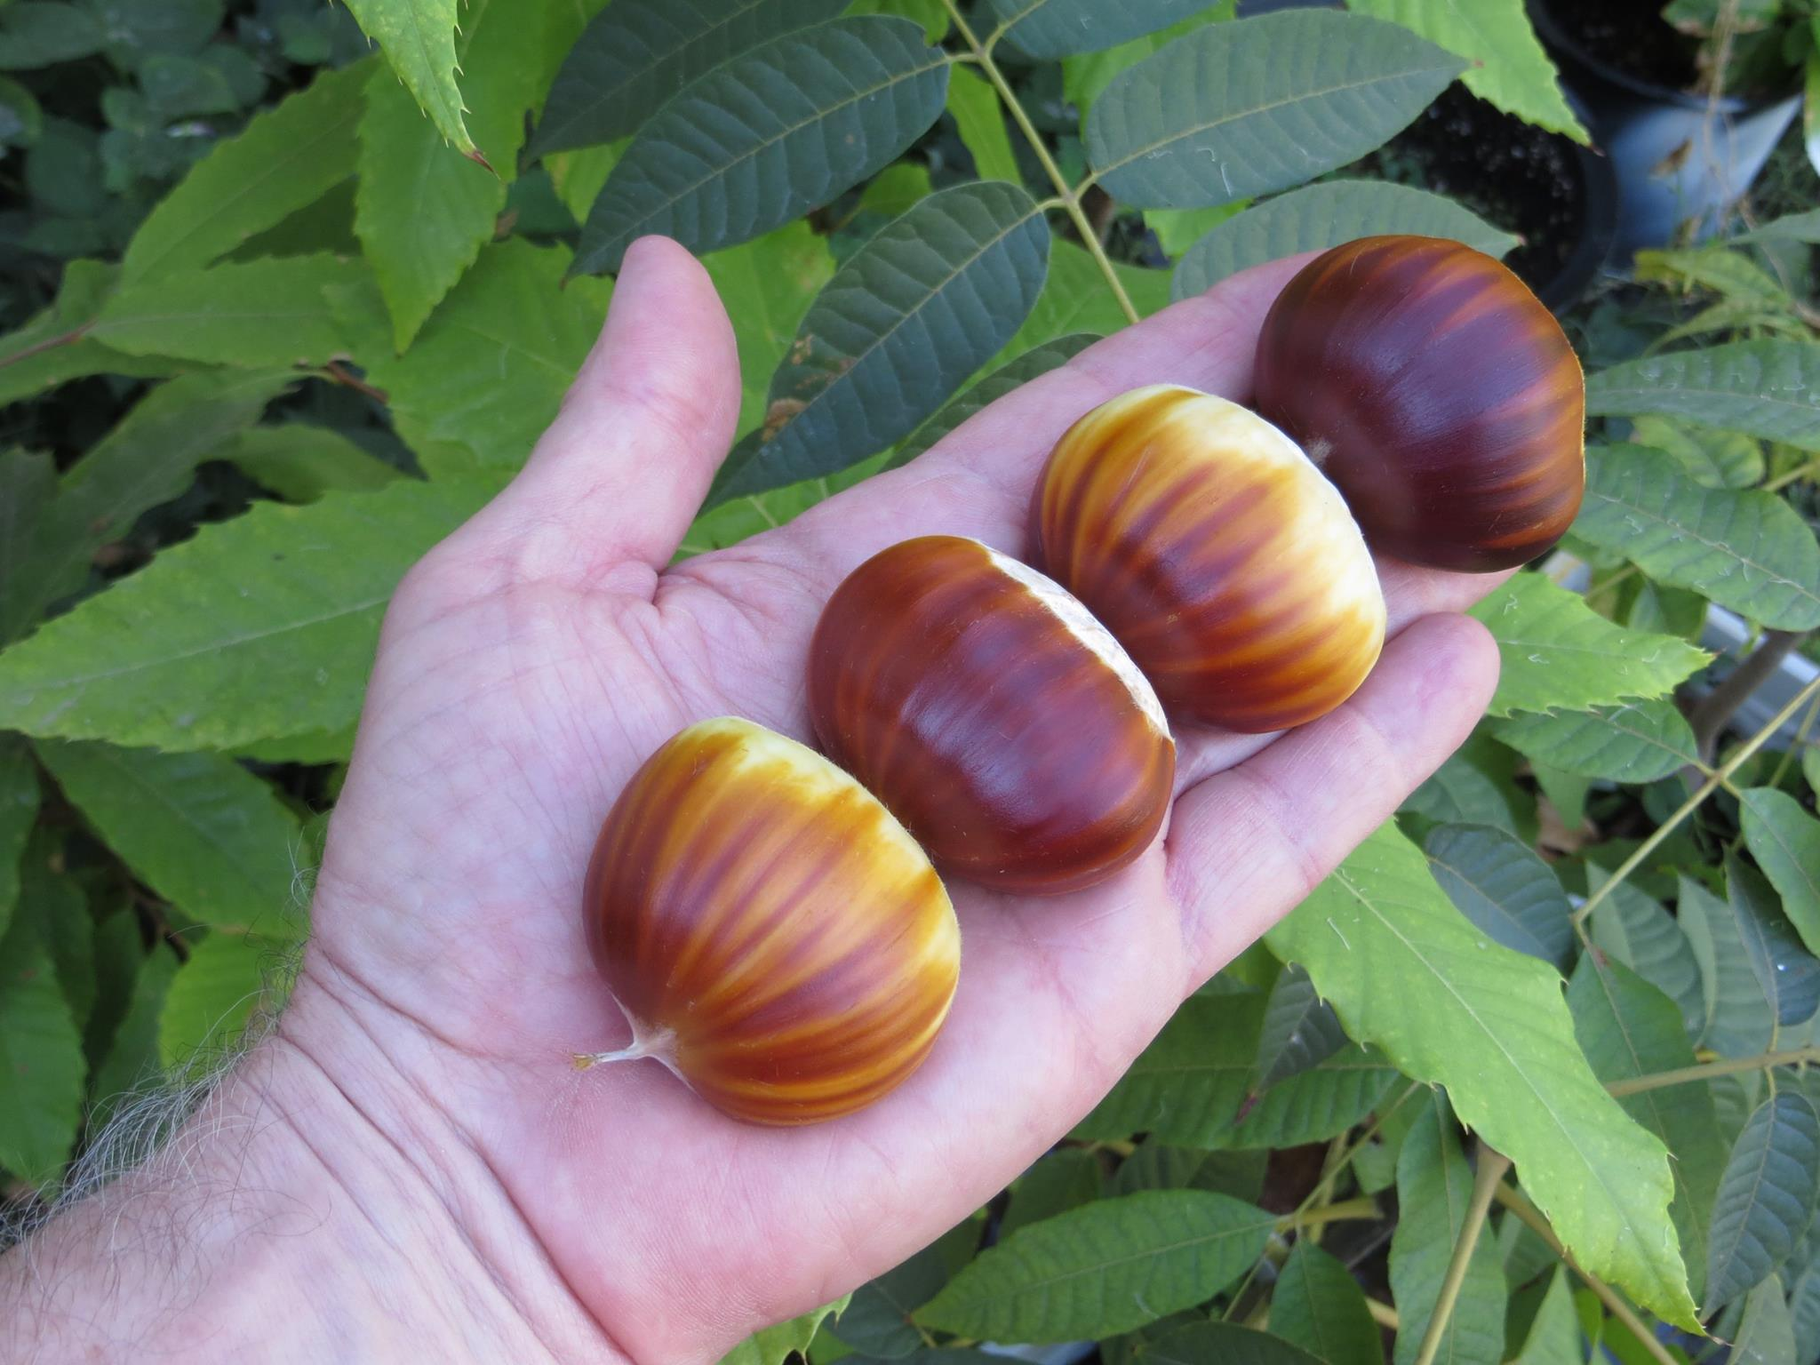
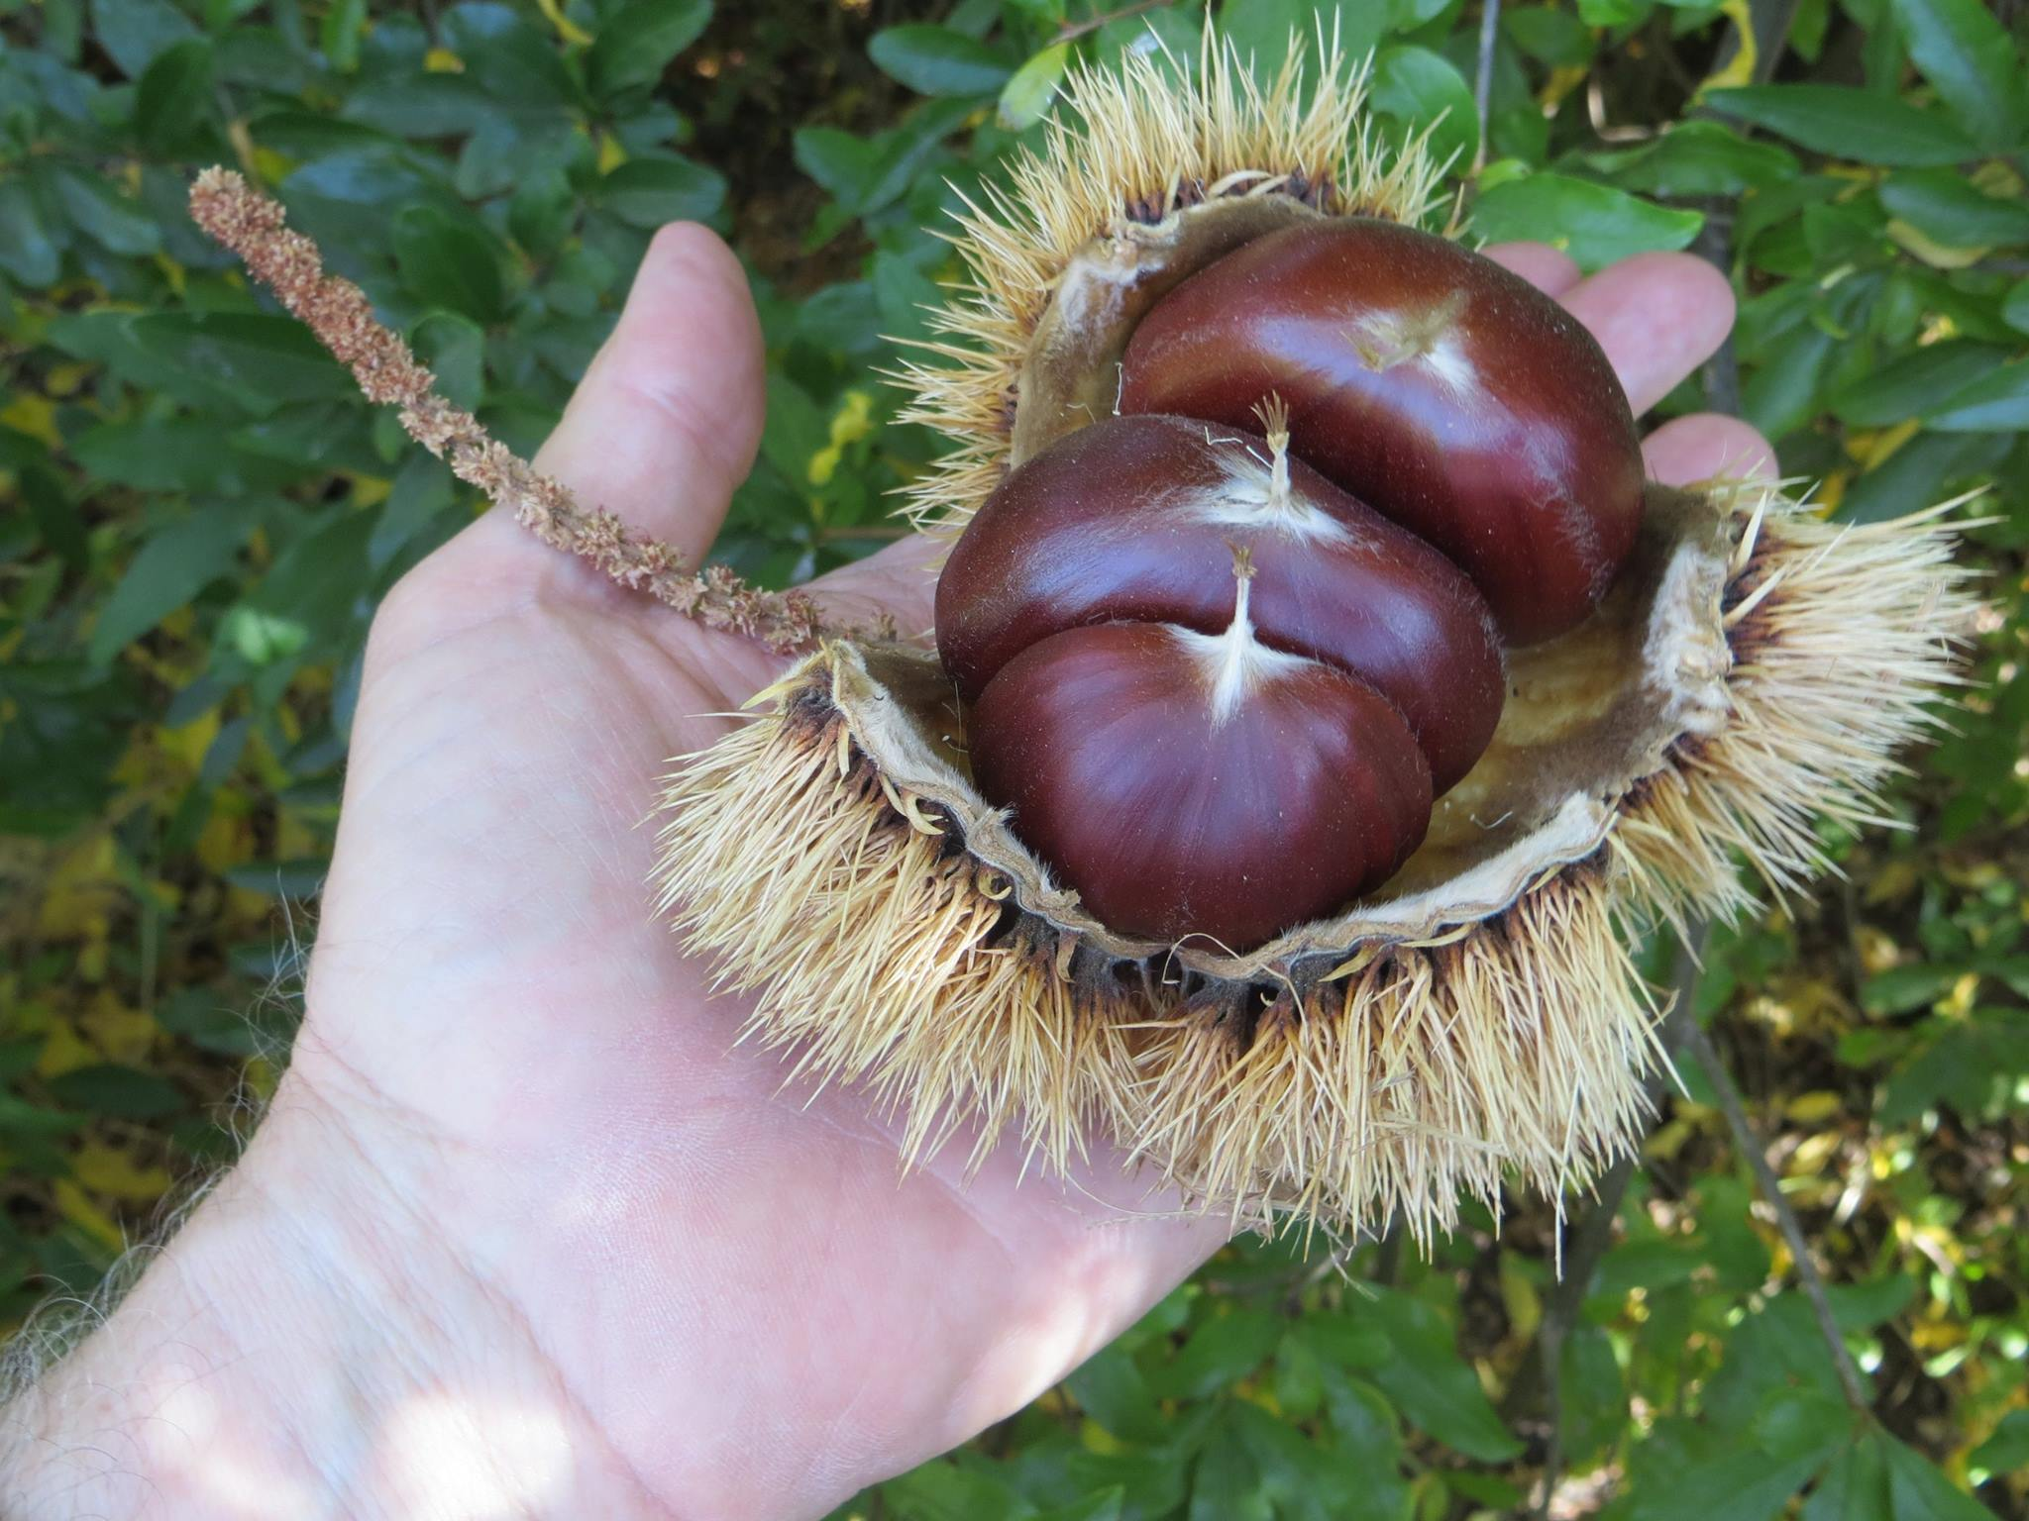
More Gillet nuts

Slide 9
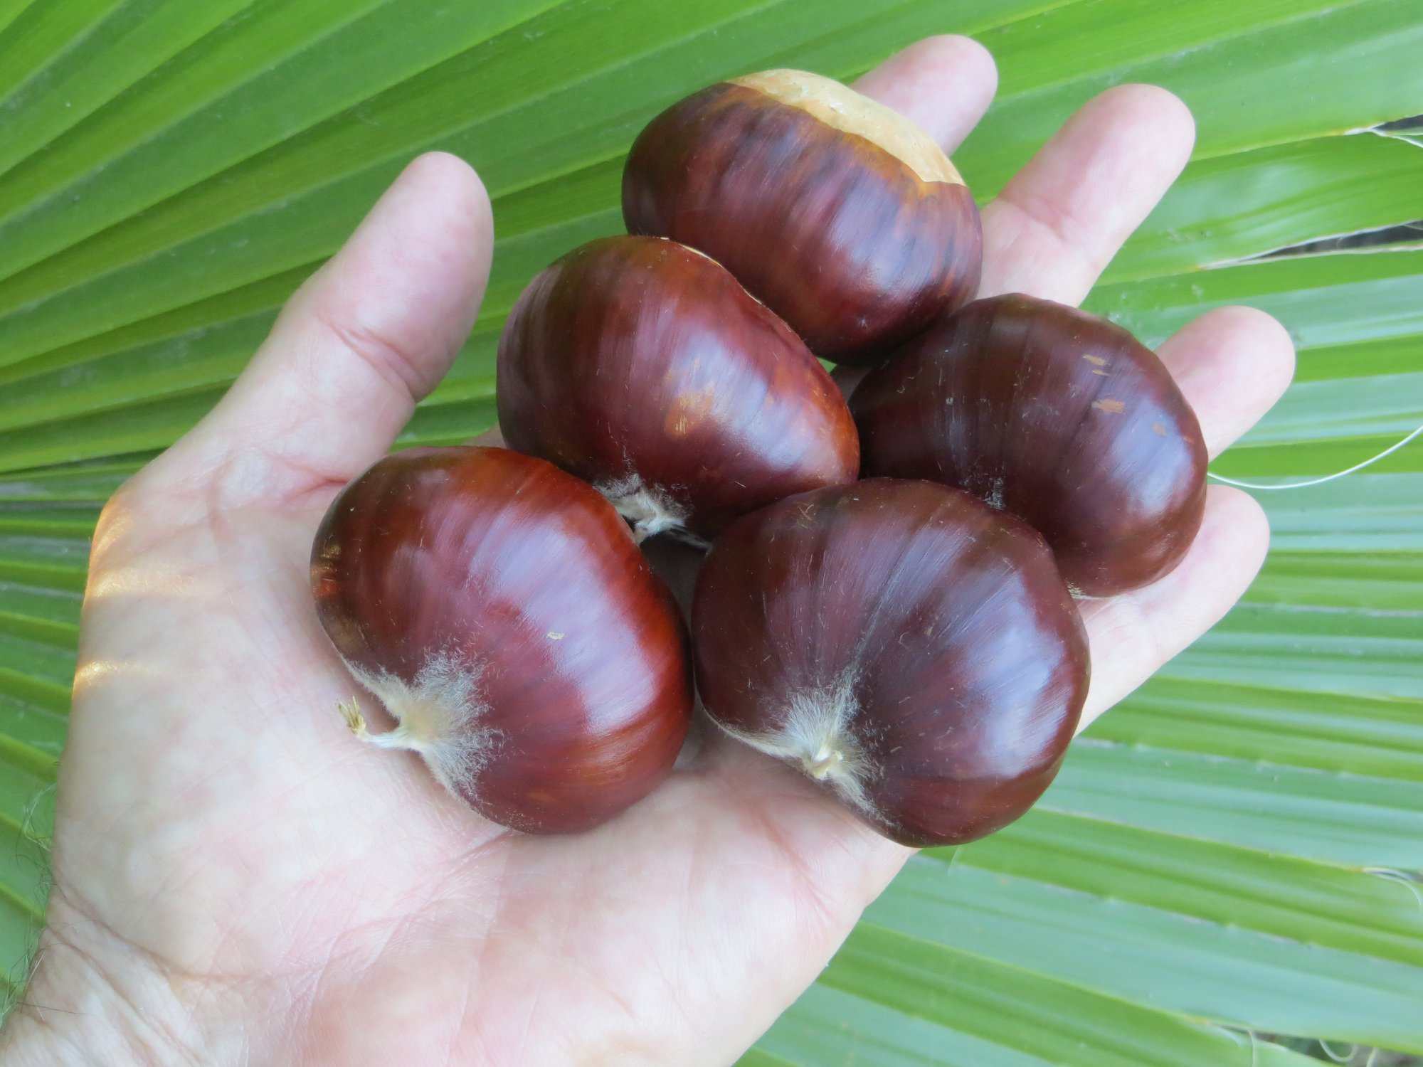
Kaibutsu
Sativa/crenata hybrid from California

Slide 10
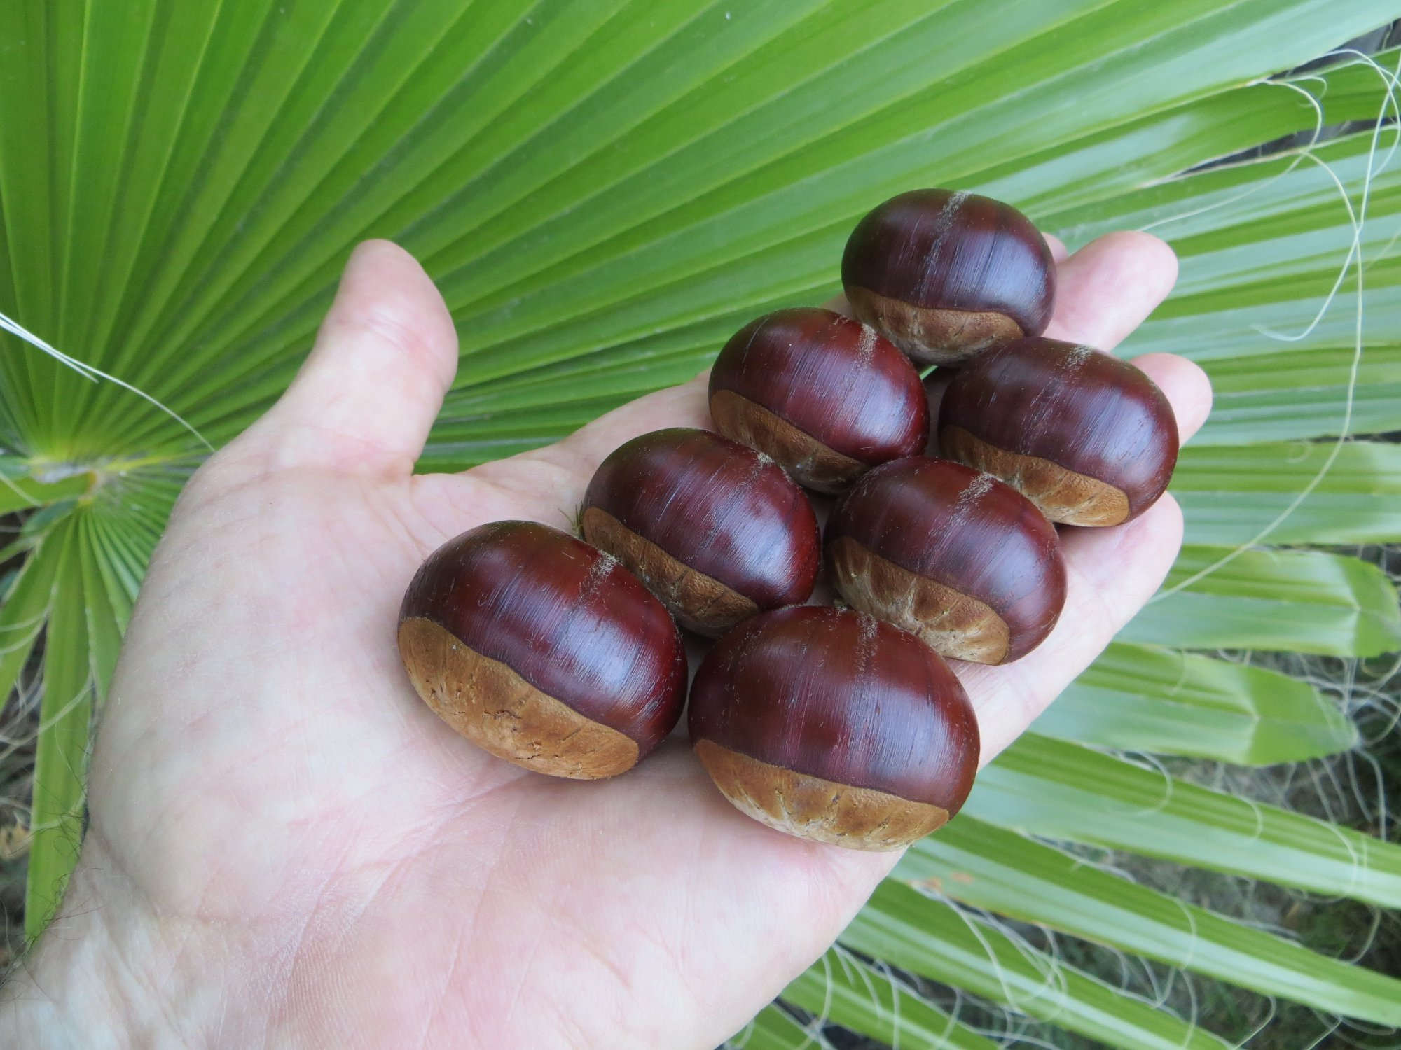
Long Street
Sativa/dentata hybrid growing in Nevada City, California

Slide 11
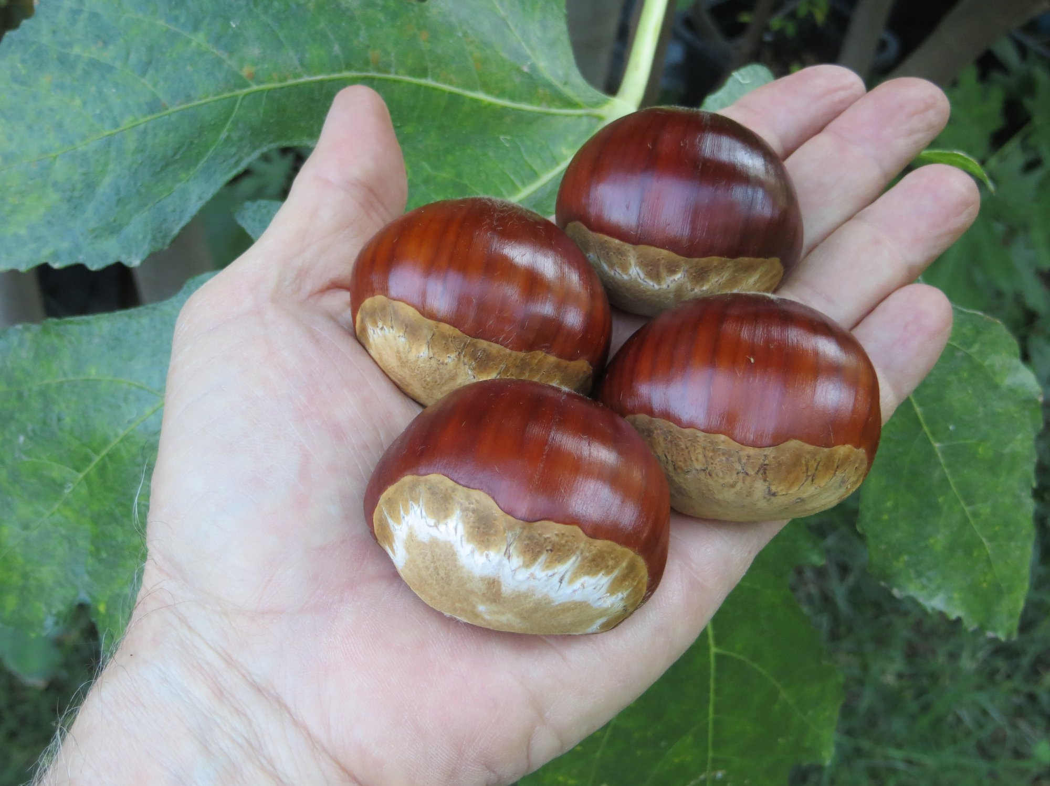
Maraval
Sativa/crenata hybrid from France

Slide 12
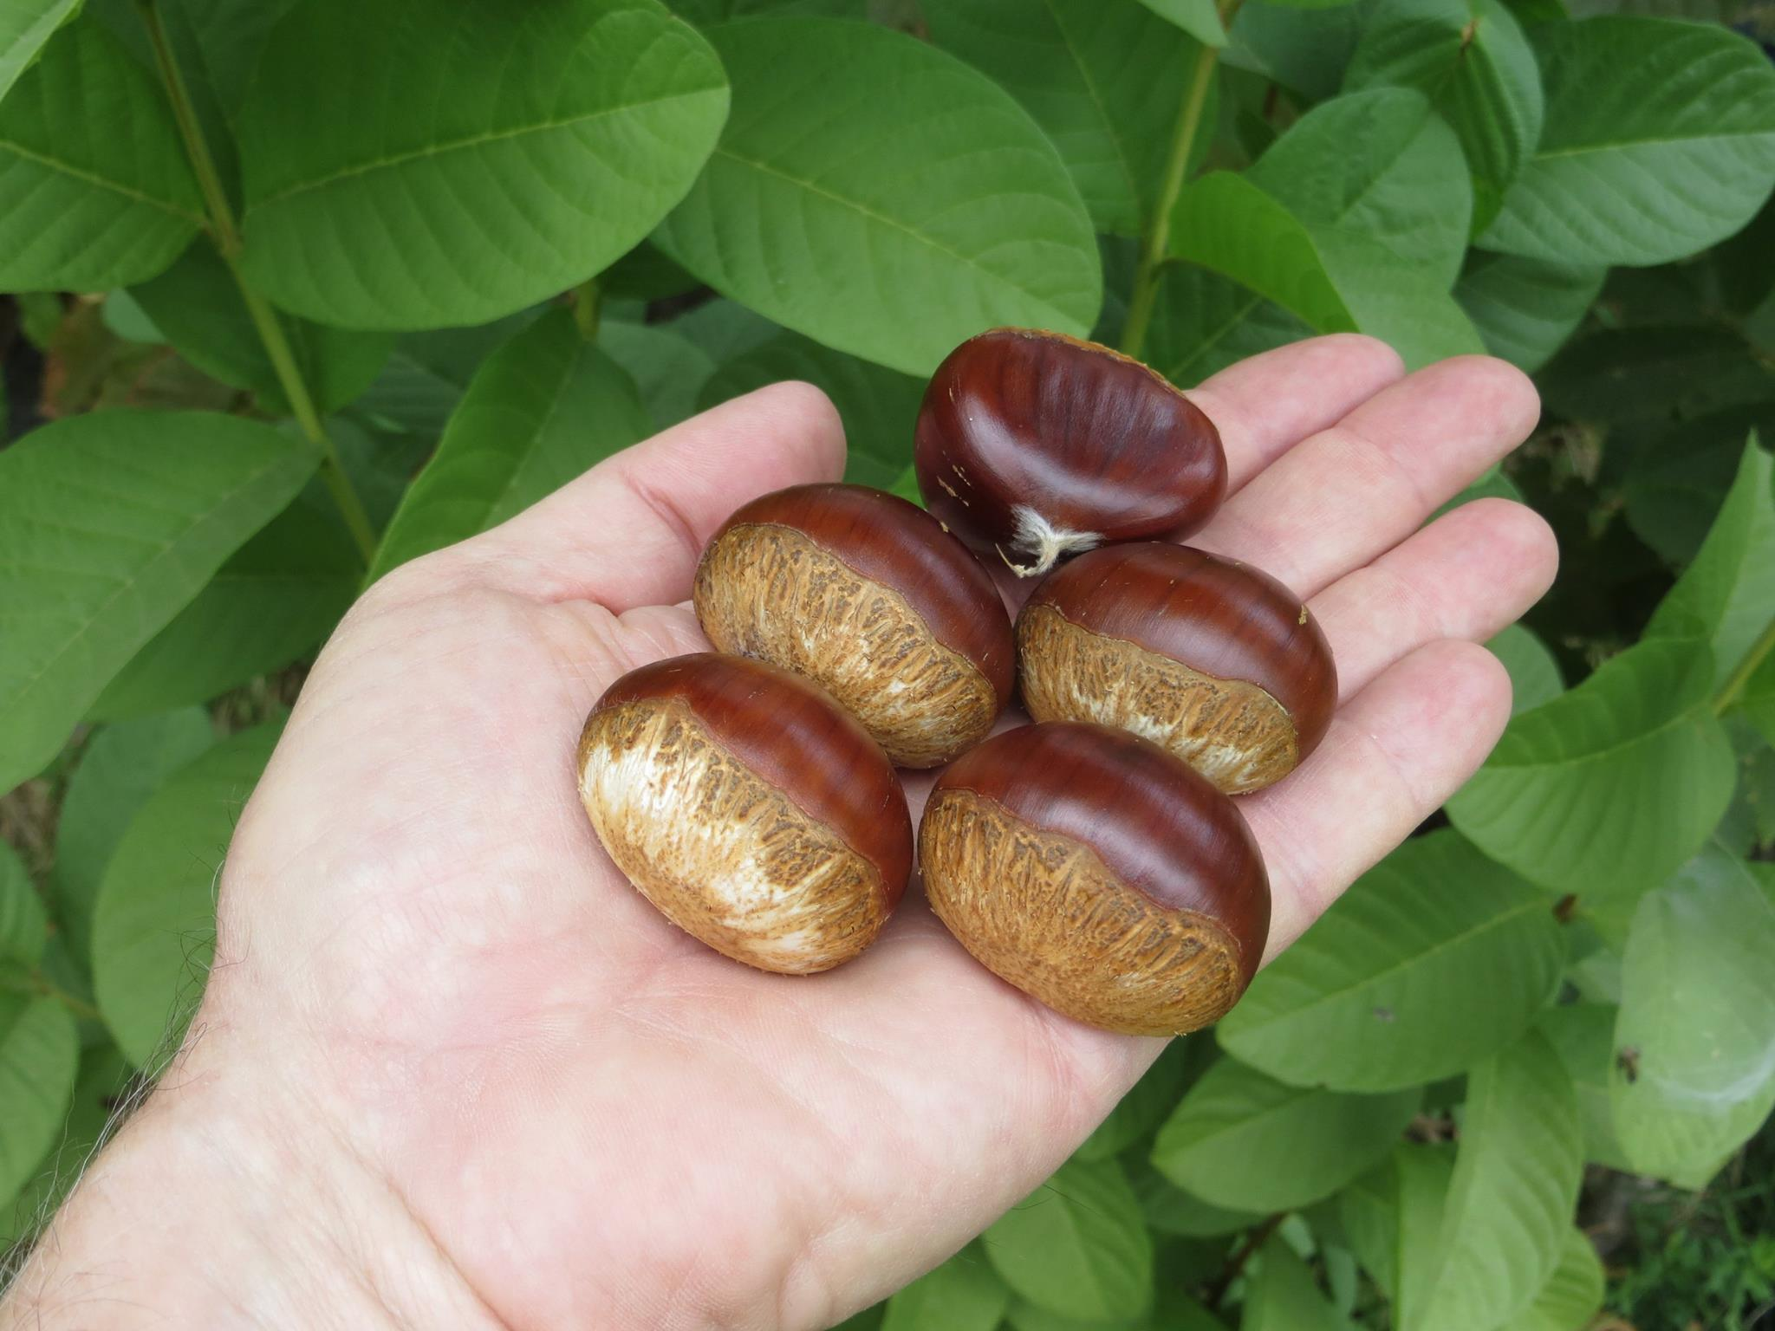
Marigoule
Sativa/crenata hybrid from France

Slide 13
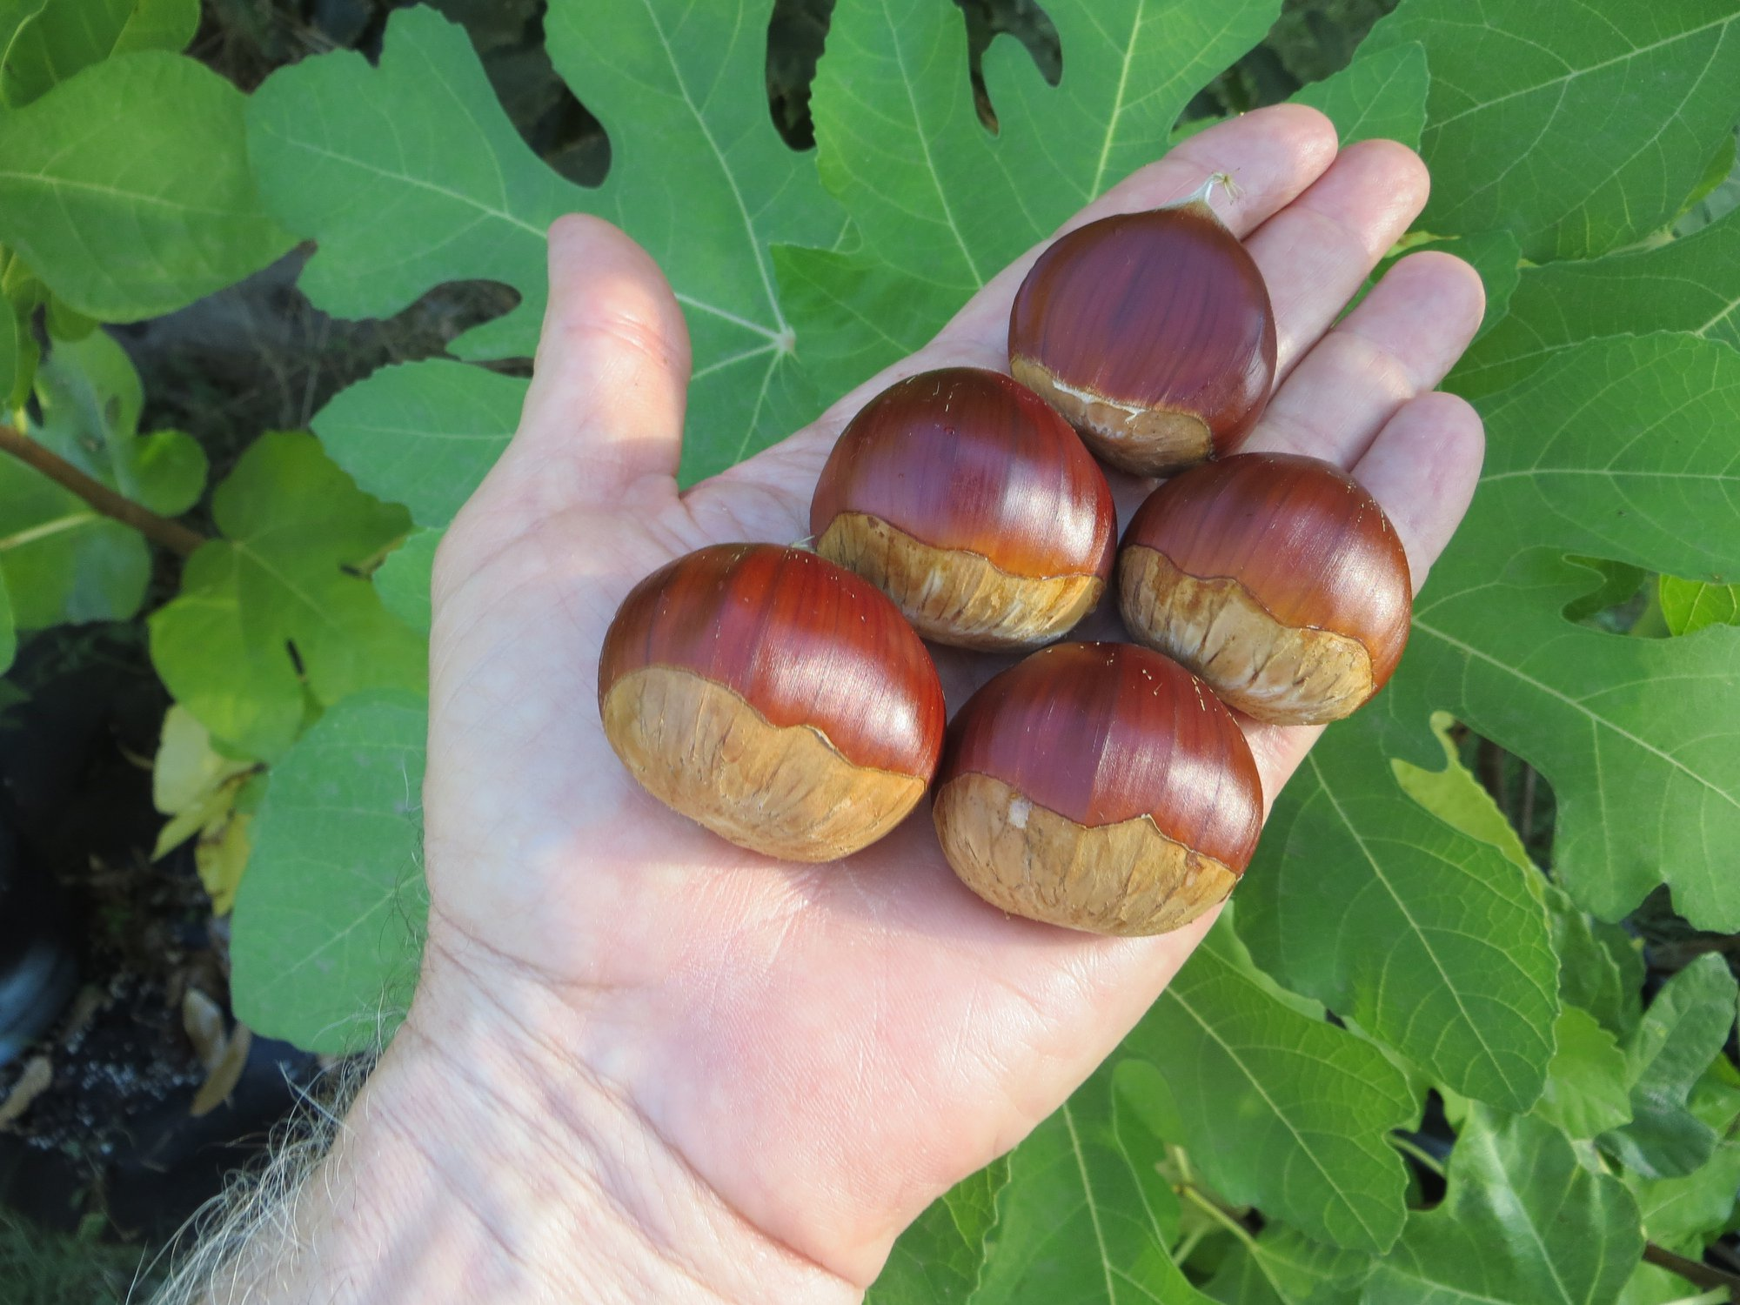
Marissard
Sativa/crenata hybrid from France

Slide 14
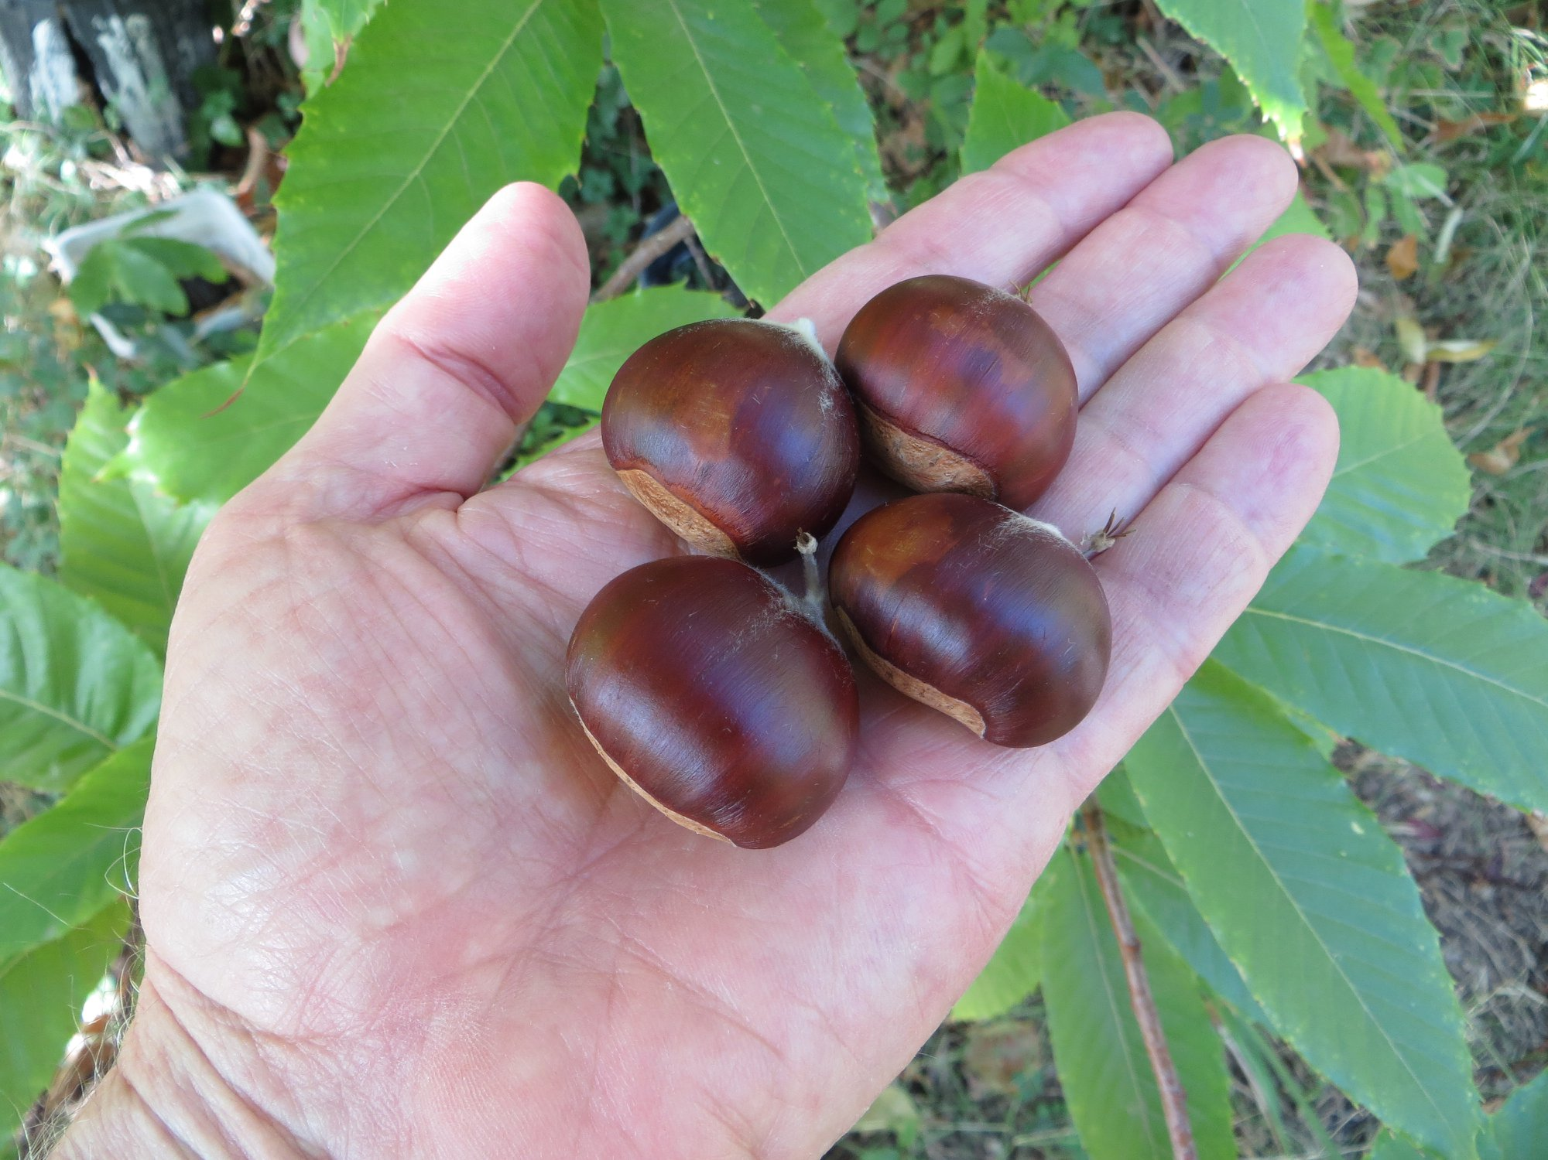
NCC 1
Sativa/dentata hybrid growing in Nevada City, California

Slide 15
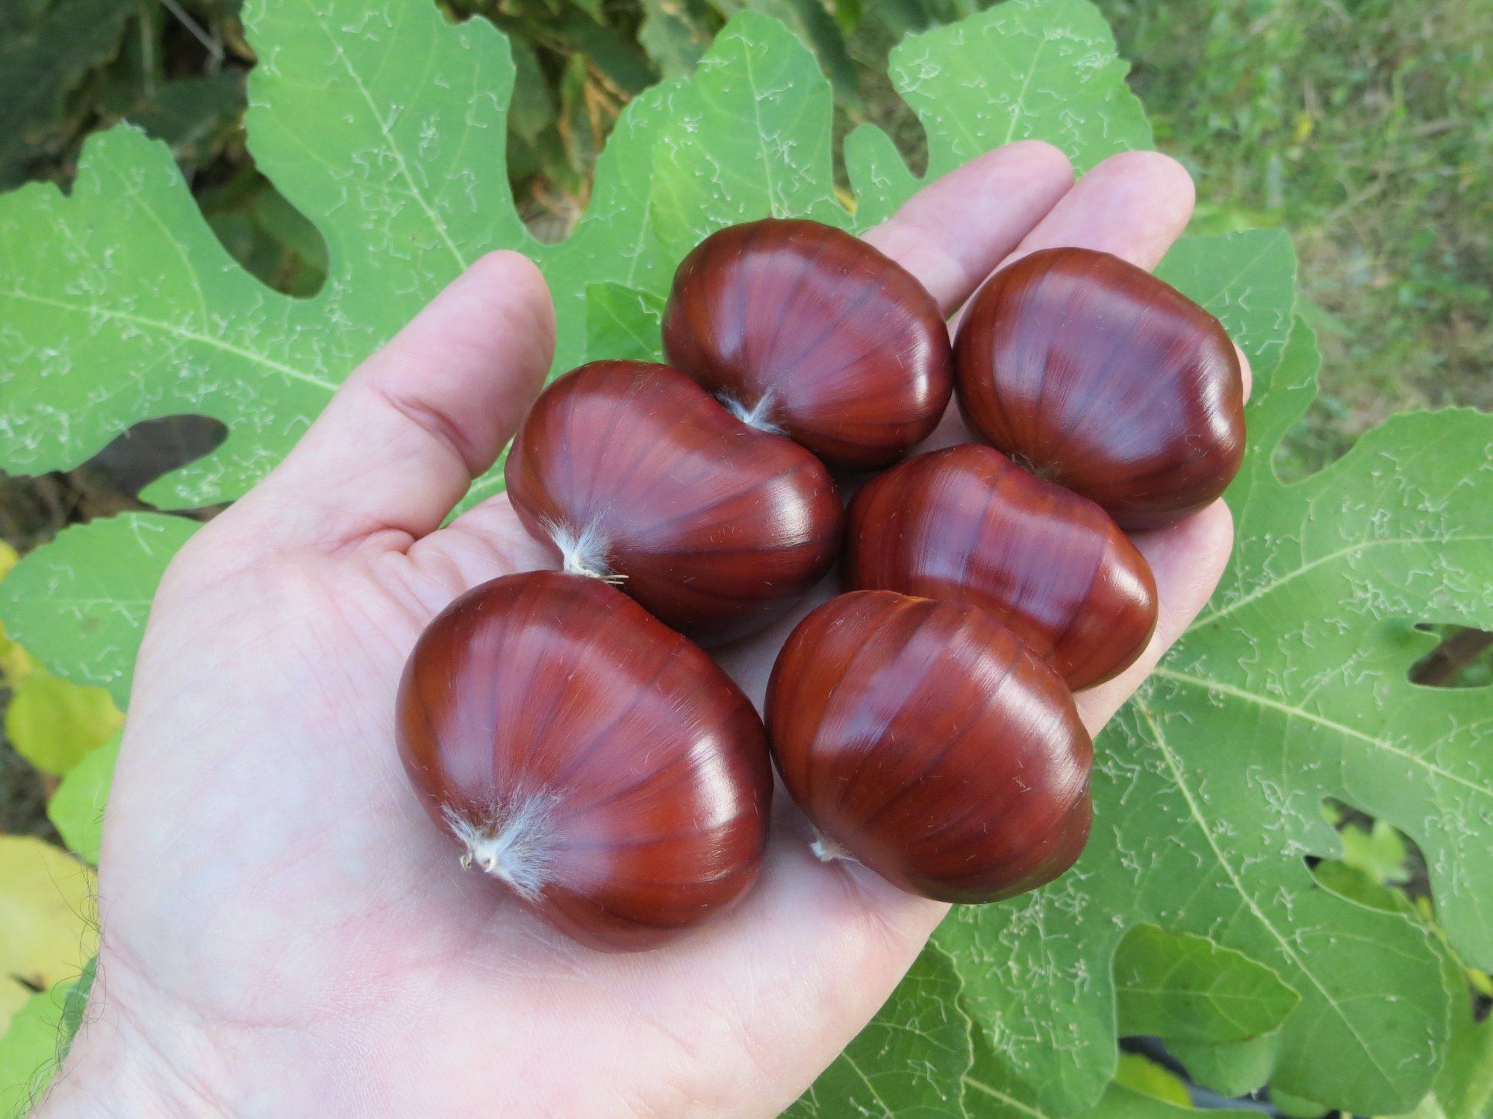
NCC 6
Sativa/crenata hybrid growing in Nevada City, California

Slide 16
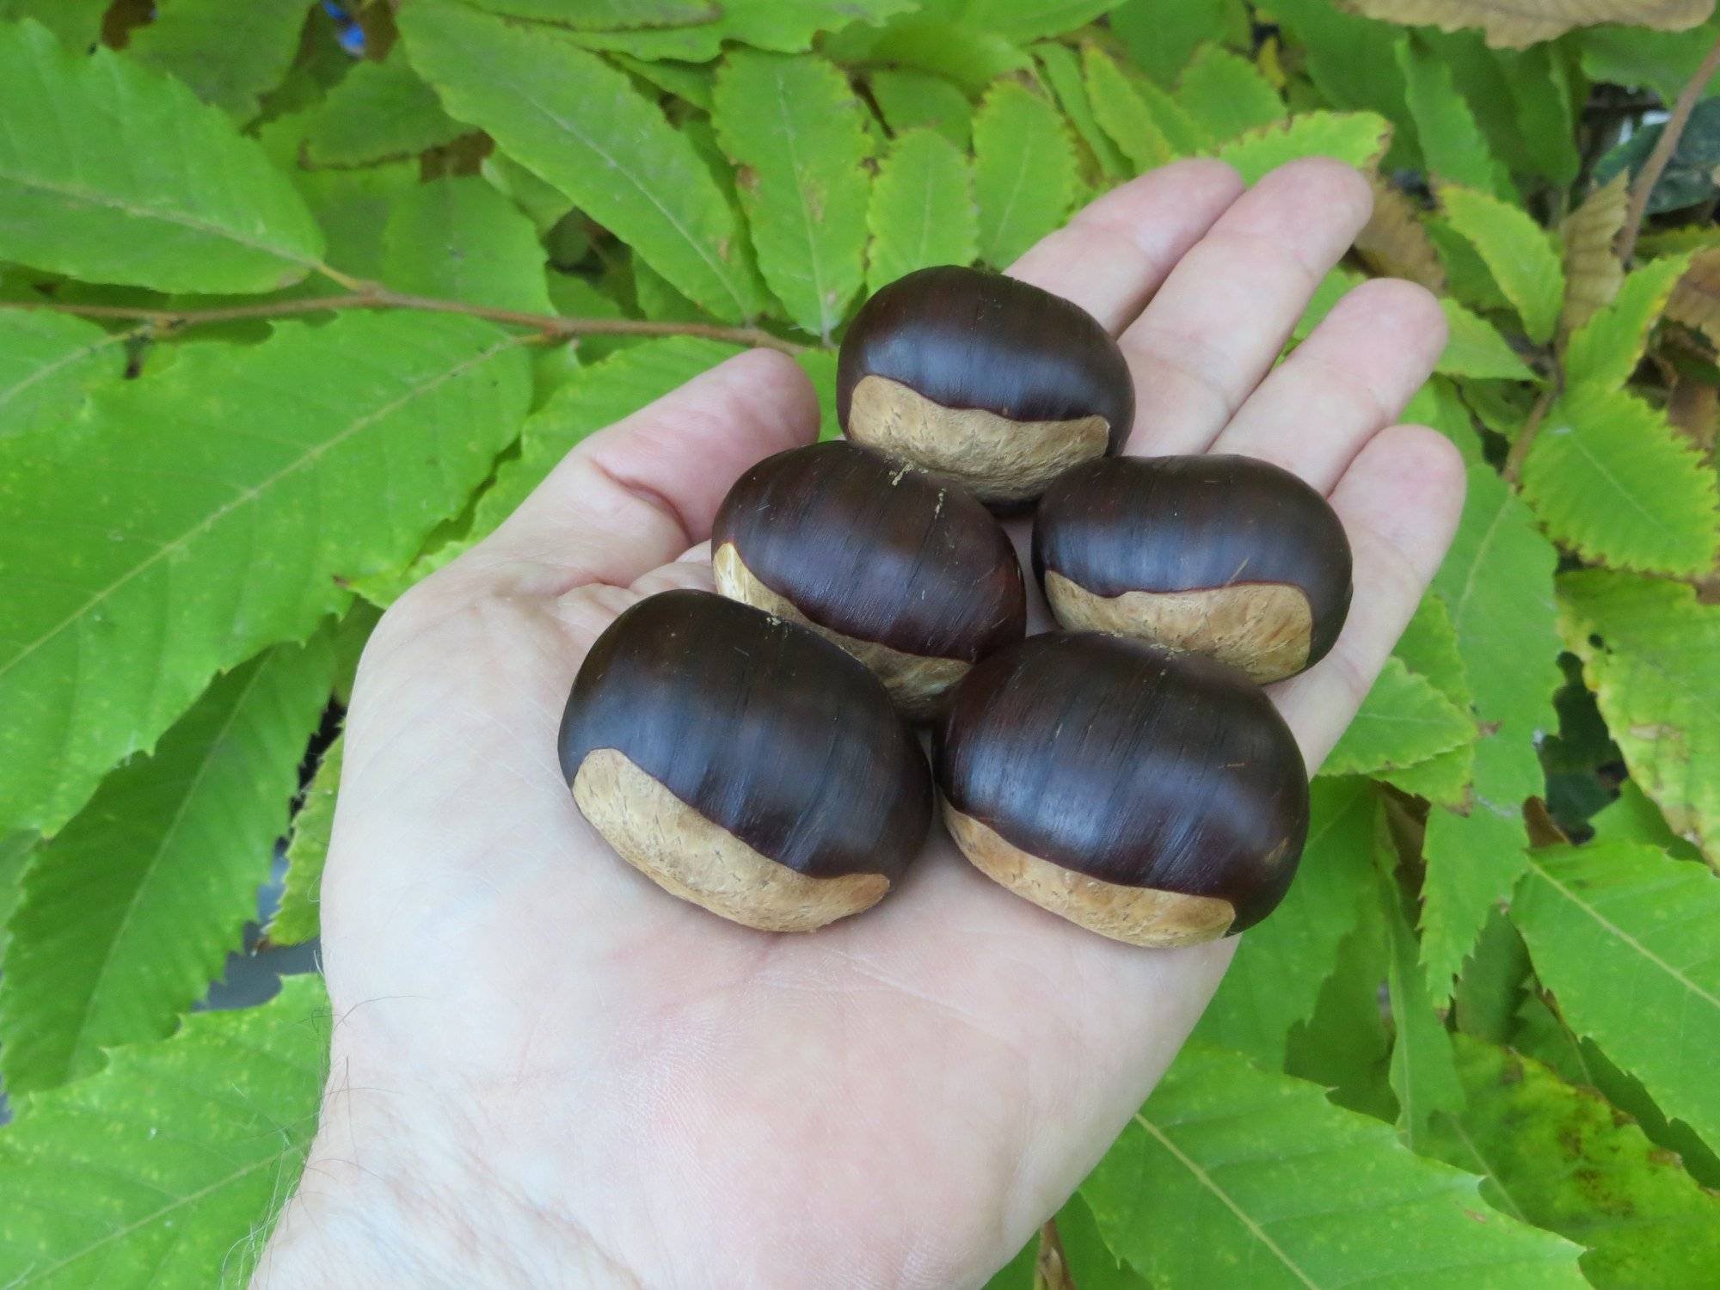
Nevada
A seedling growing in Nevada City, California

Slide 17
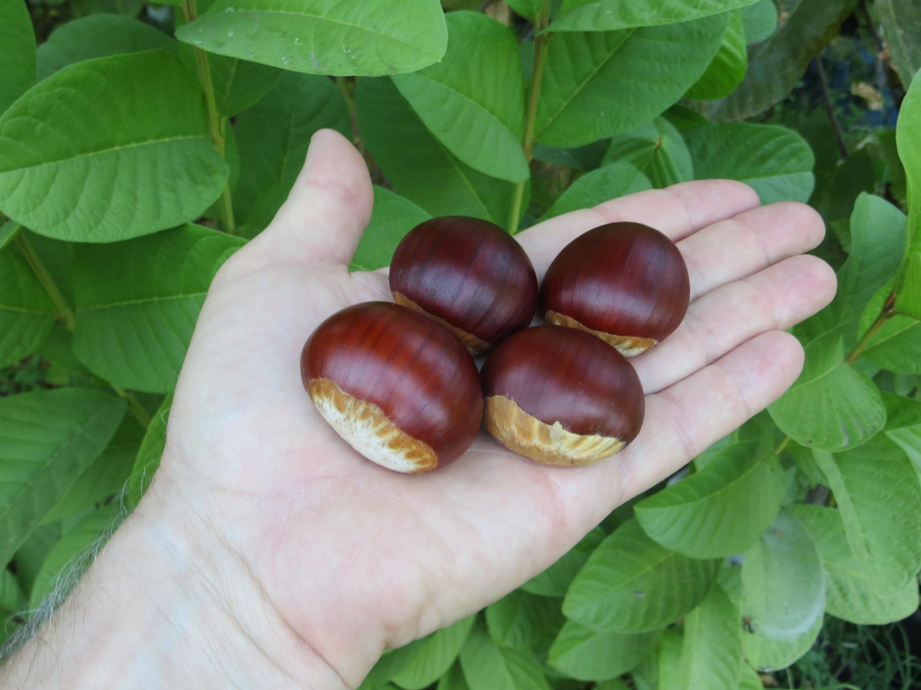
Okinakuri
Sativa/crenata hybrid from California

Slide 18
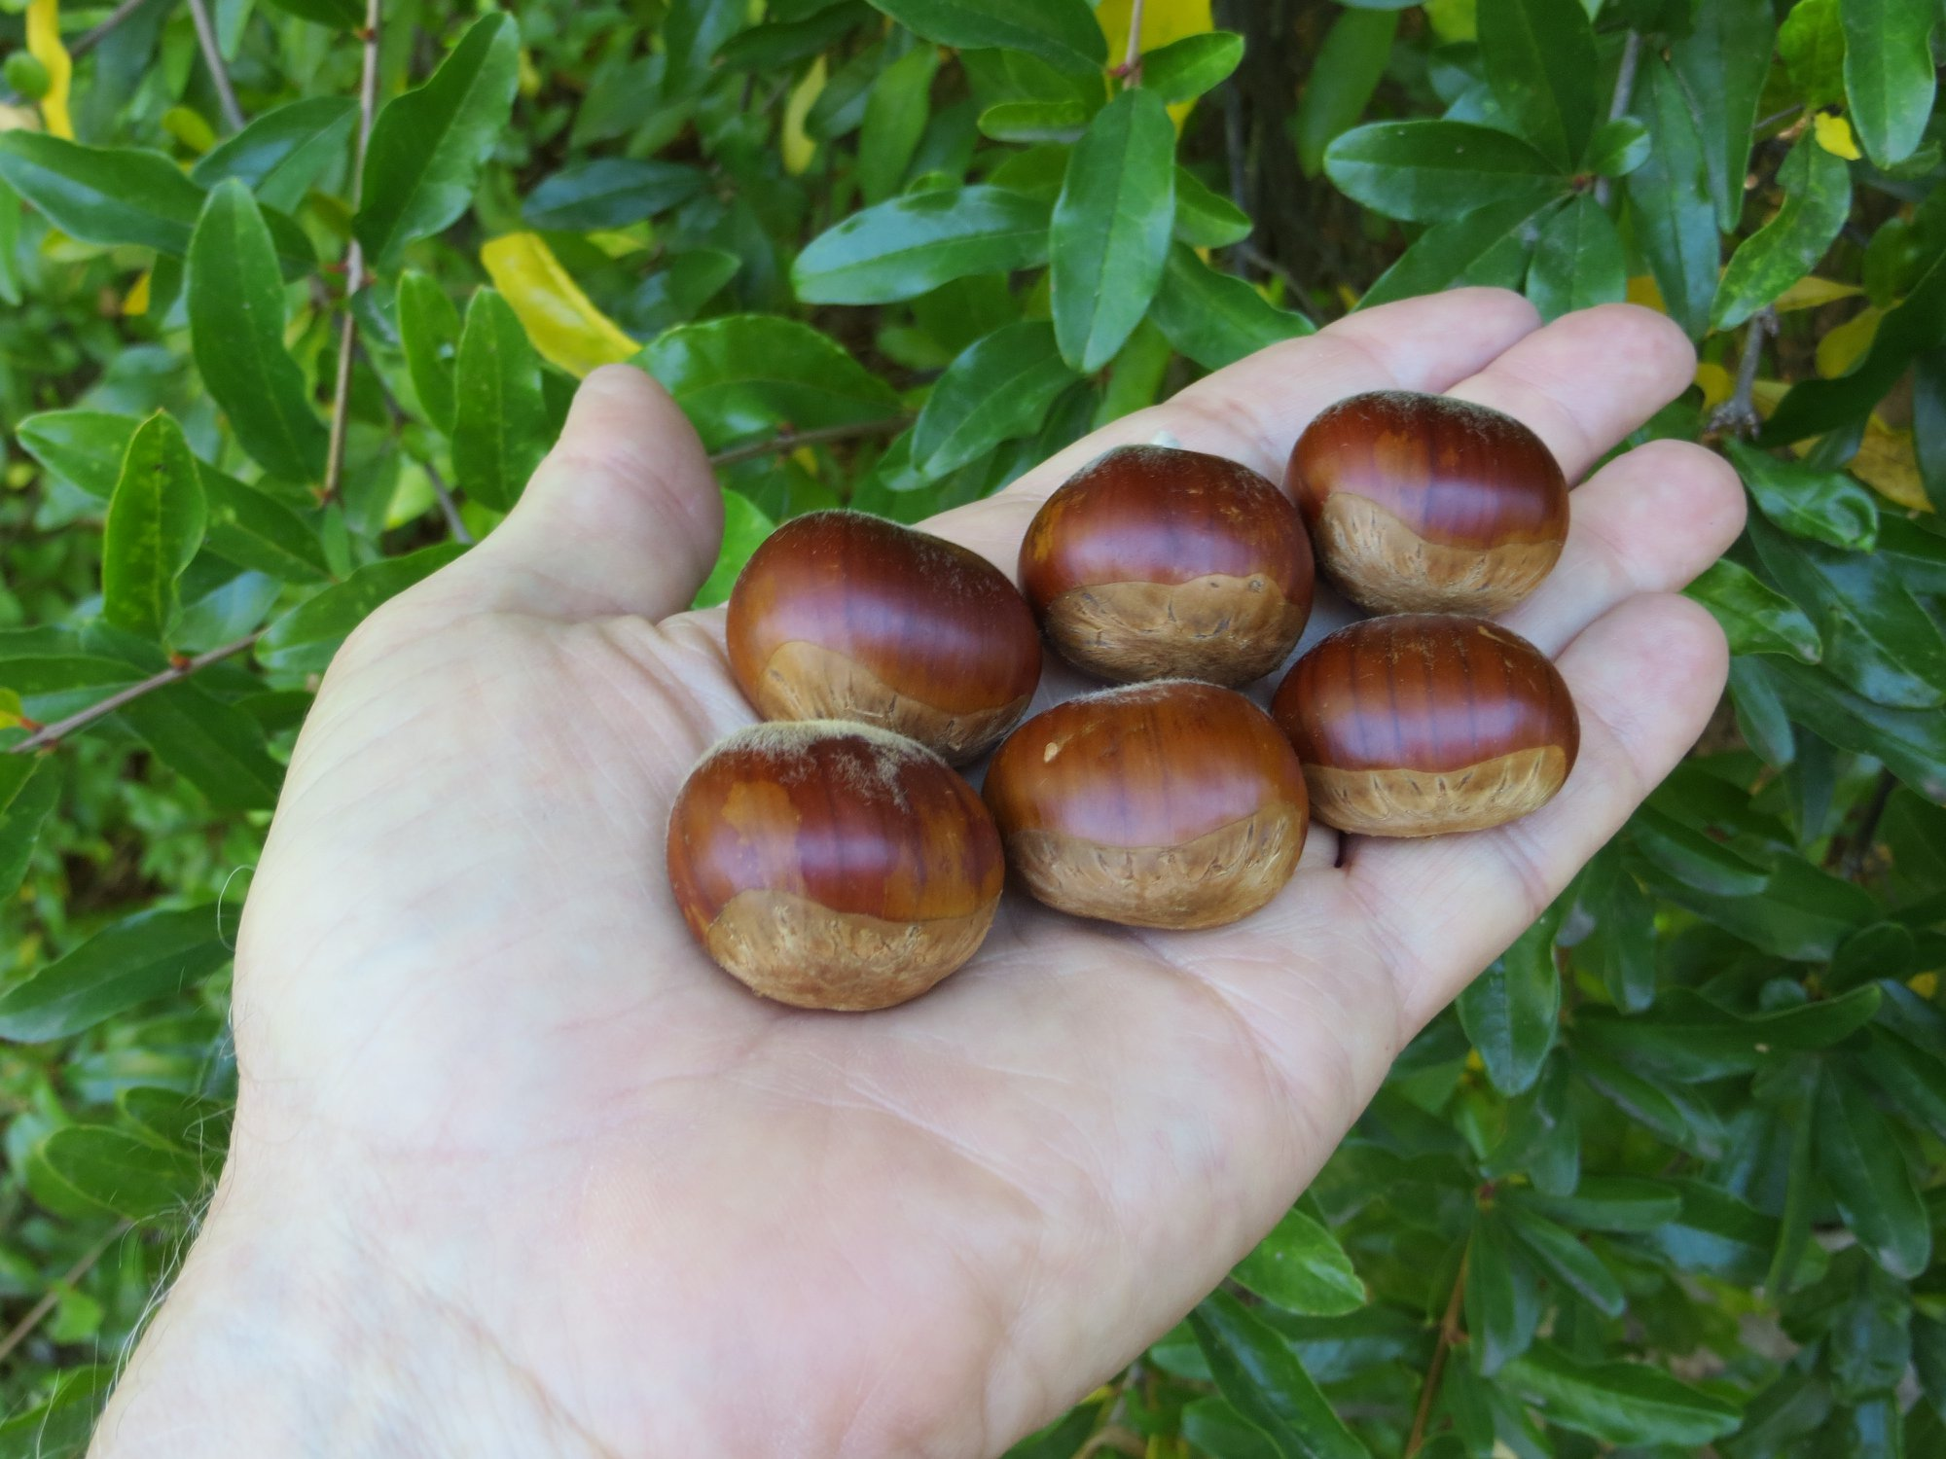
Paragon
Sativa/dentata hybrid

Slide 19
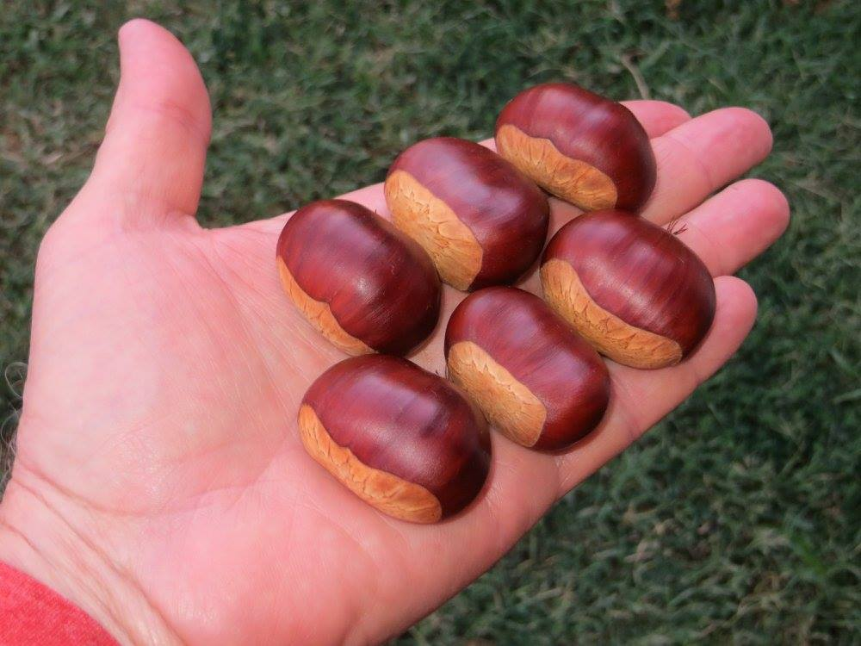
Regis Montis
Seedling grown out by Washington Chestnut Company

Slide 20
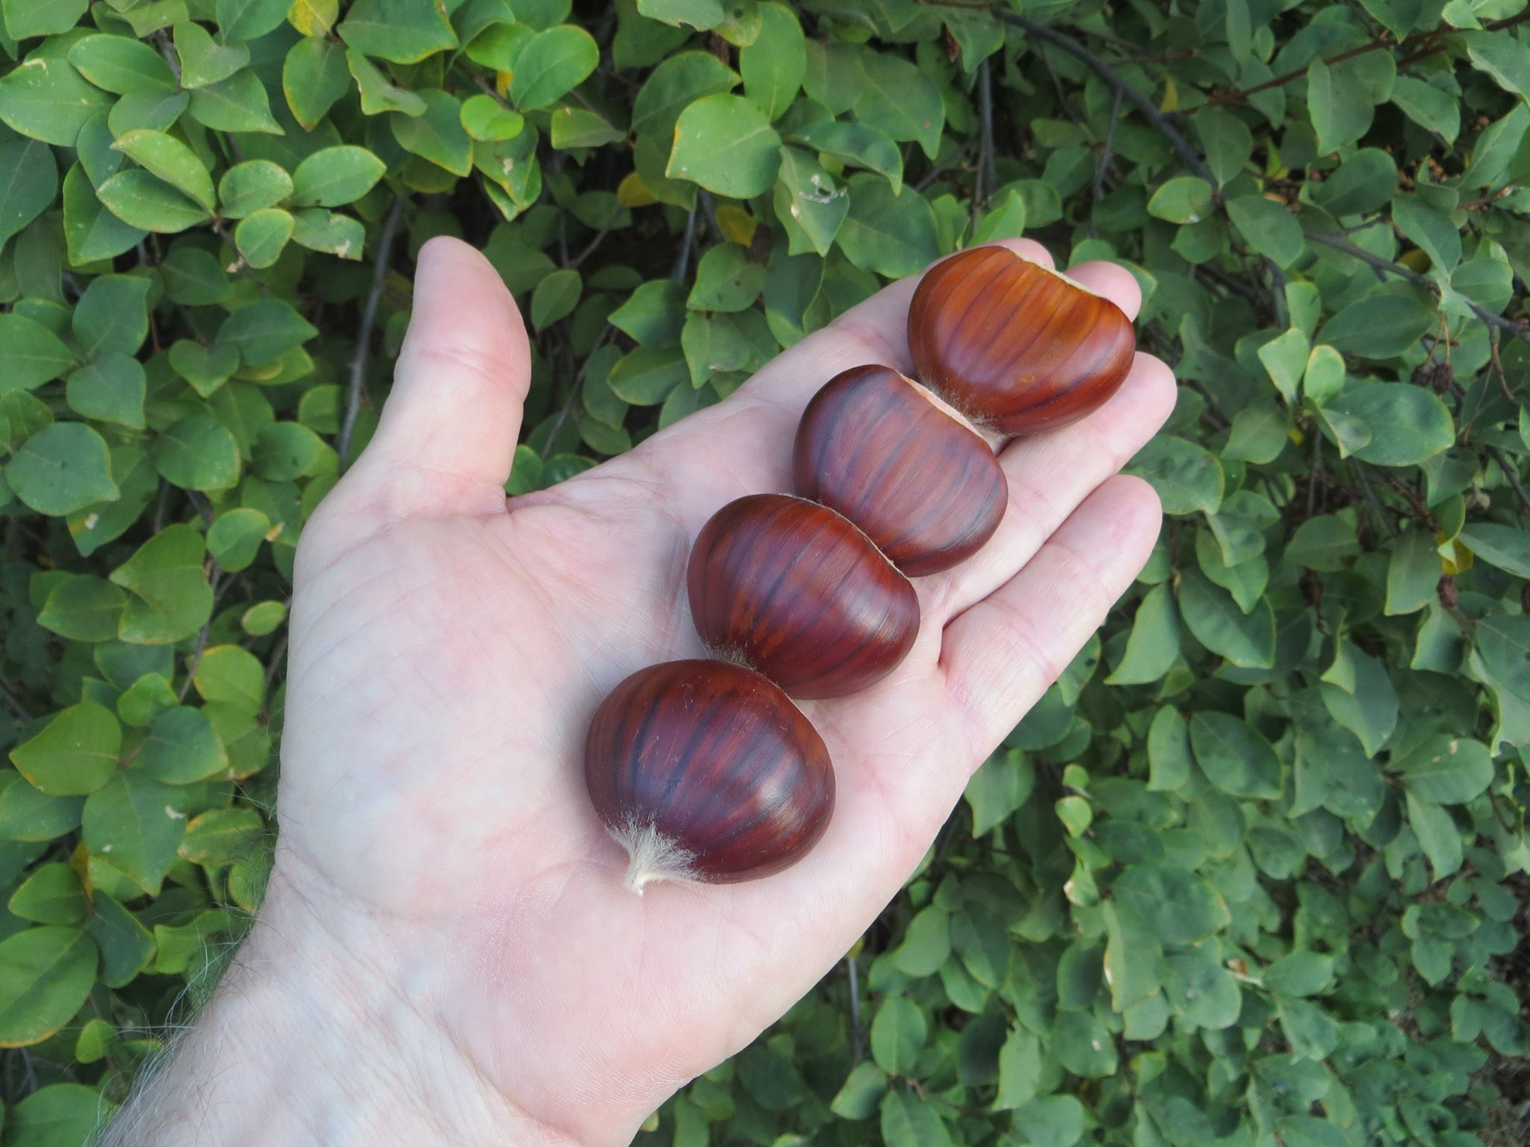
Serr, aka Yolo Grande
Serr is either pure Sativa, or a Sativa/mollissima hybrid

Slide 21
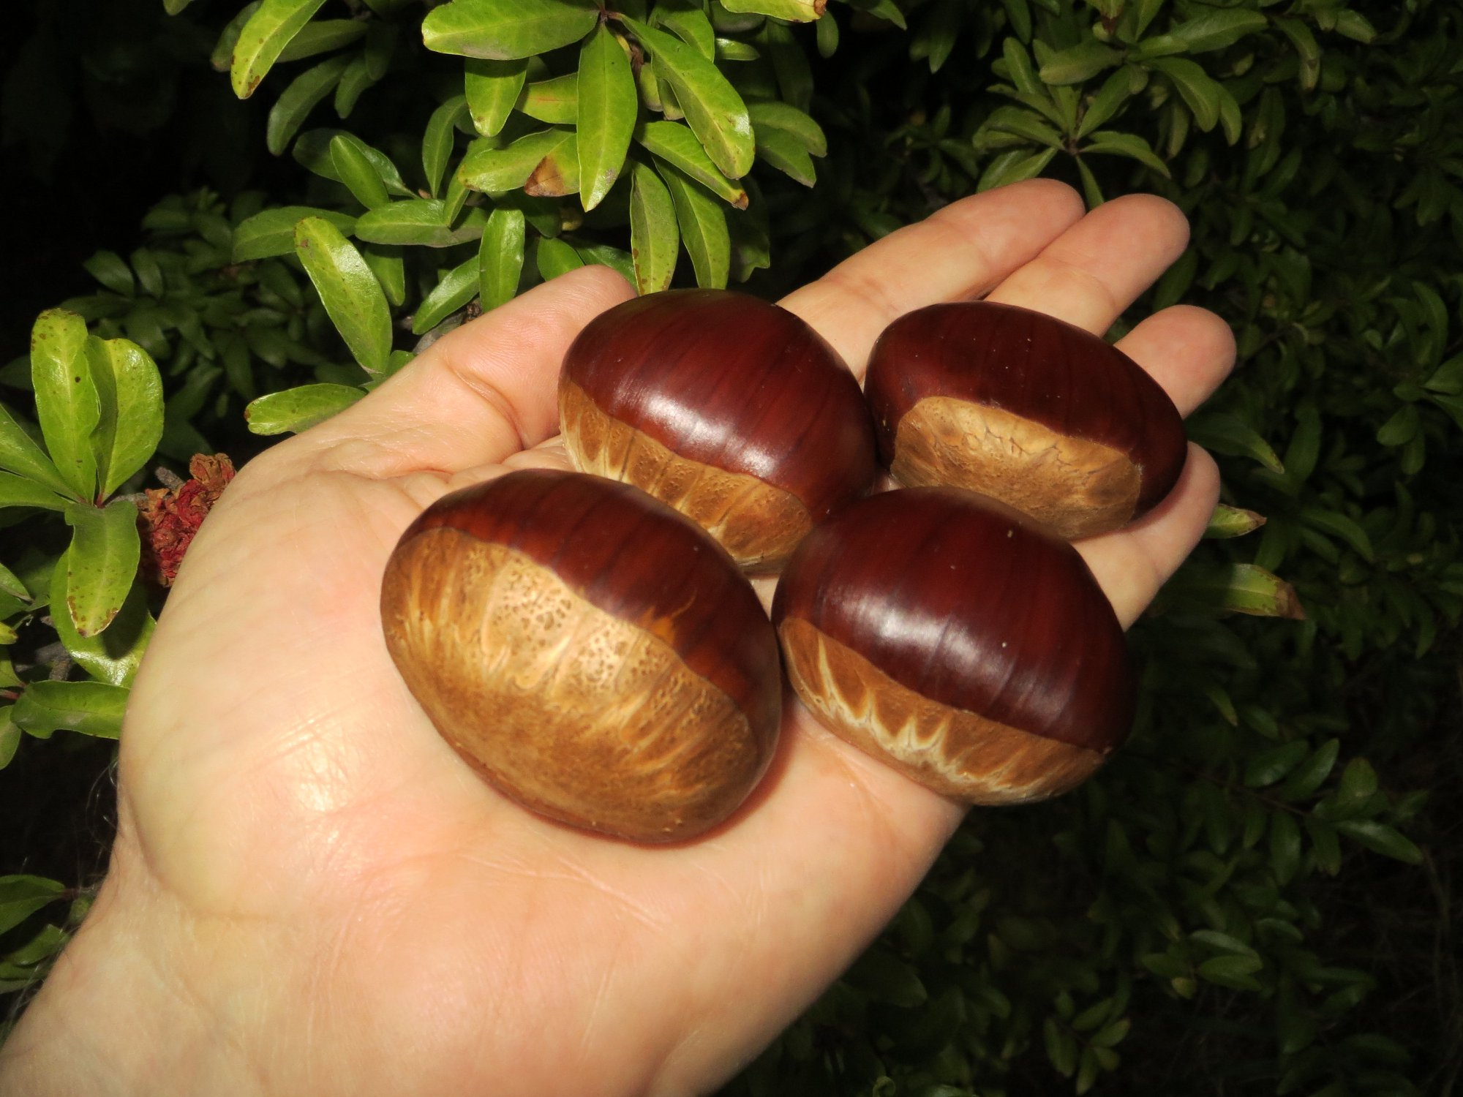
Sloane
Sativa/crenata seedling grown out by JMN

Slide 22
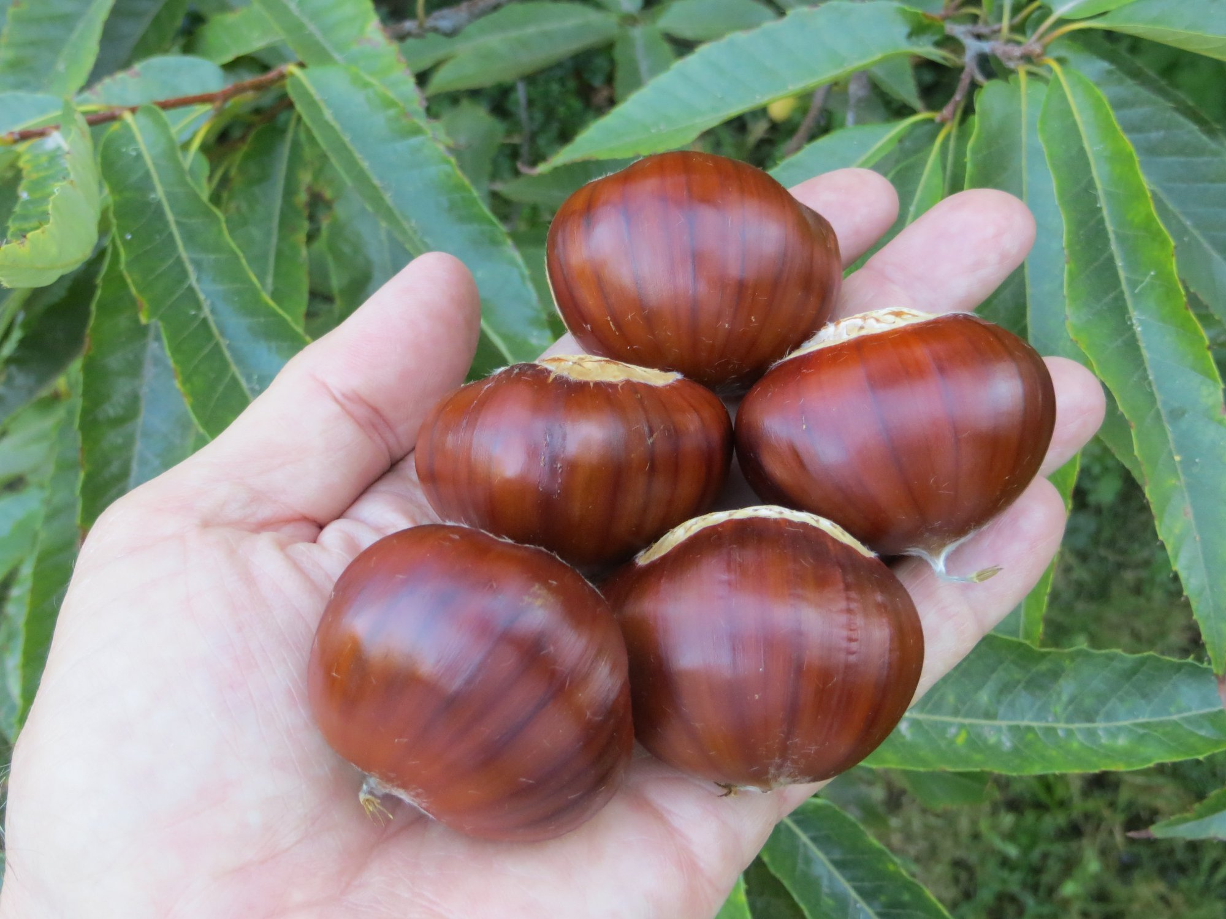
Torakuri
Sativa/crenata seedling from California

