Slide 1
Castanea Mollissima (and hybrids) cultivar nut photos
By J.M.Nave
February 2021

Slide 2
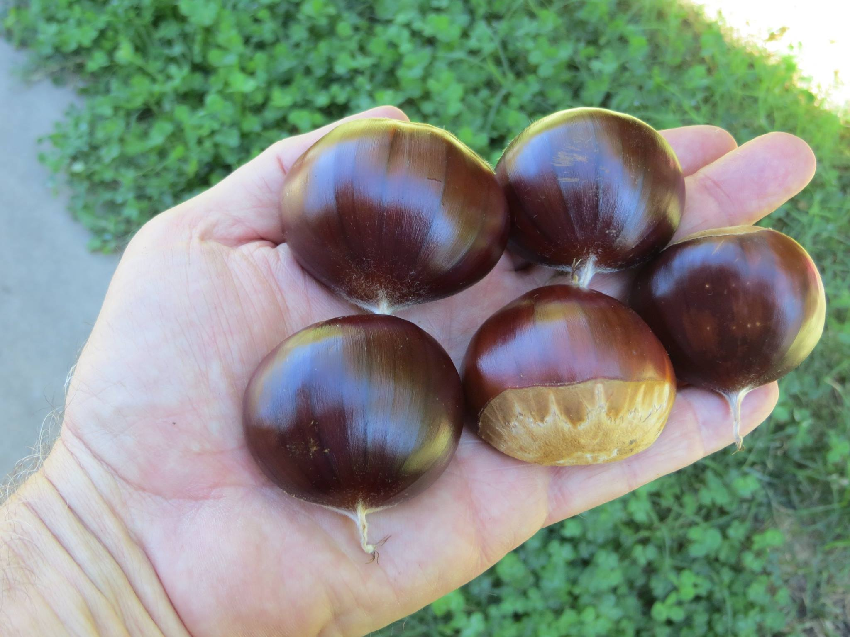
Big Euro
Mollissima/crenata/sativa/dentata hybrid grown out by JMN

Slide 3
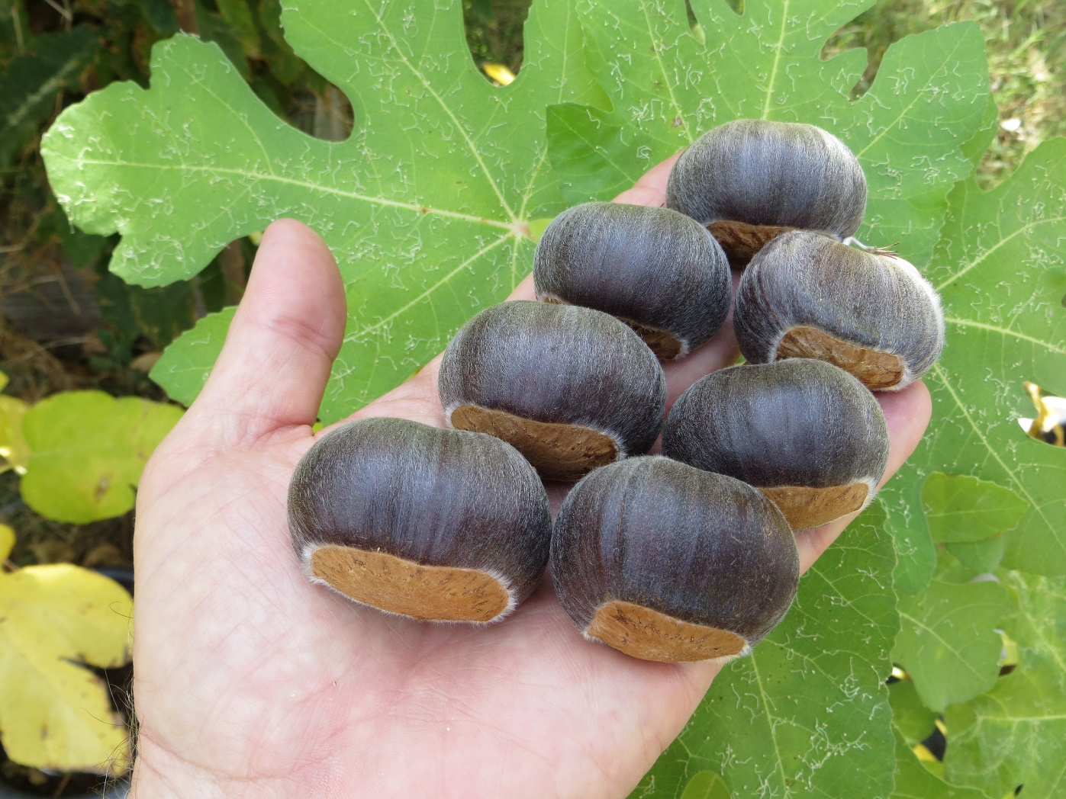
Black Satin
A seedling of Peach grown out by MP

Slide 4
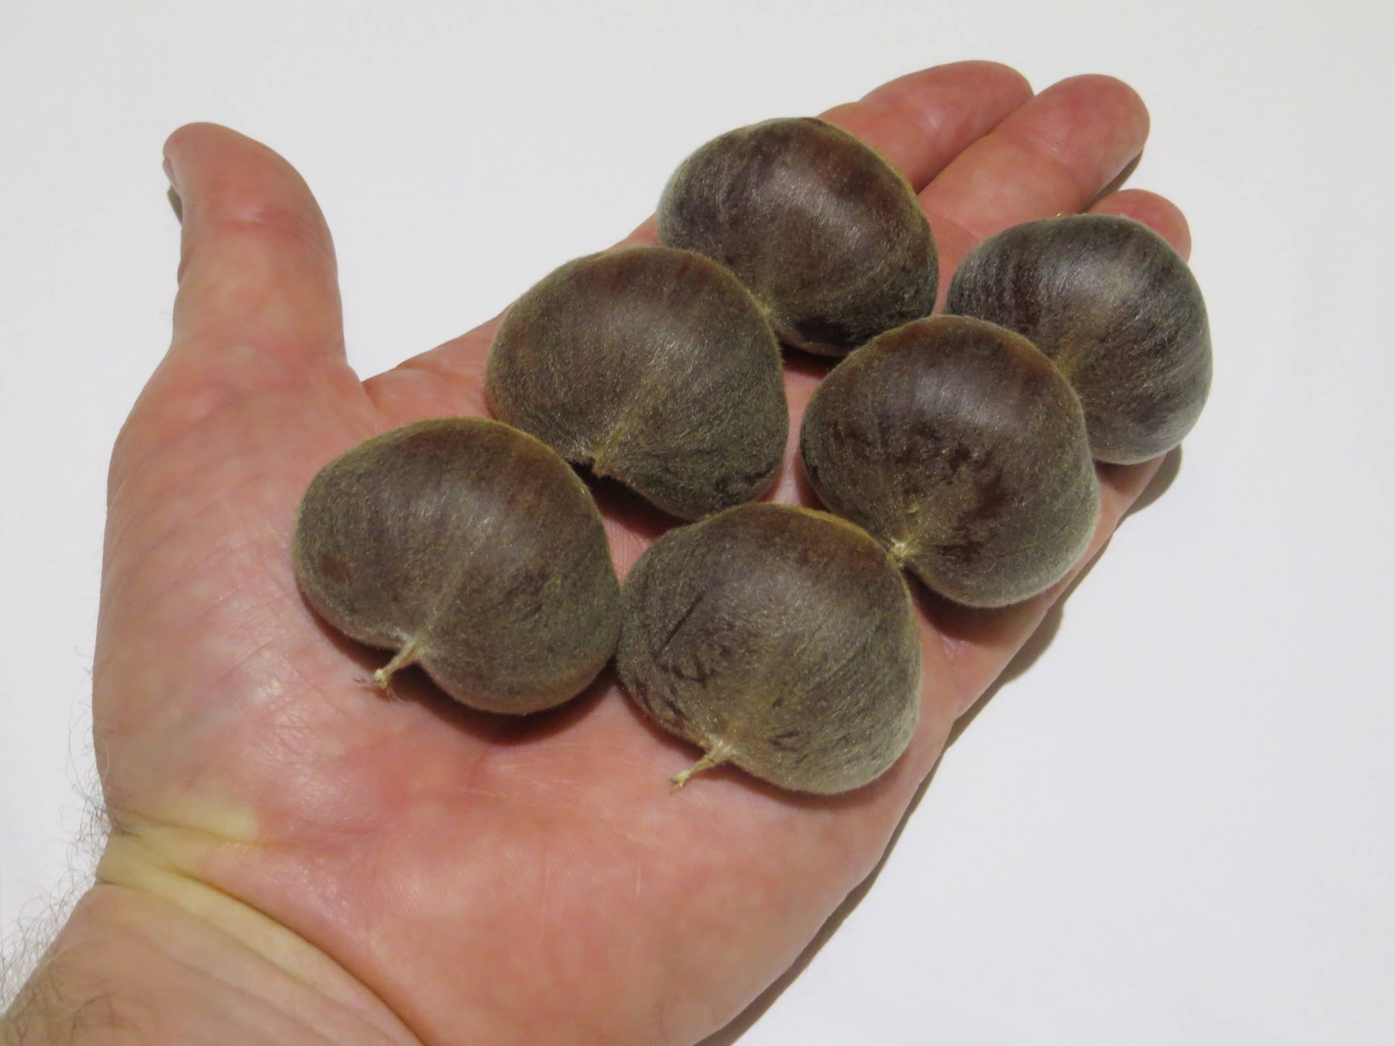
Chushuhong
A cultivar from China

Slide 5
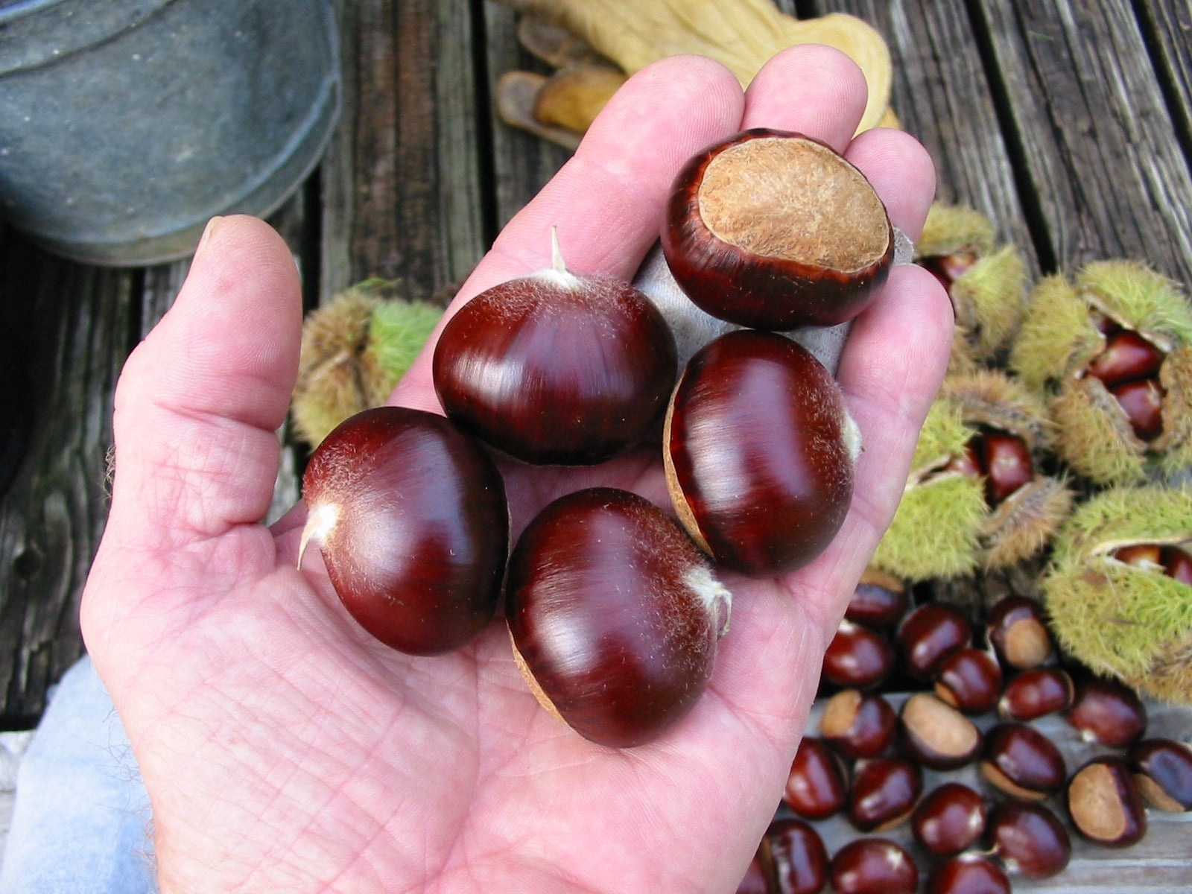
Eaton
Chinese hybrid from the CAES, photo by MP

Slide 6
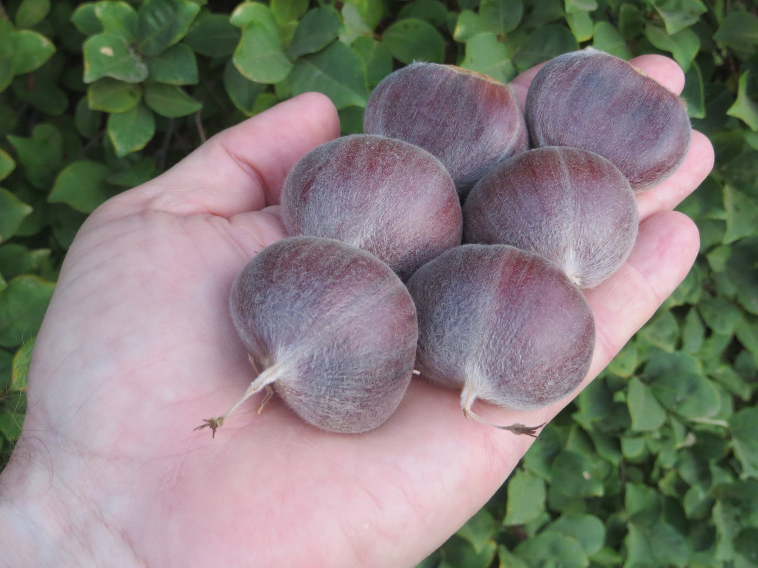
Emalyn’s Purple
Seedling grown out by JMN

Slide 7
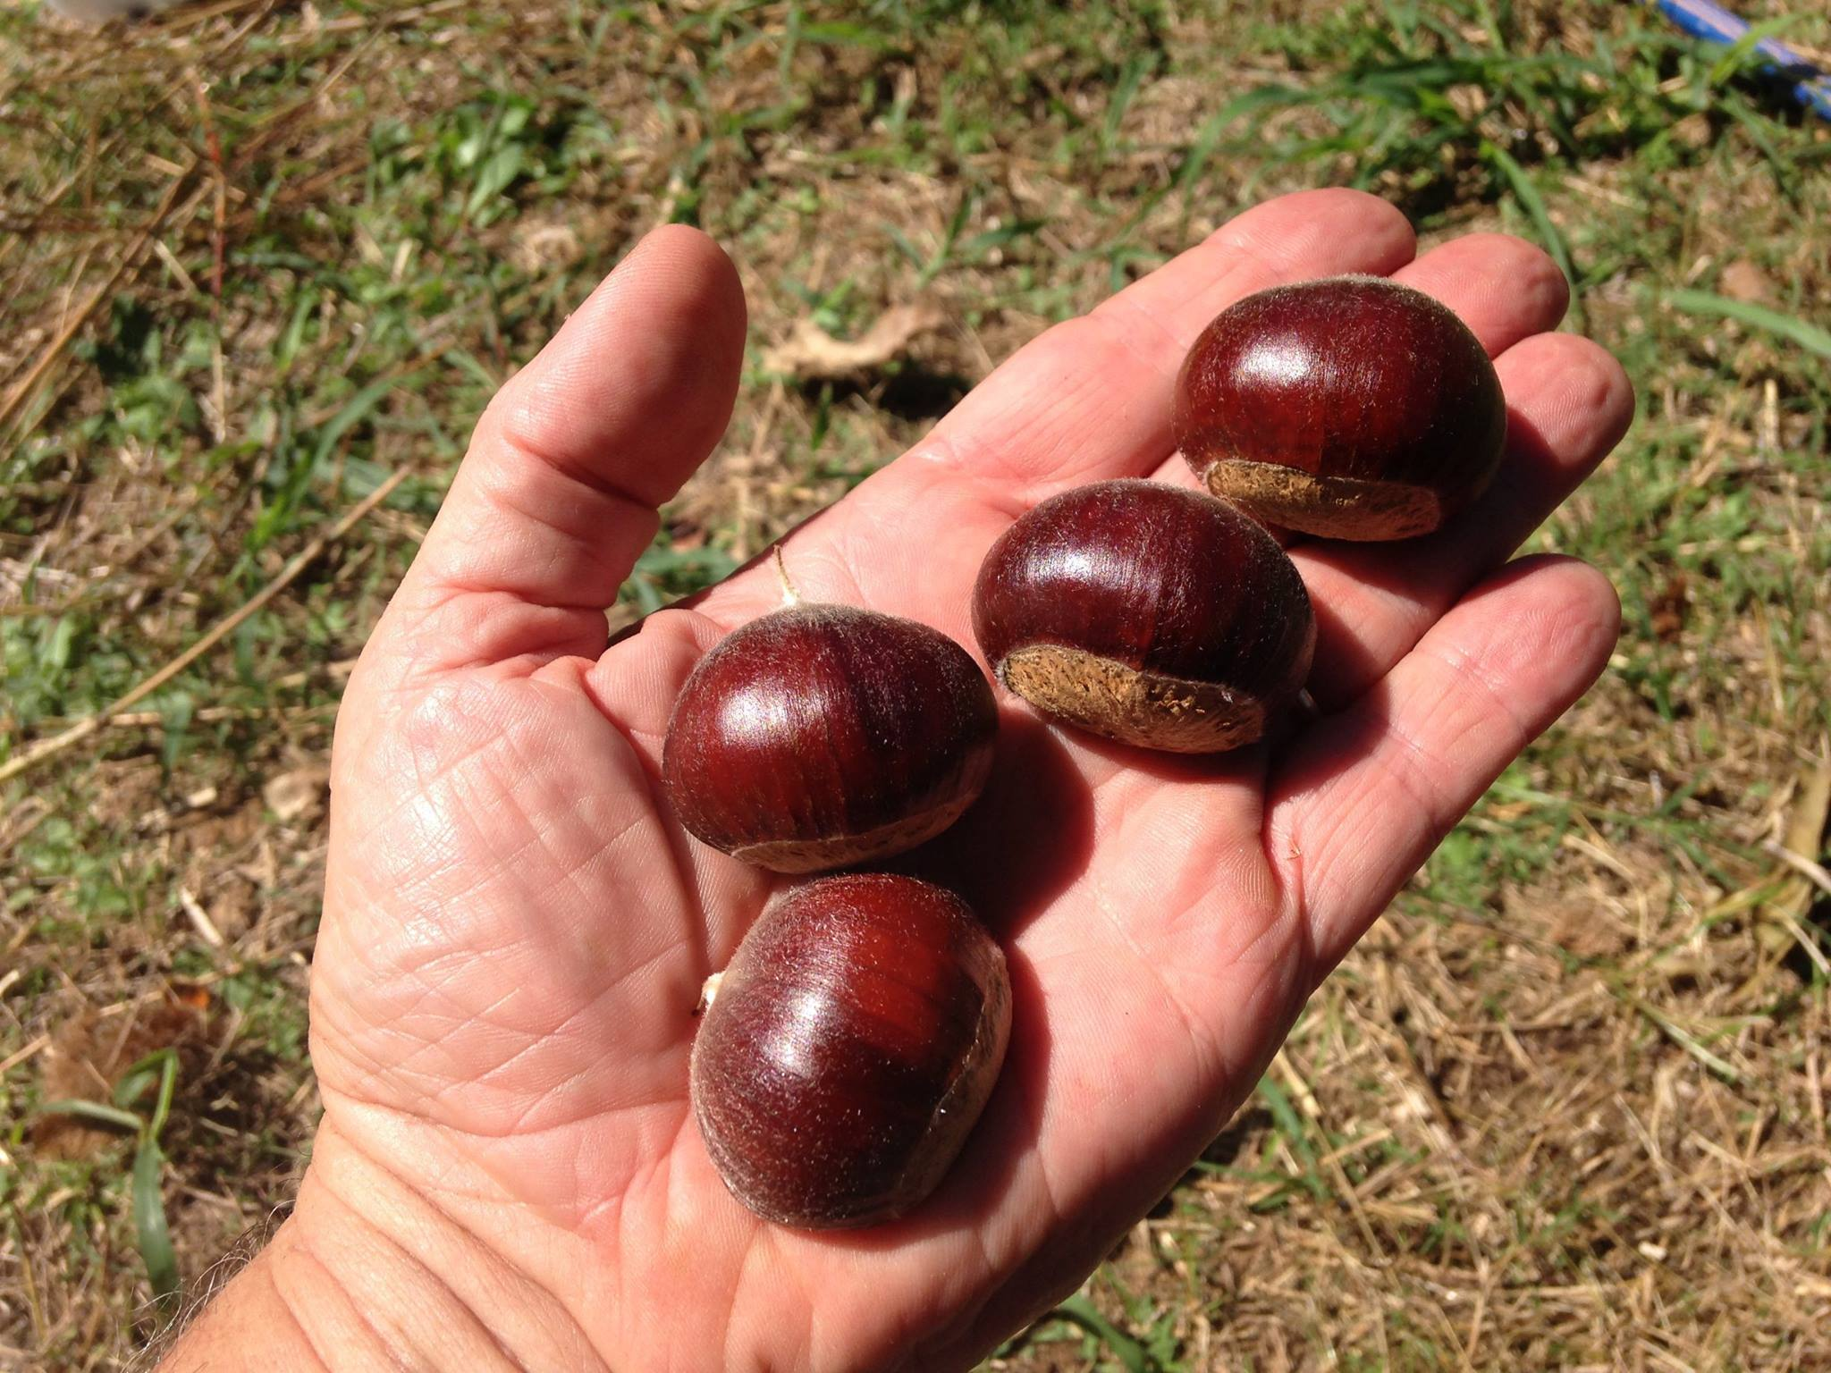
Gideon
A seedling grown out by Empire Chestnut Co., photo by HC

Slide 8
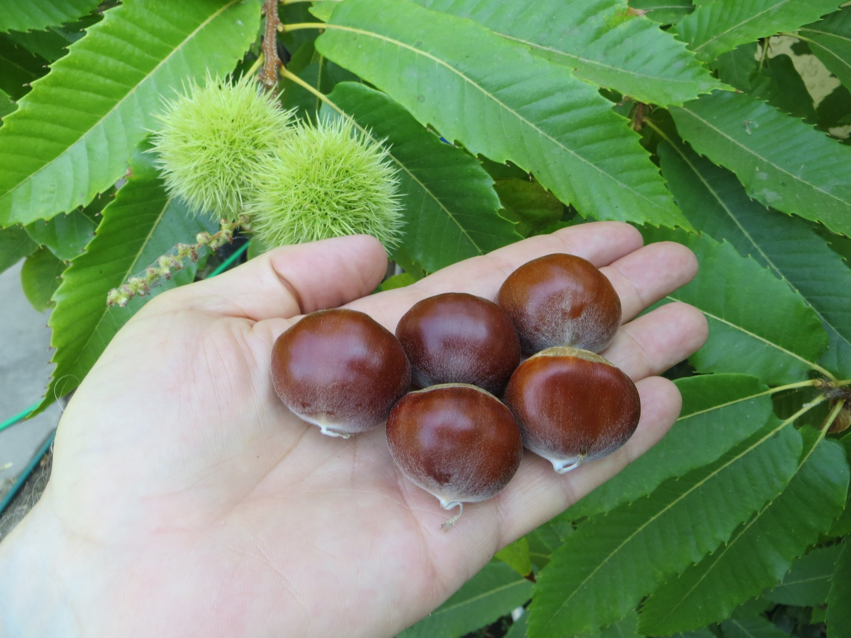
Hong Kong
Seedling grown out by JMN

Slide 9
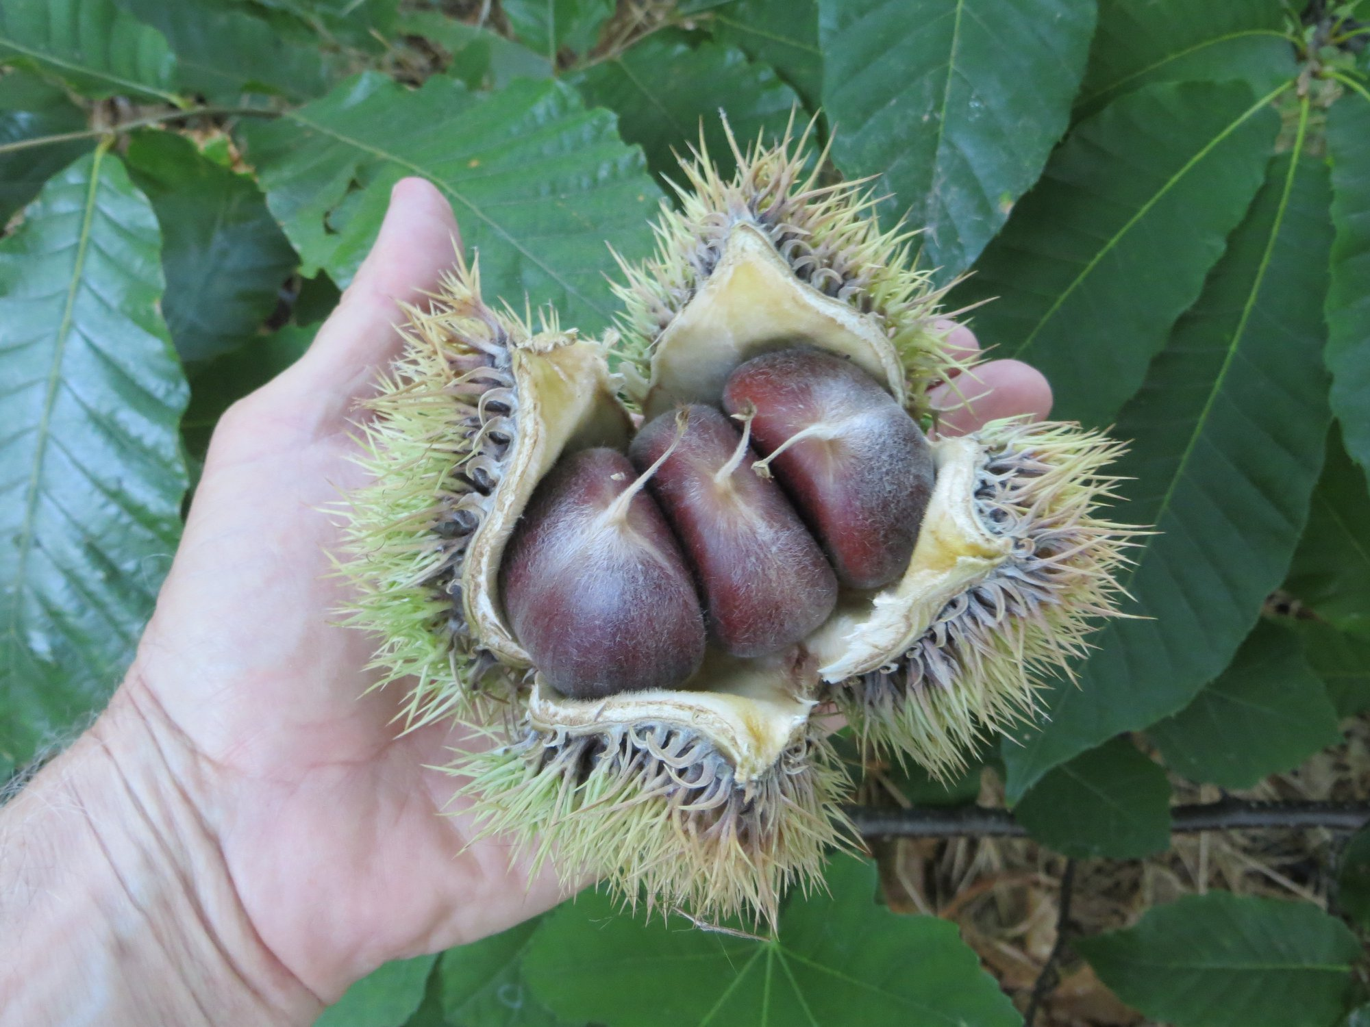
Jenny
Seedling grown out by JMN

Slide 10
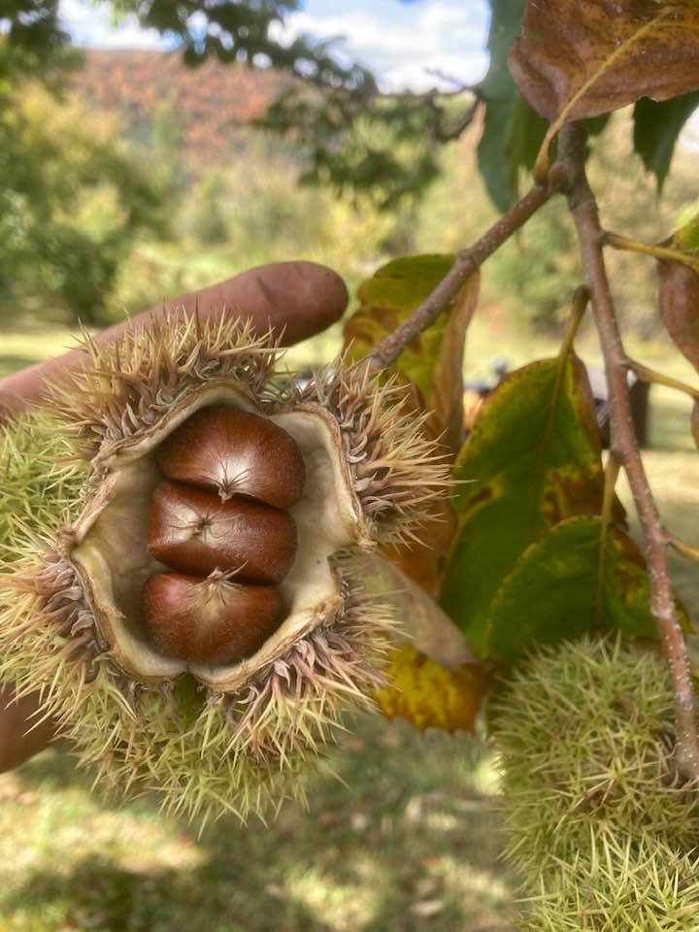
Jersey Gem
Seedling of Orrin grown out by HH. Photo by BF.

Slide 11
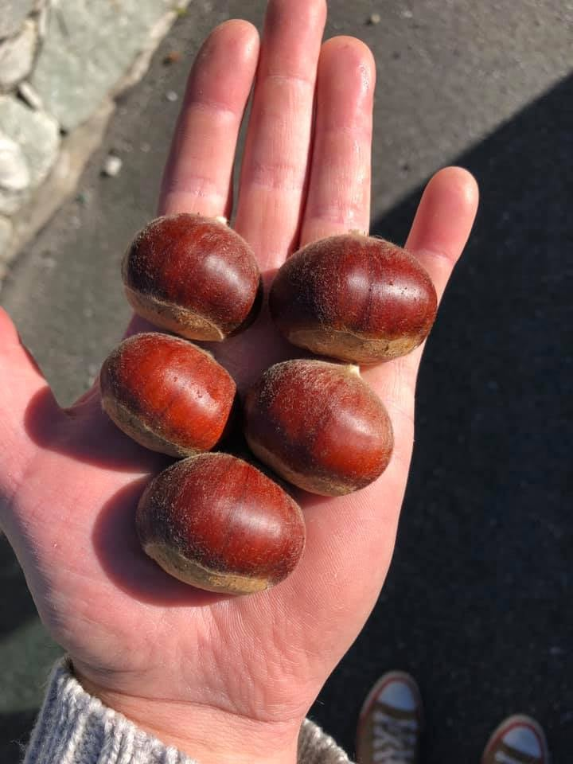
Jiaoza
Cultivar from China. Photo by MI.

Slide 12
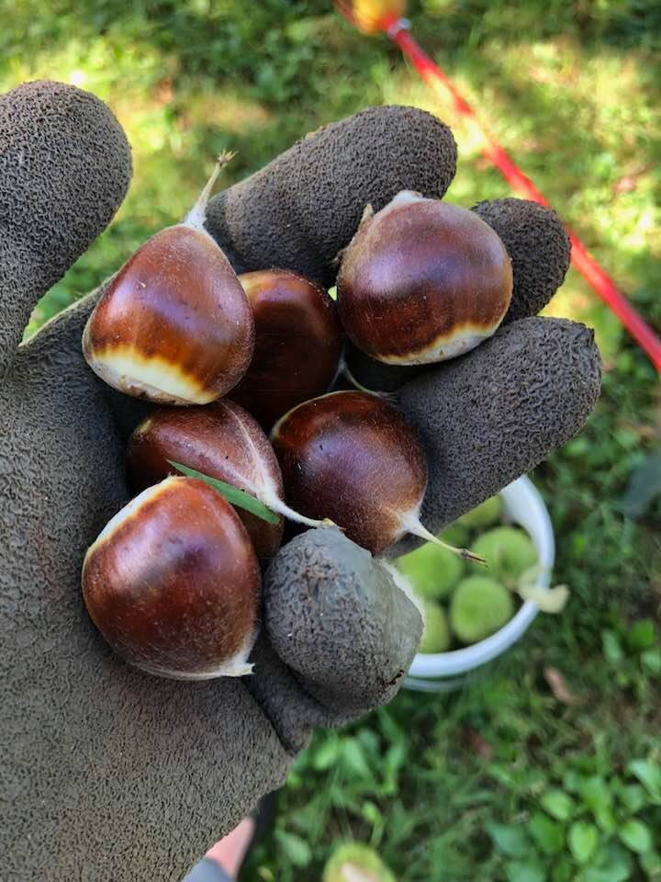
King Arthur
A seedling grown out by the CAES. Photo by BF.

Slide 13
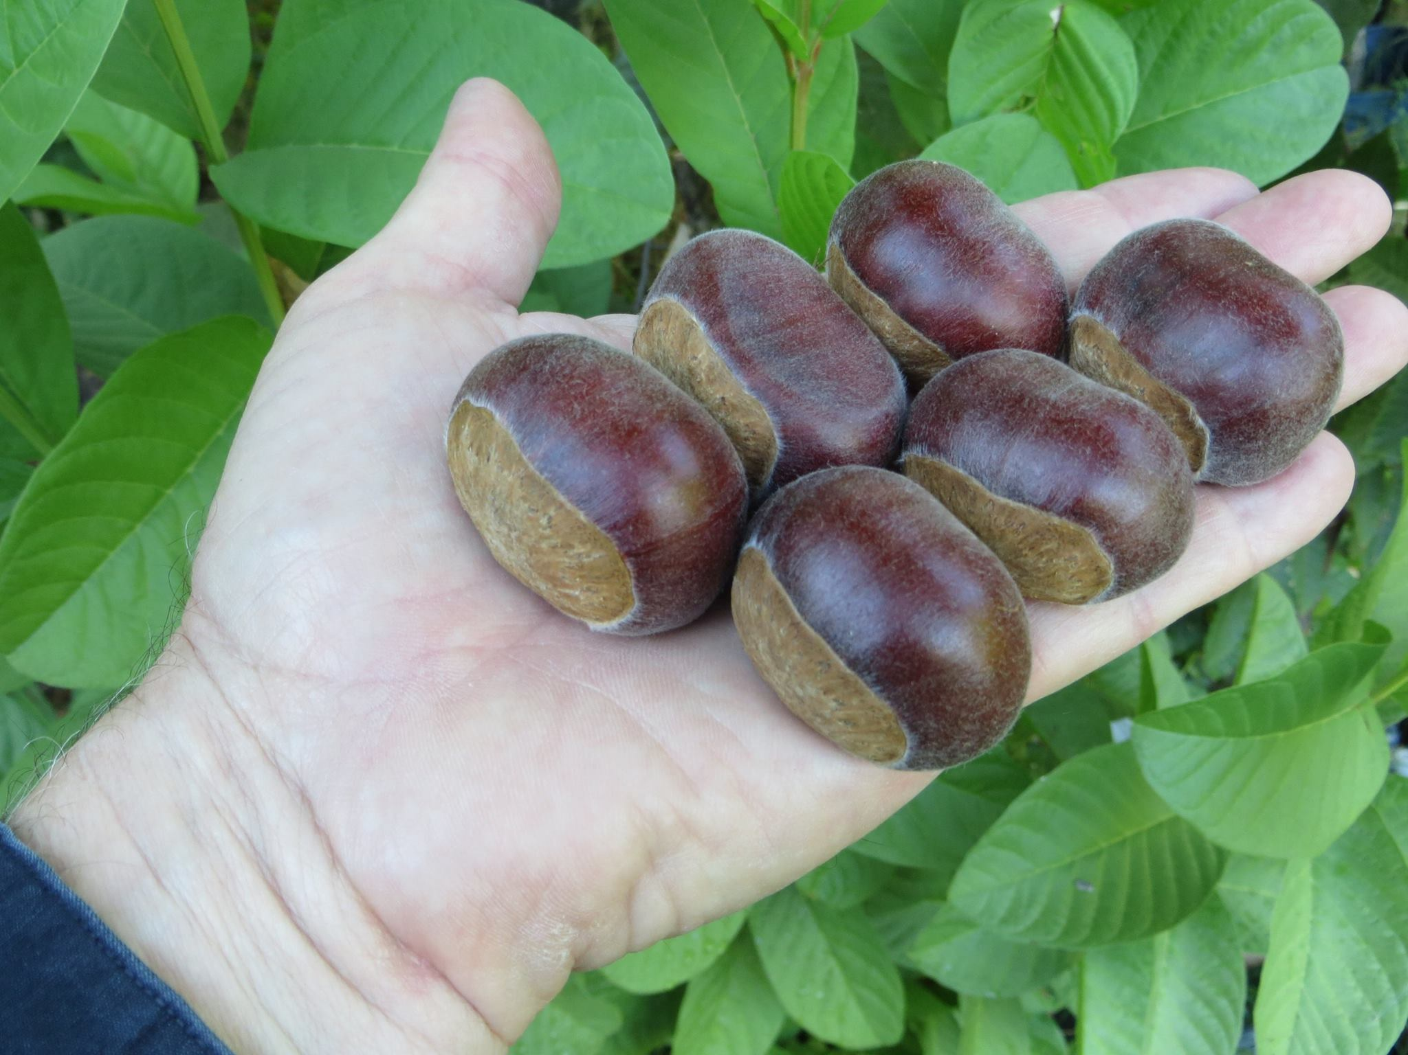
Kyoung
Bud sport on a seedling of Beth grown out by JMN

Slide 14
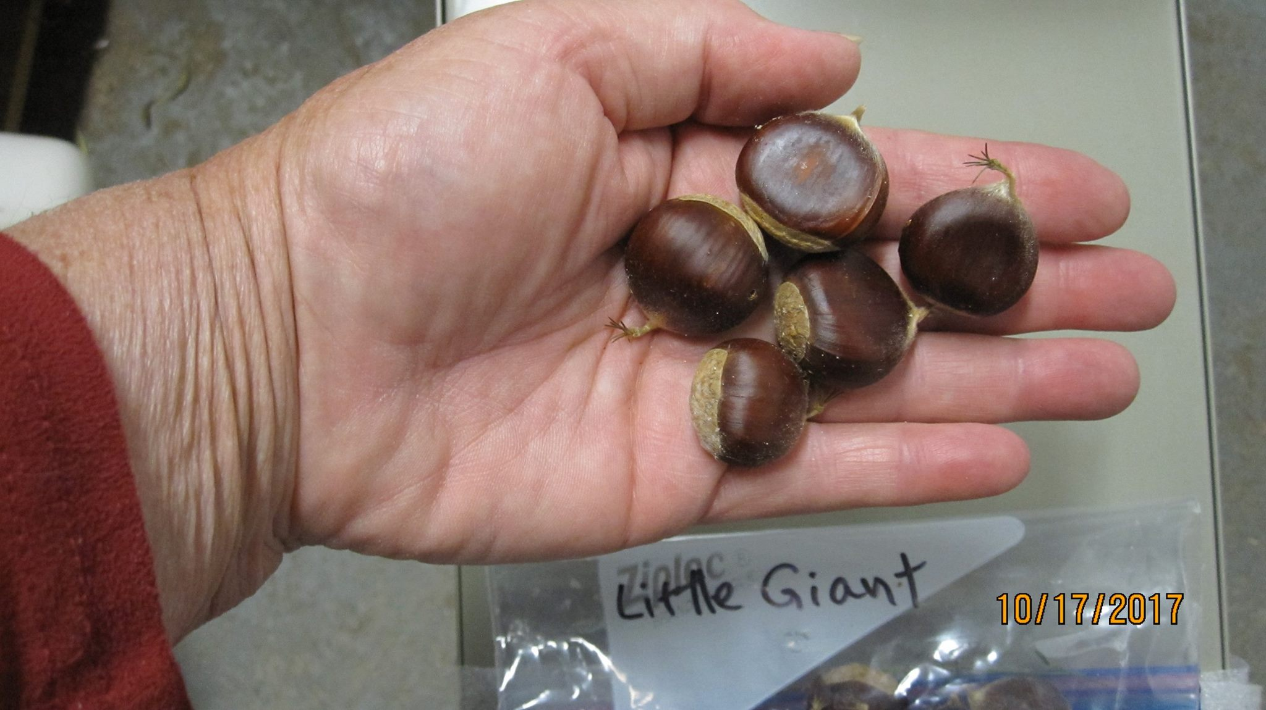
Little Giant
Seedling grown out at the CAES. Photo by SA

Slide 15
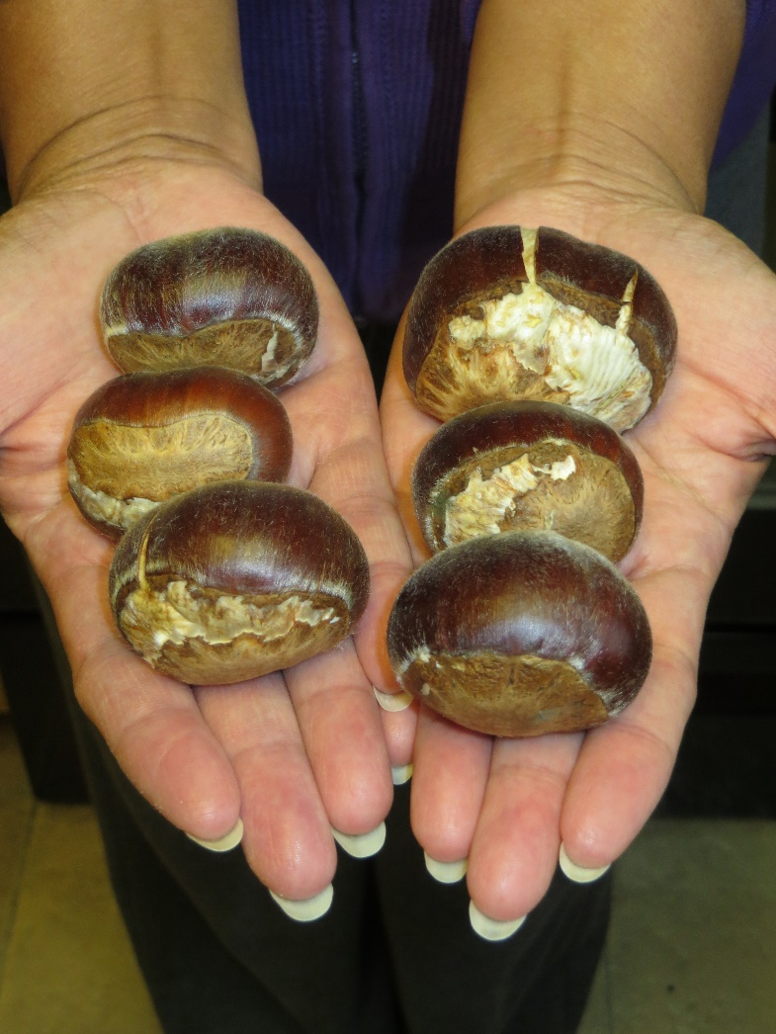
Luvall’s Monster
Seedling grown out by VL

Slide 16
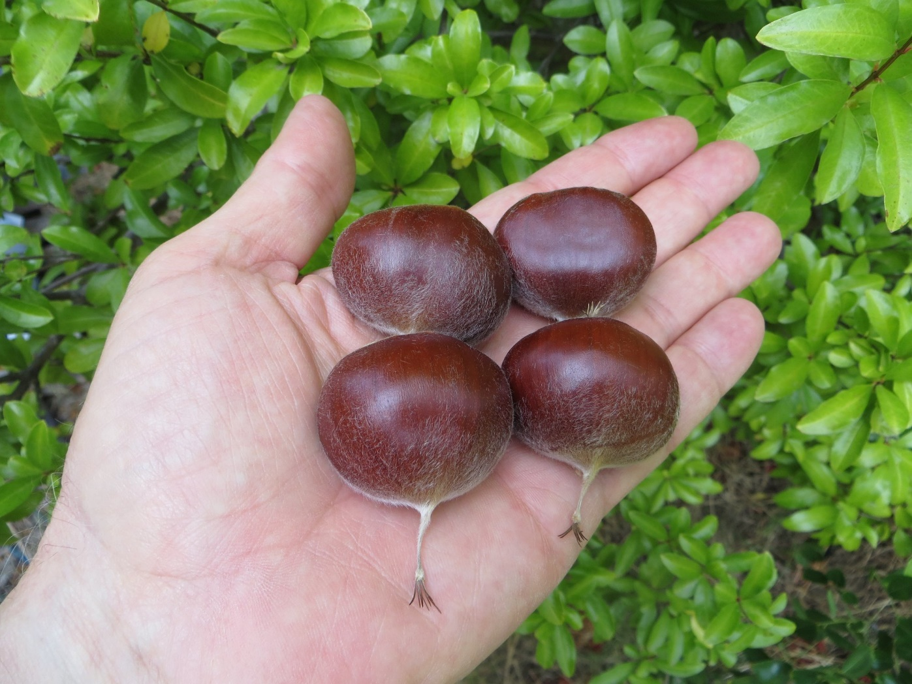
Miller’s Hope
Seedling grown out by JMN

Slide 17
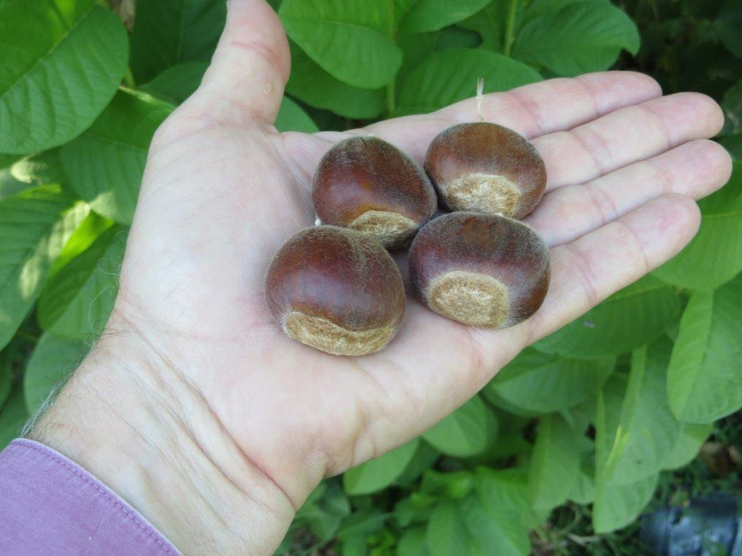
Nanjing Special #1
Seedling grown out by JMN

Slide 18
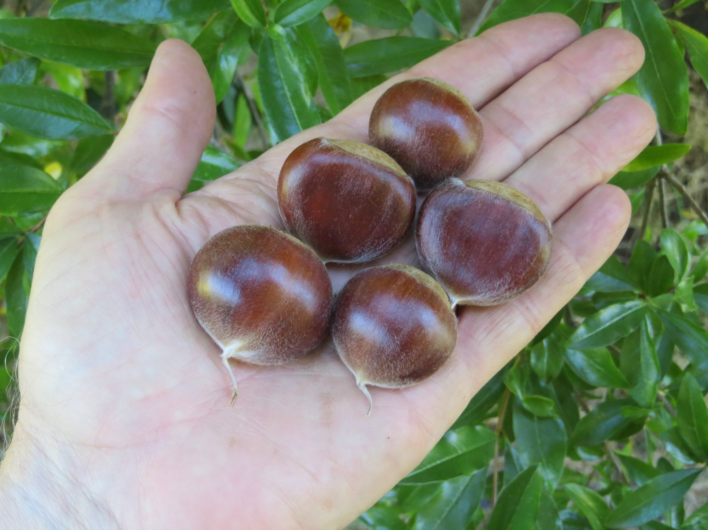
Nanjing Special #2
Seedling grown out by JMN

Slide 19
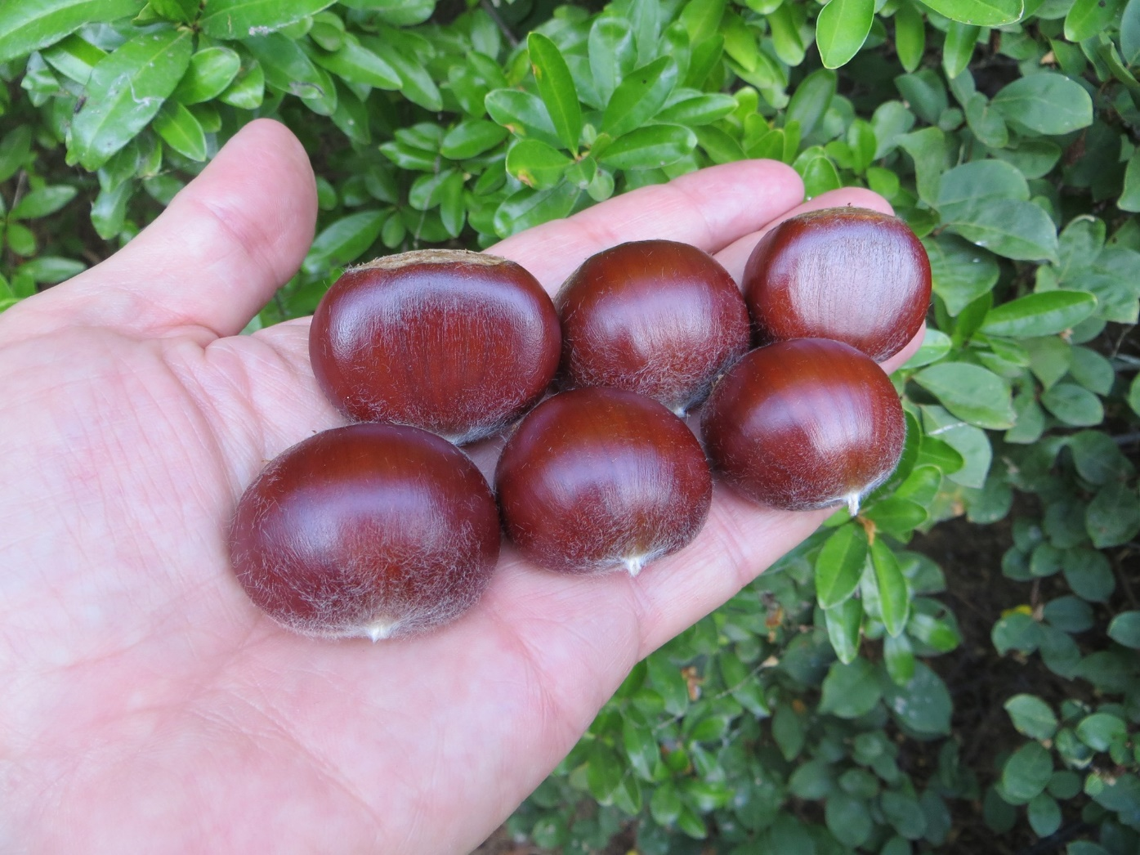
Nanjing Special #3
Seedling grown out by JMN

Slide 20
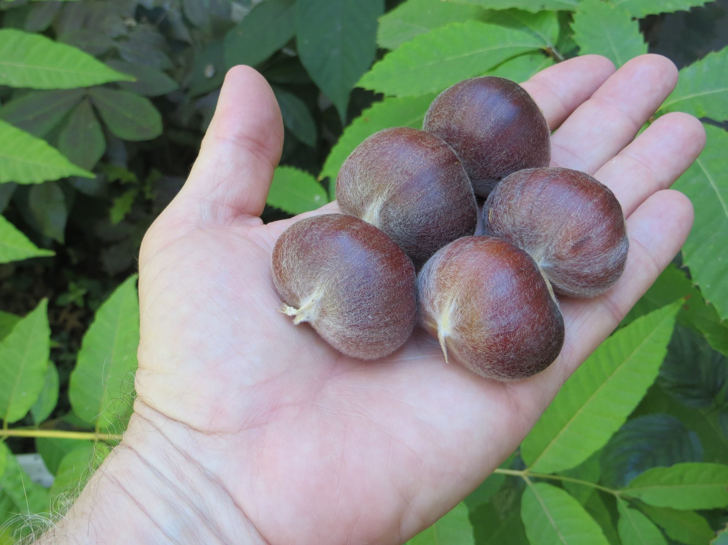
Ness
Seedling grown out by JMN

Slide 21
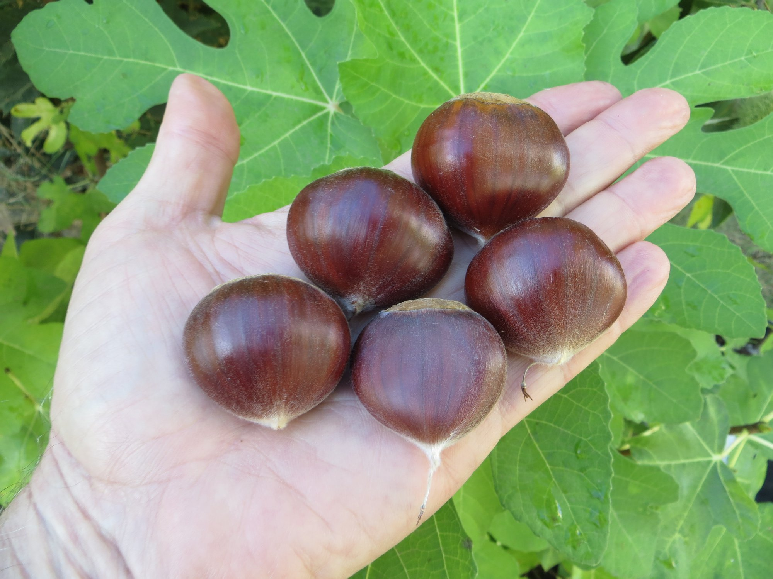
Pandora
Mollissima/Seguin x Burbank Stump Sprout, grown out by JMN

Slide 22
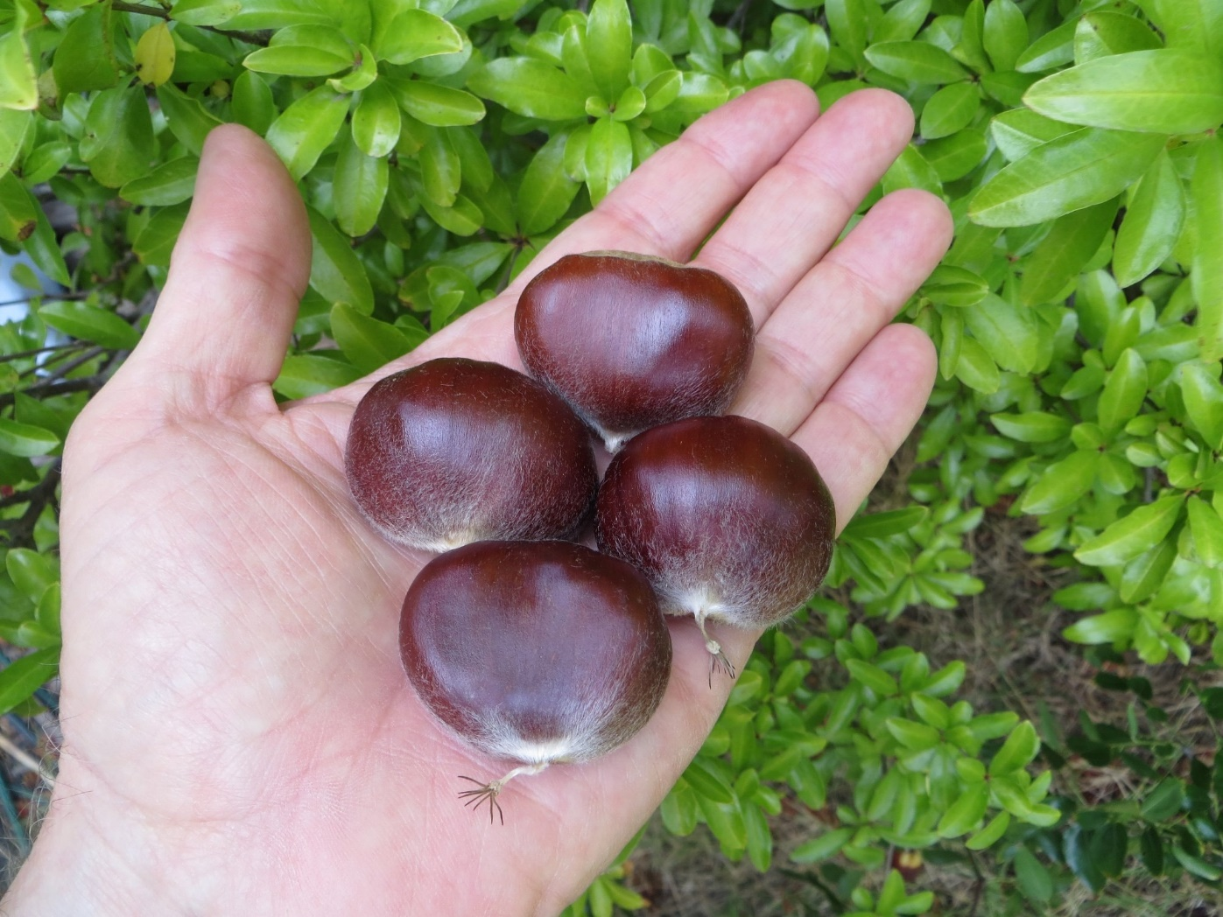
Patterson
Seedling grown out by JMN

Slide 23
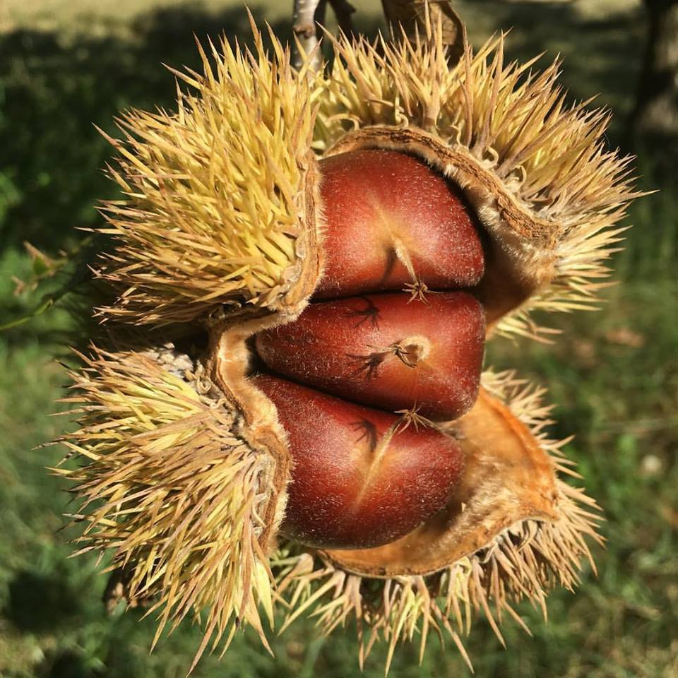
Payne
Seedling grown out at the USDA in Byron, GA. Photo by HC.

Slide 24
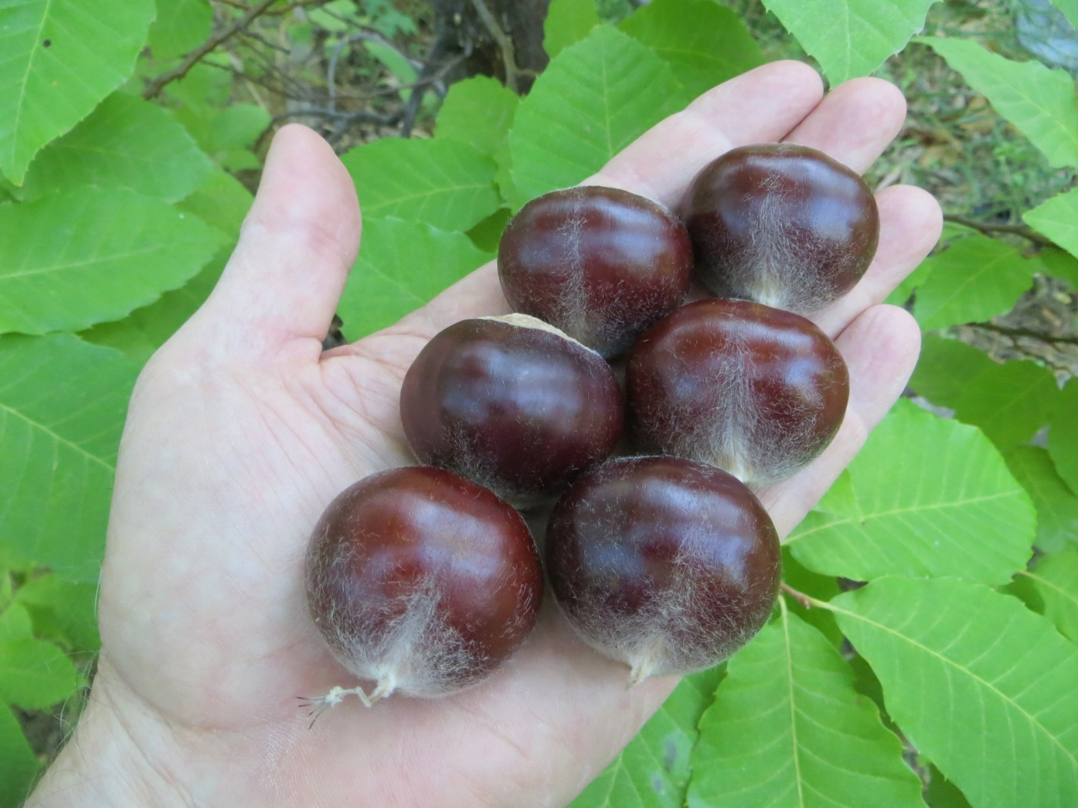
Qing
Probable Mollissima/pumila seedling, grown out in western KY. Possibly from the TVA.

Slide 25
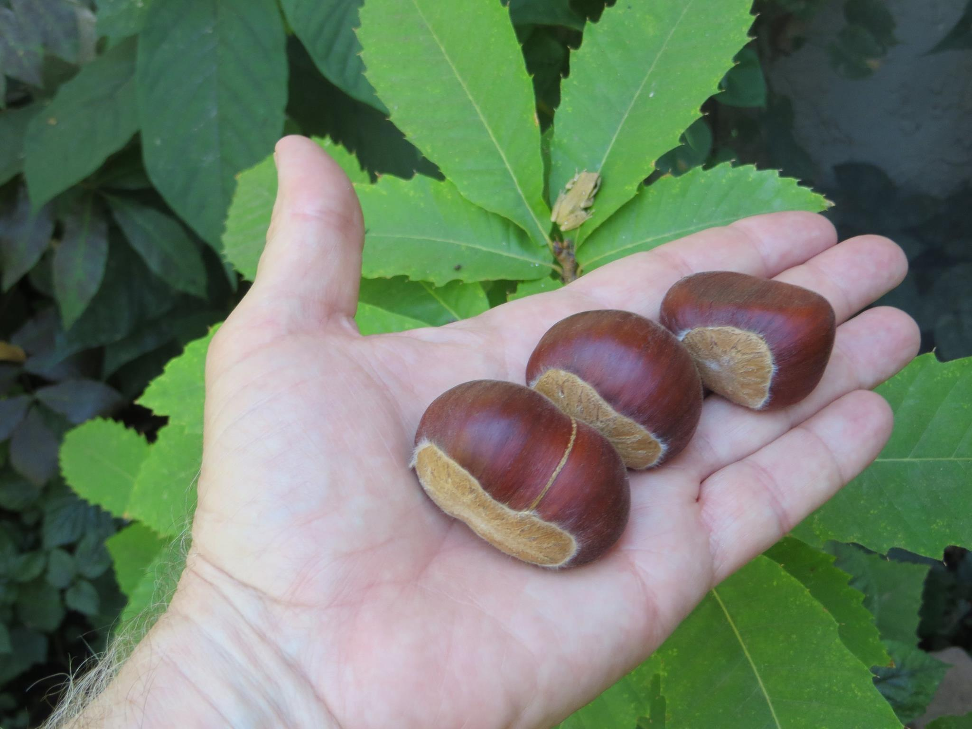
Revival
Mollissima/dentata seedling from Chestnut Hill.

Slide 26
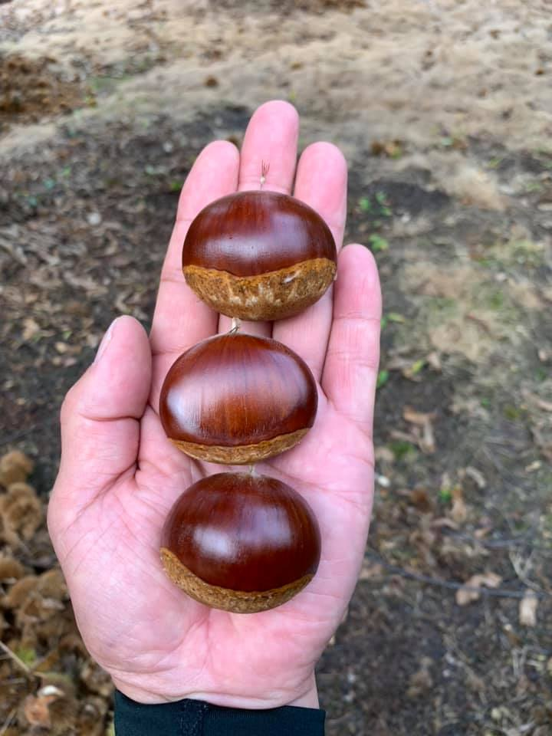
Rihei
Crenata/Mollissima cultivar from Japan. Photo by NI.

Slide 27
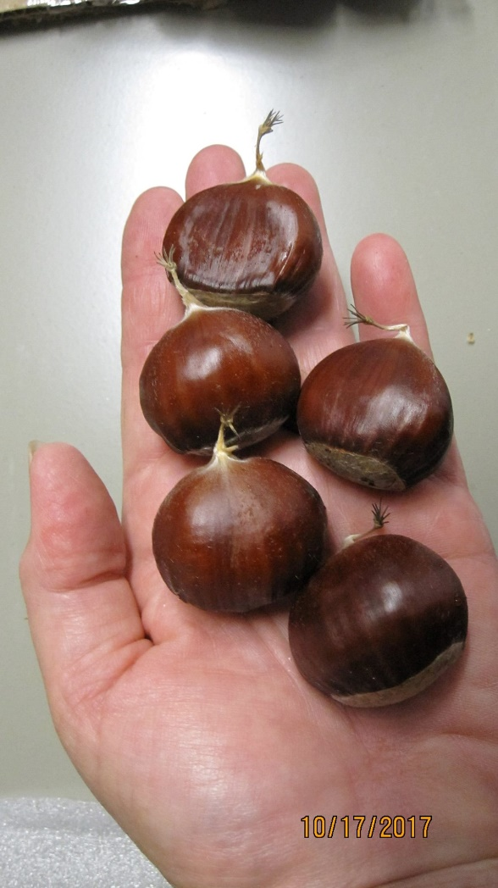
Sadie Hunter
Seedling grown out at the CAES. Photo by SA.

Slide 28
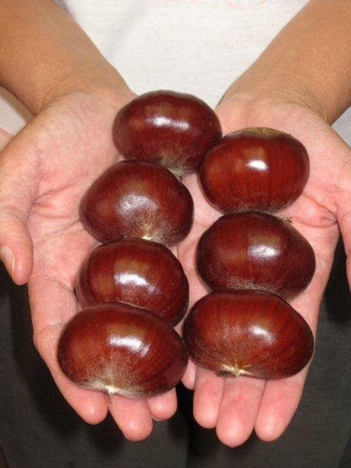
Schlarbaum
Crenata x mollissima seedling grown out by JMN

Slide 29
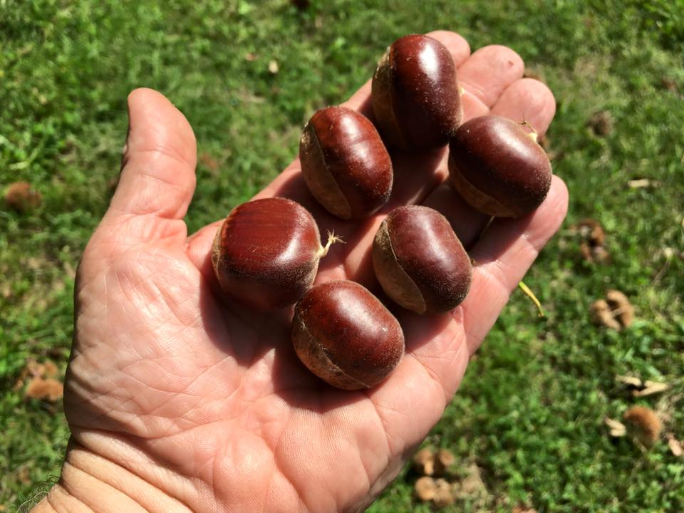
Shing
Seedling grown out by JMN. Photo by HC.

Slide 30
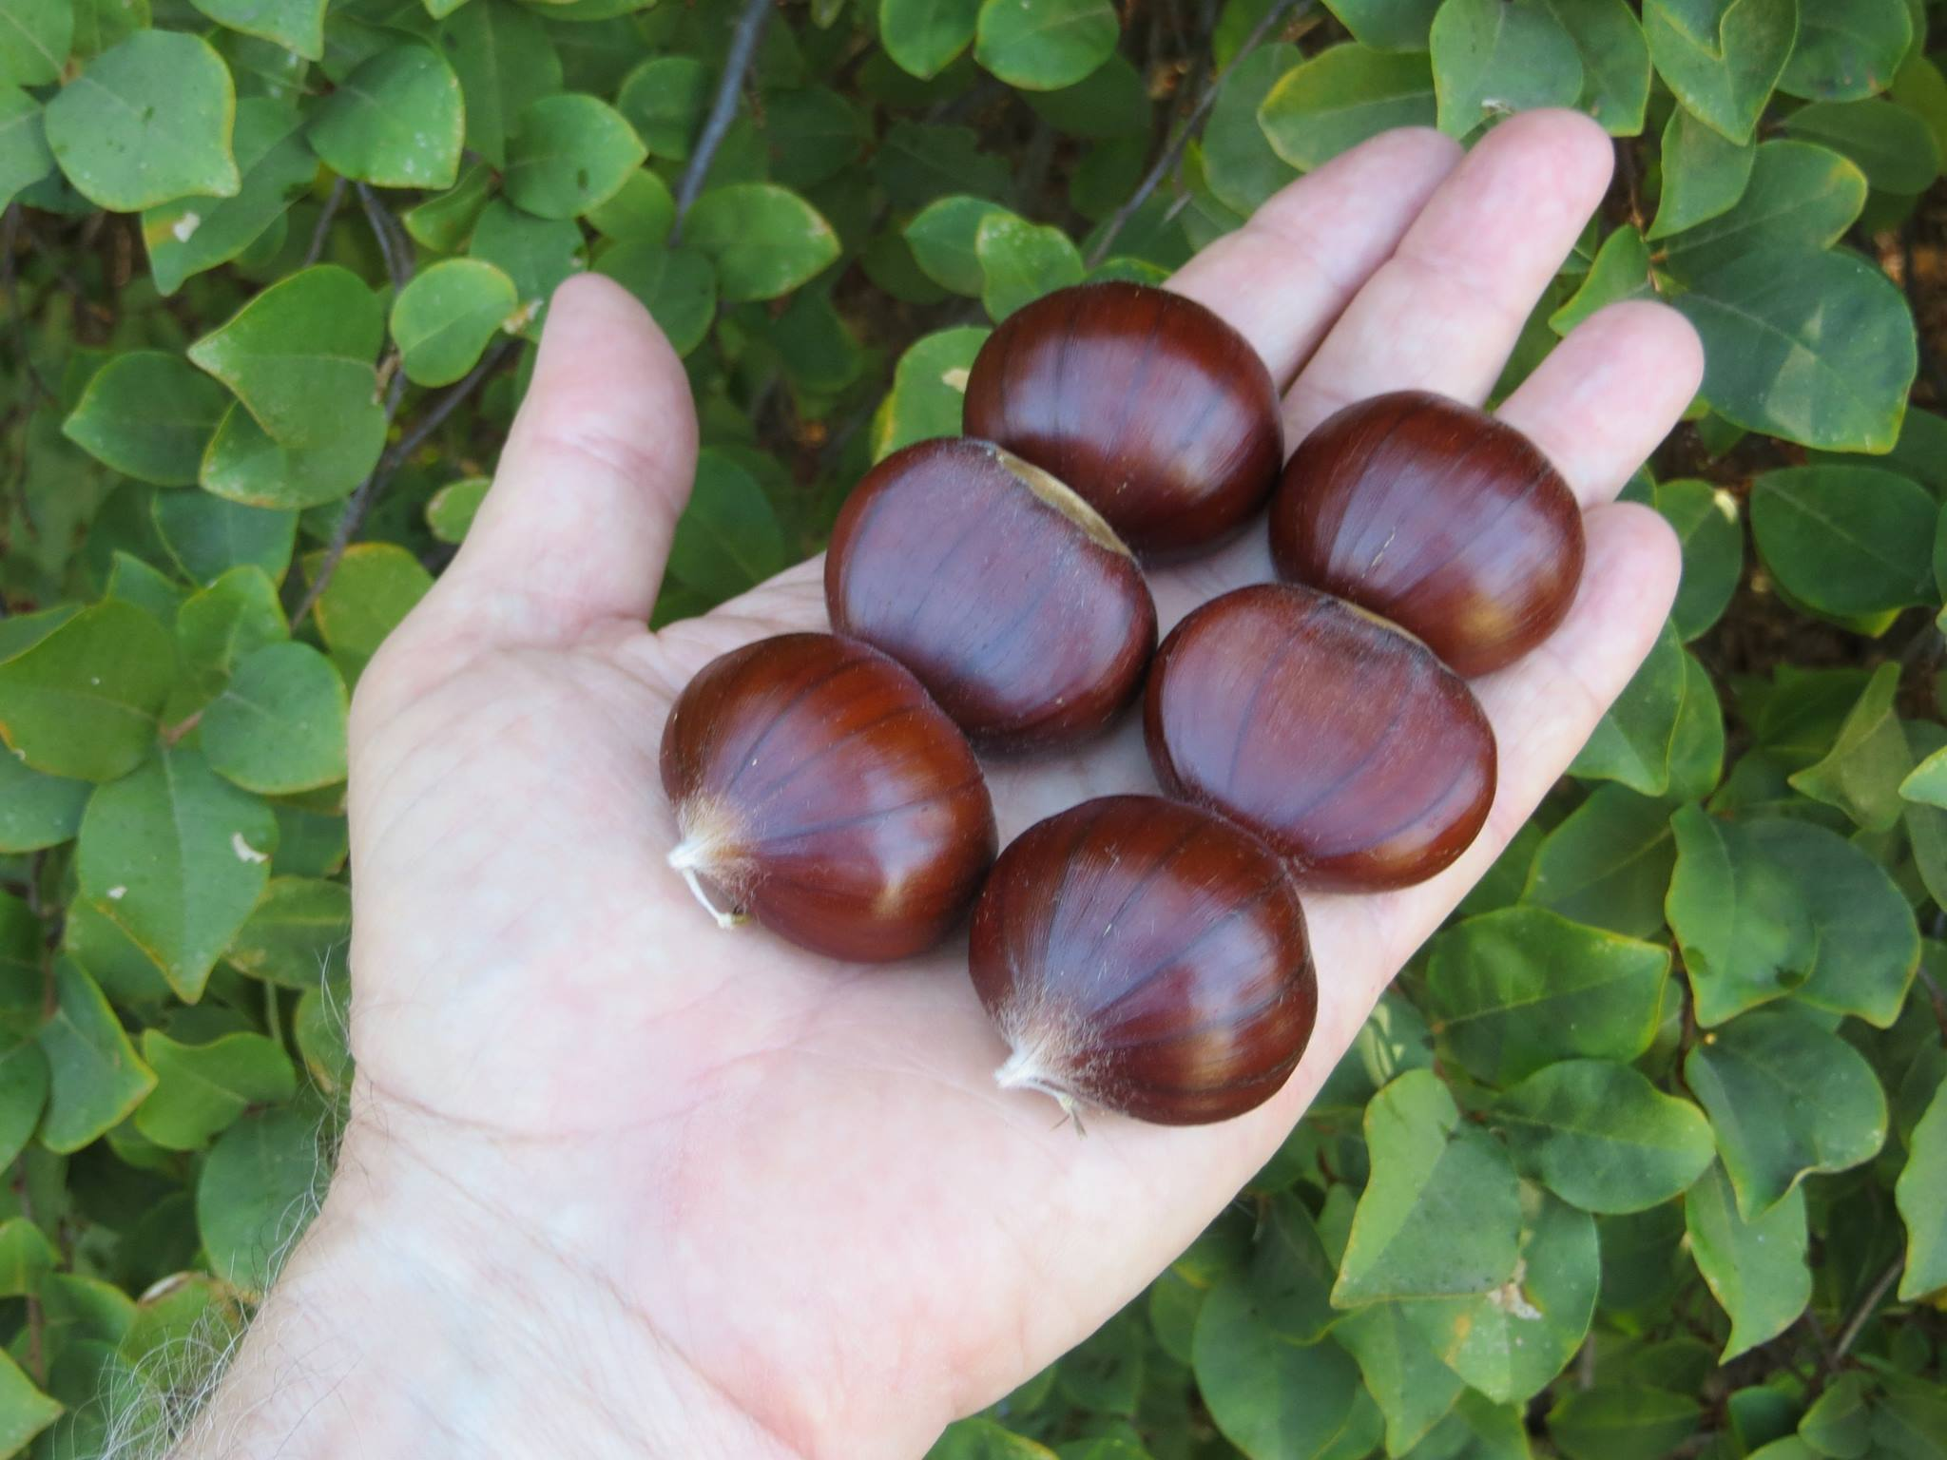
Skookum
Complex Mollissima hybrid

Slide 31
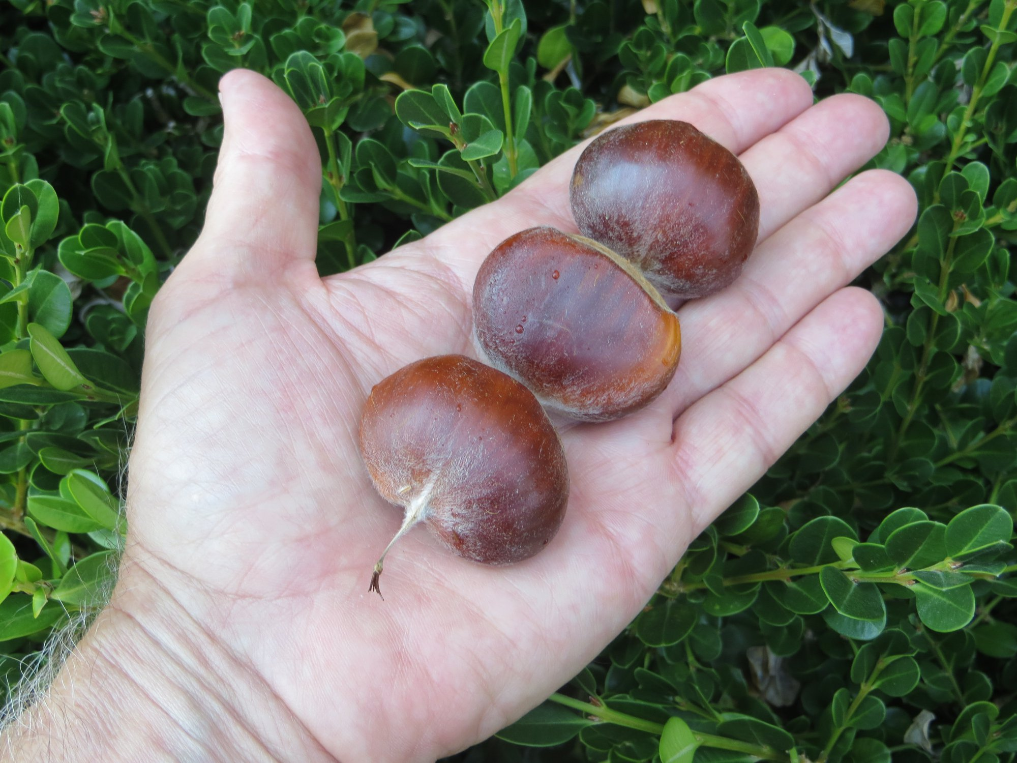
Super, or AU Super
A seedling grown out by Auburn University

Slide 32
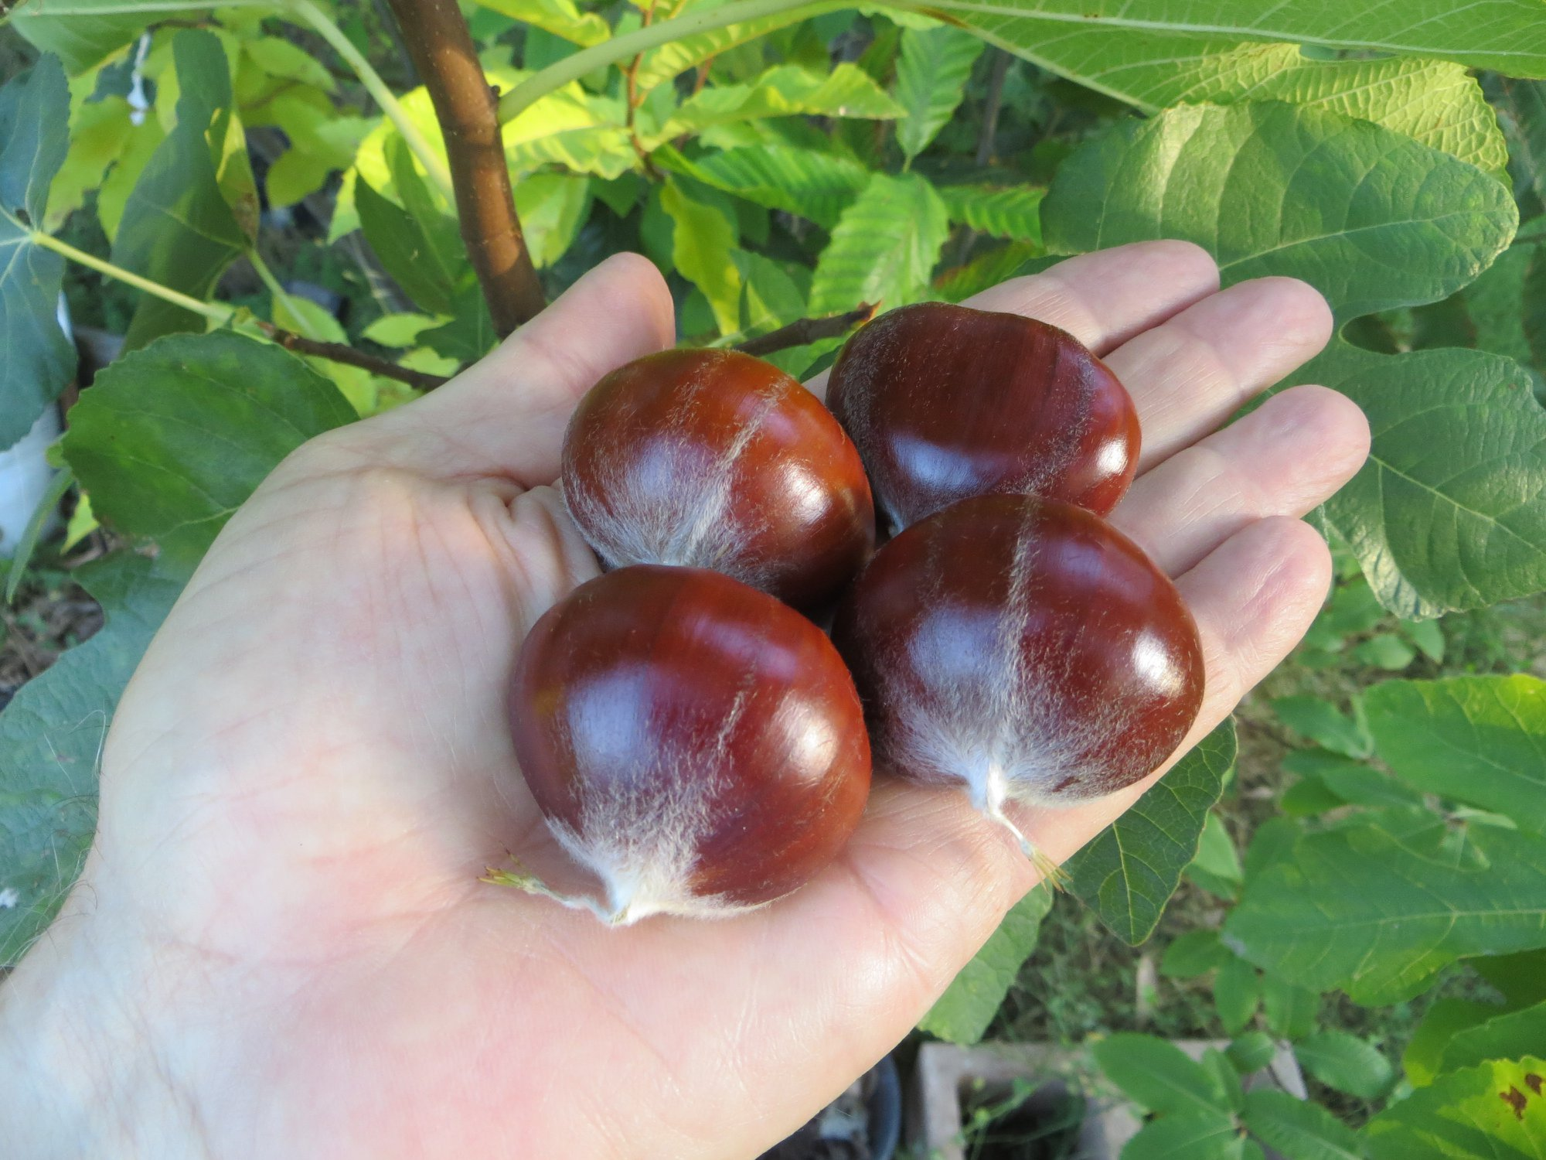
Szego
Complex Crenata/Mollissima hybrid grown out by JMN

Slide 33
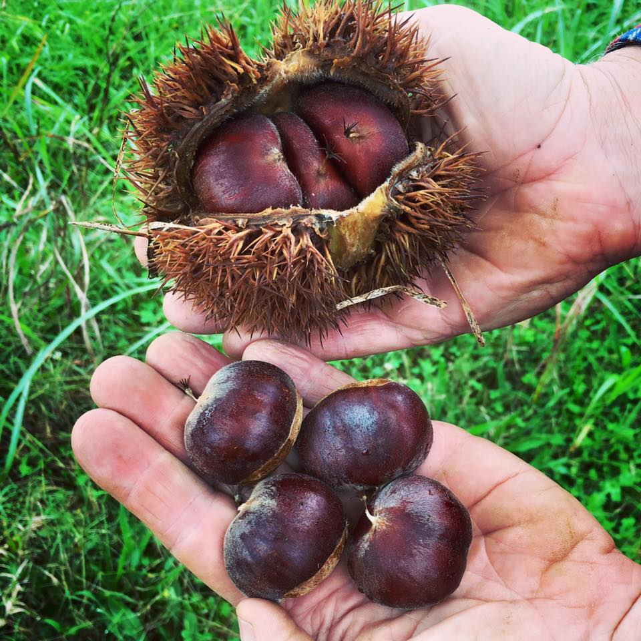
YGF (Yixian Good Flavor)
Seedling grown out by JMN. Photo by HC

Slide 34
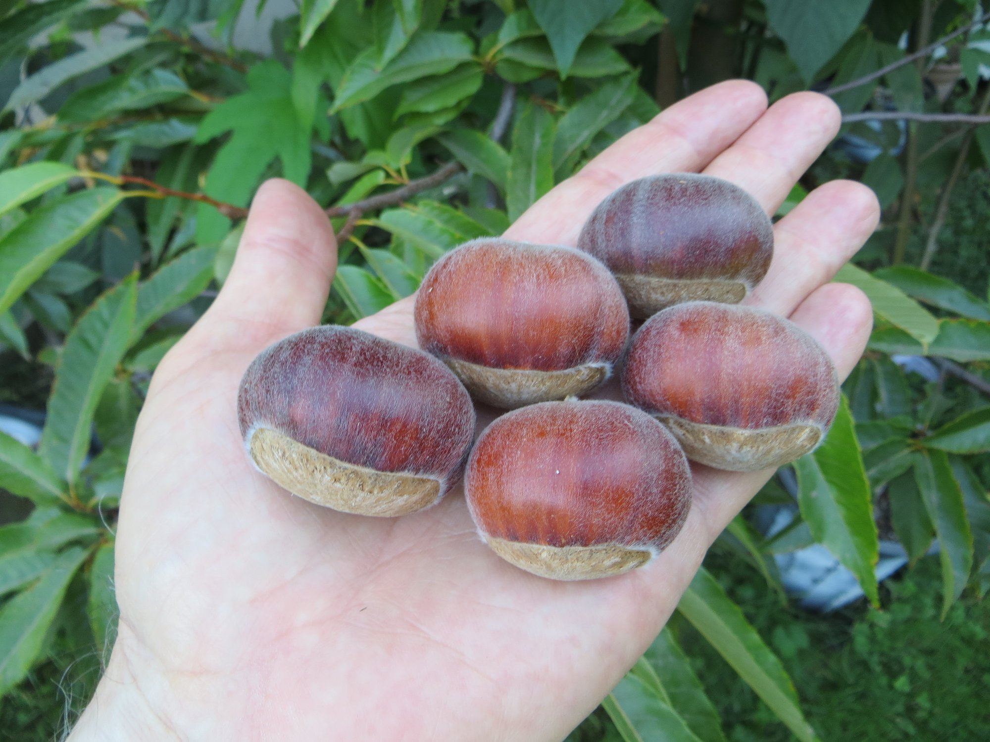
Yixian Large
Seedling grown out by JMN

Slide 35
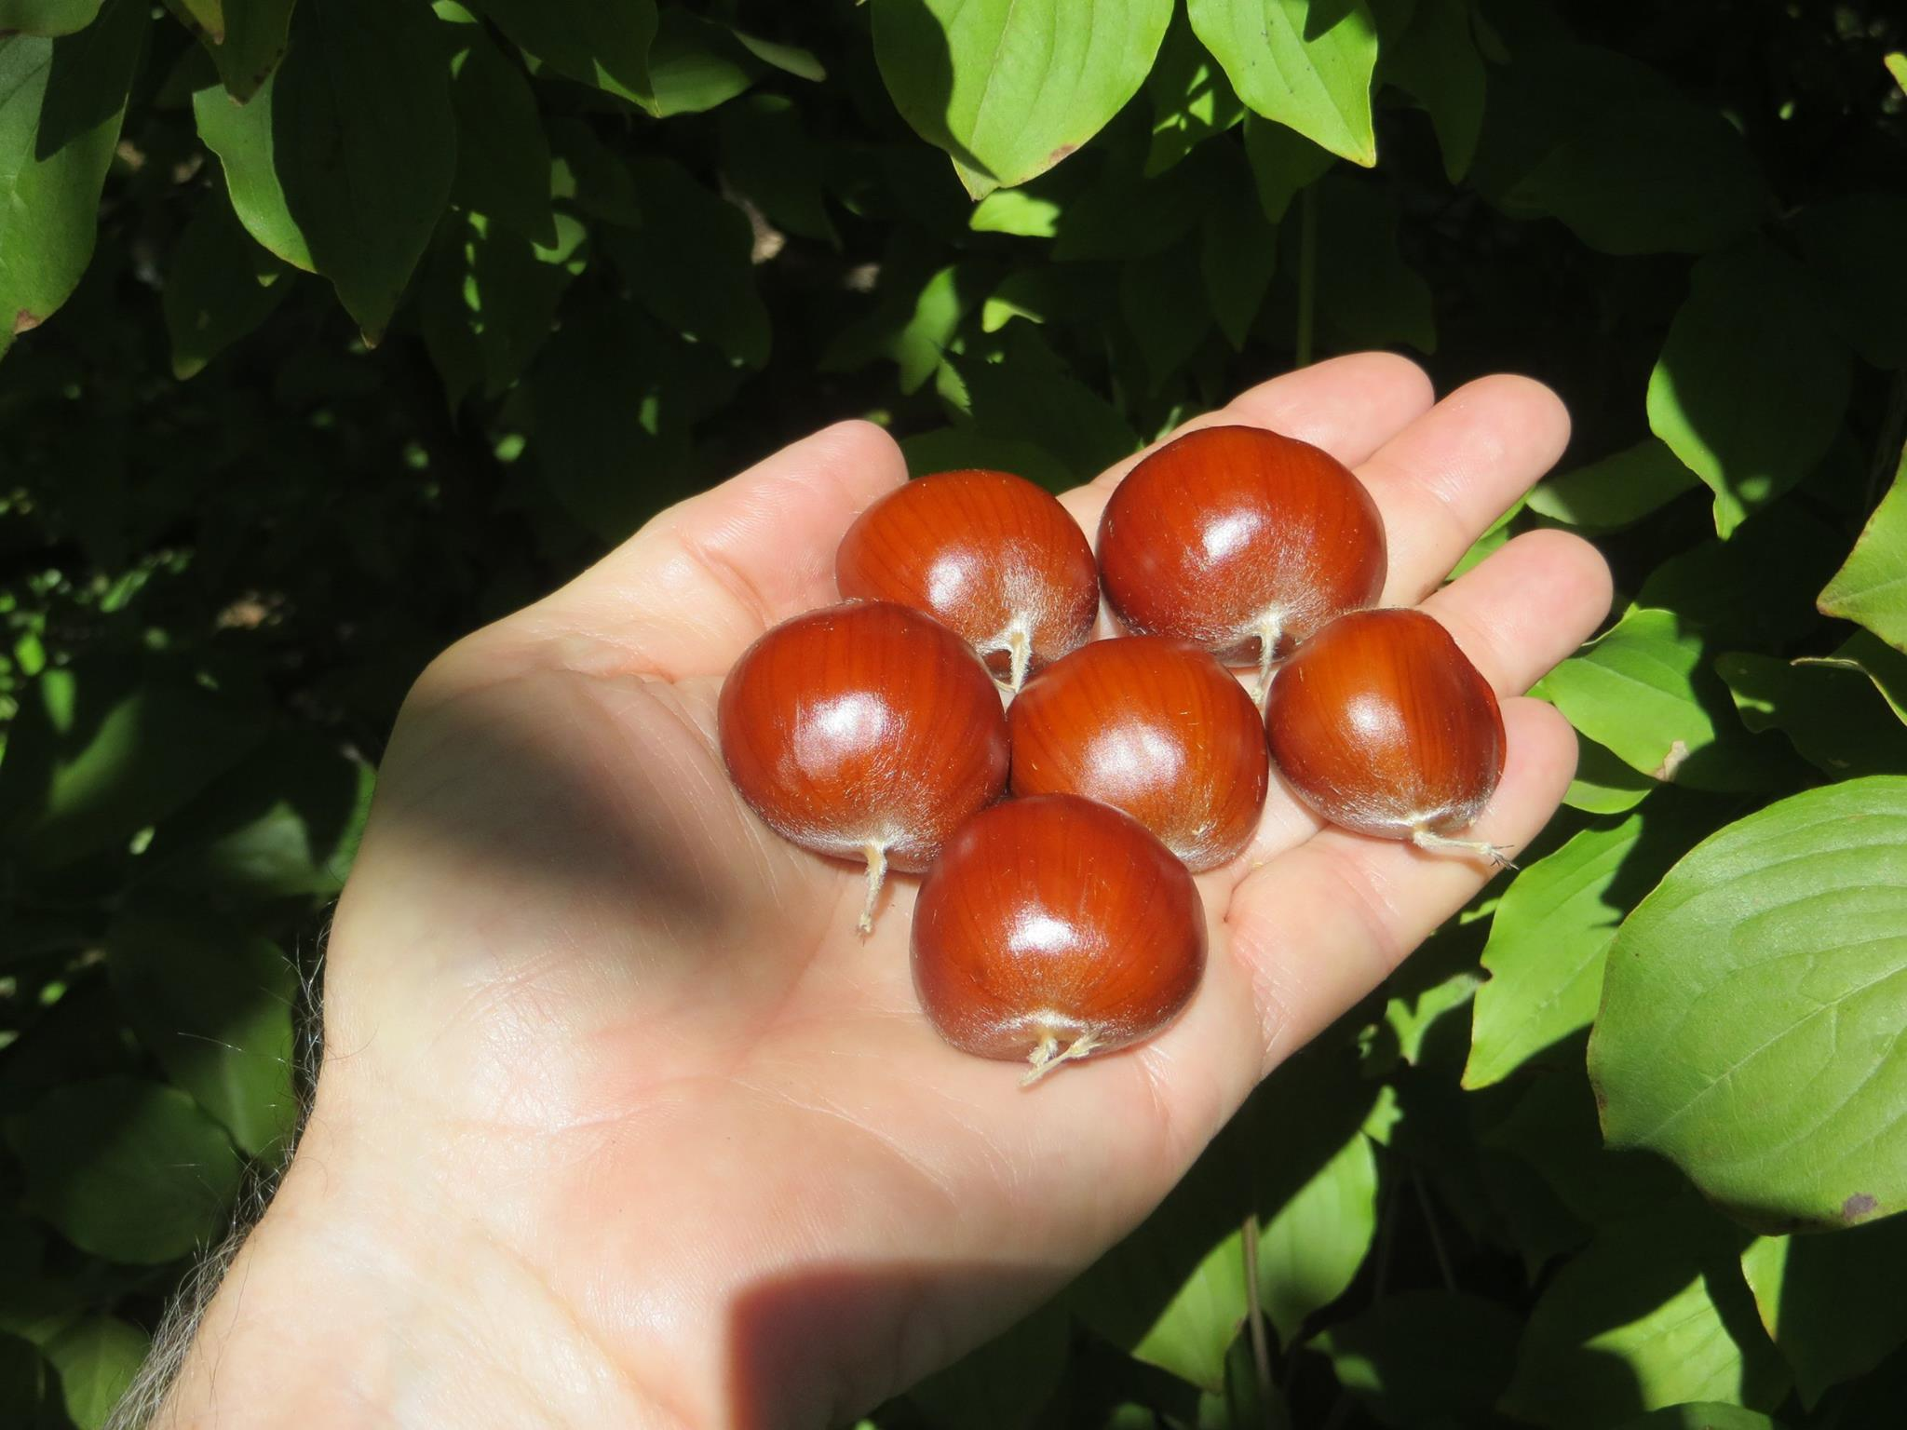
Yixian Orange
Seedling grown out by JMN

Slide 36
The nuts on the following pages are from interesting Mollissima seedlings, grown out by Auburn University, that do not yet have cultivar status

Slide 37
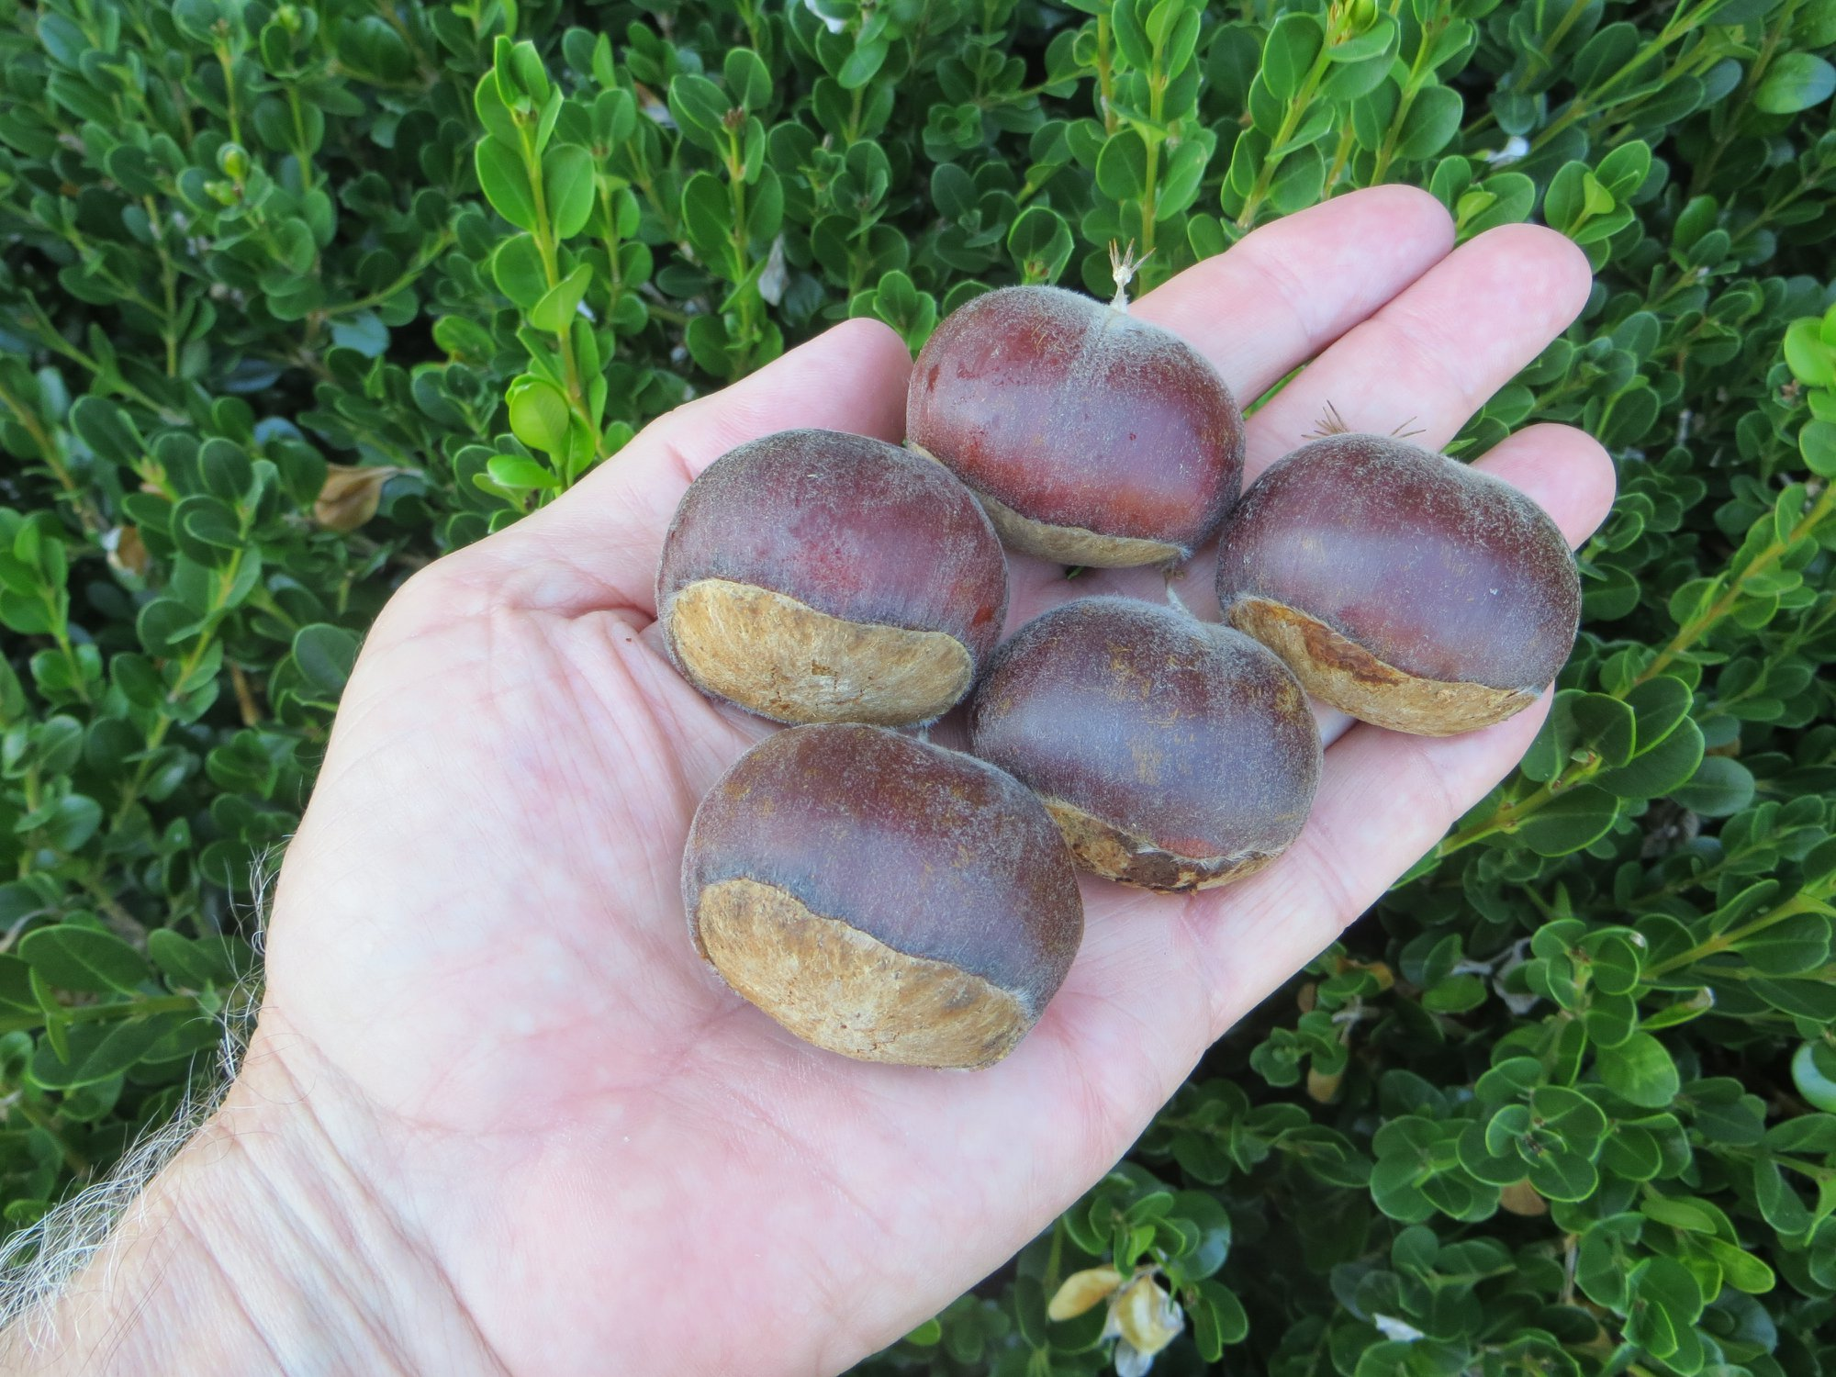
AU Northwest

Slide 38
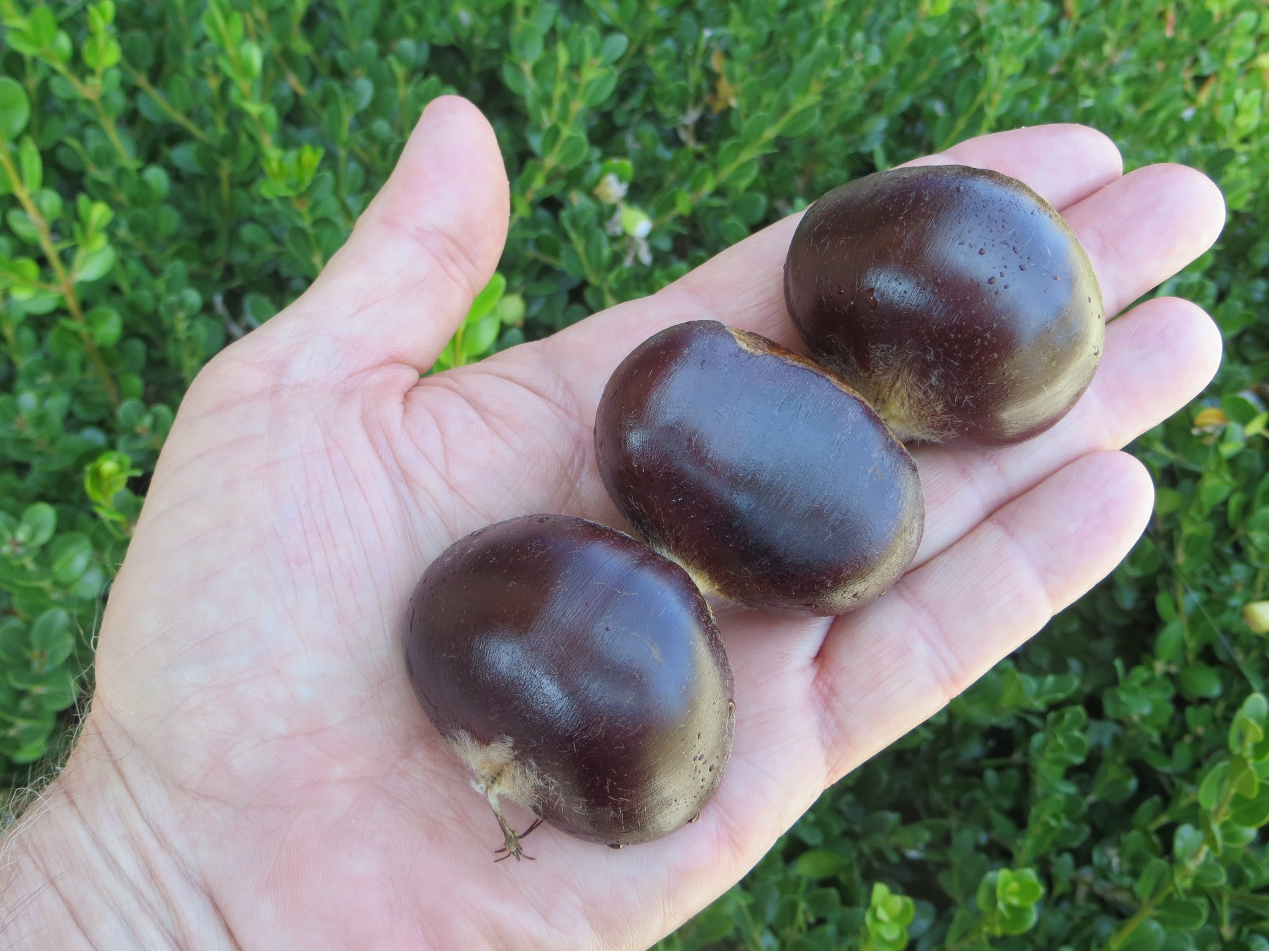
AU Mammoth

Slide 39
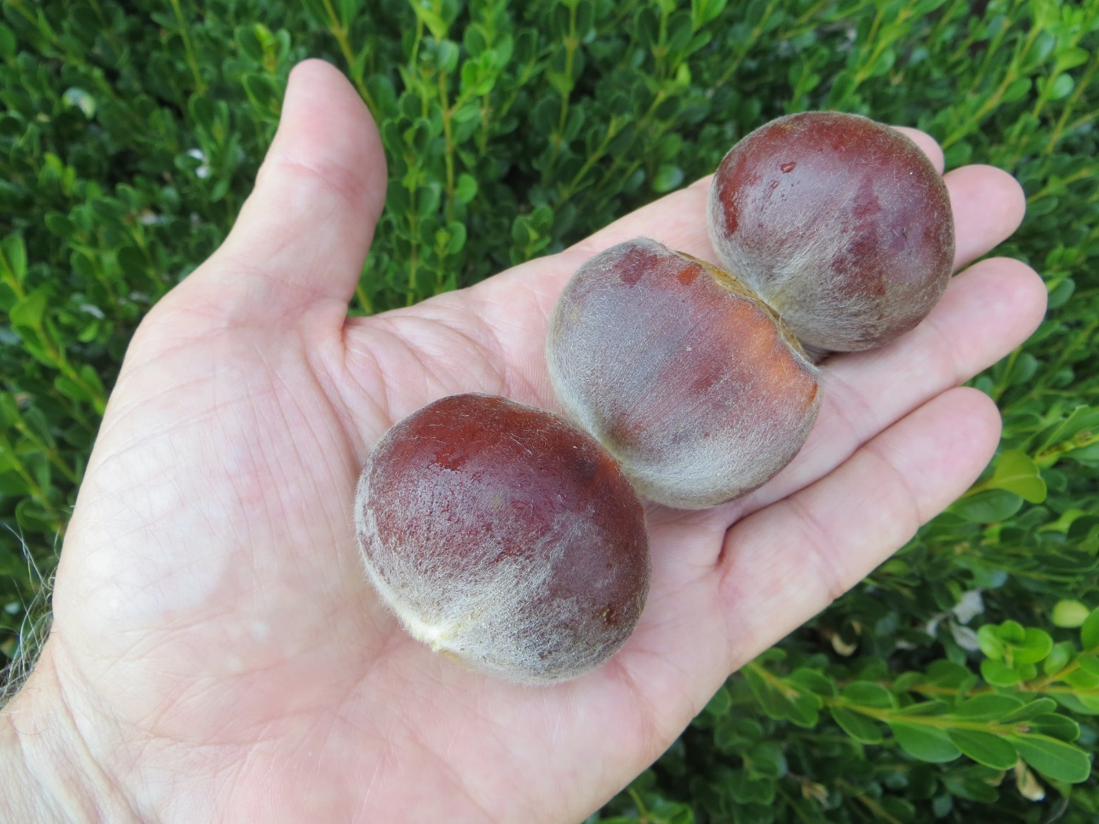
AU 1-11

Slide 40
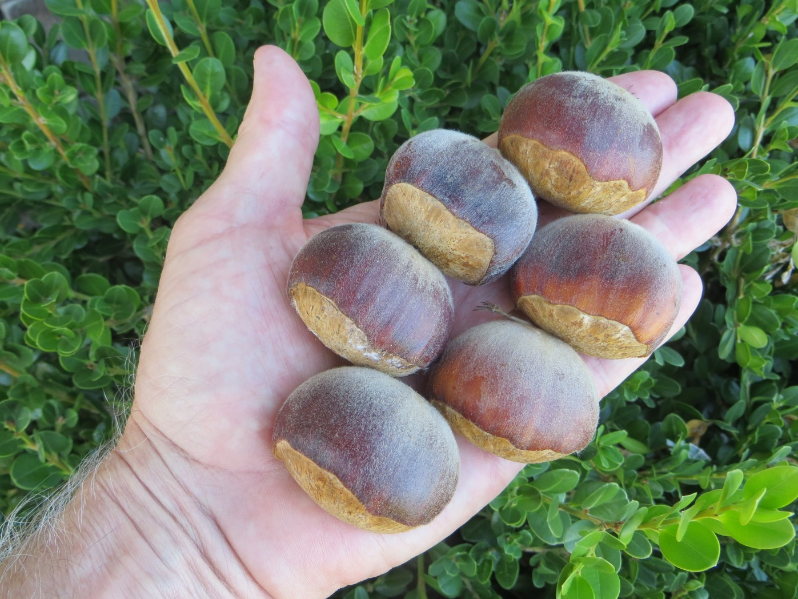
AU 2-18

Slide 41
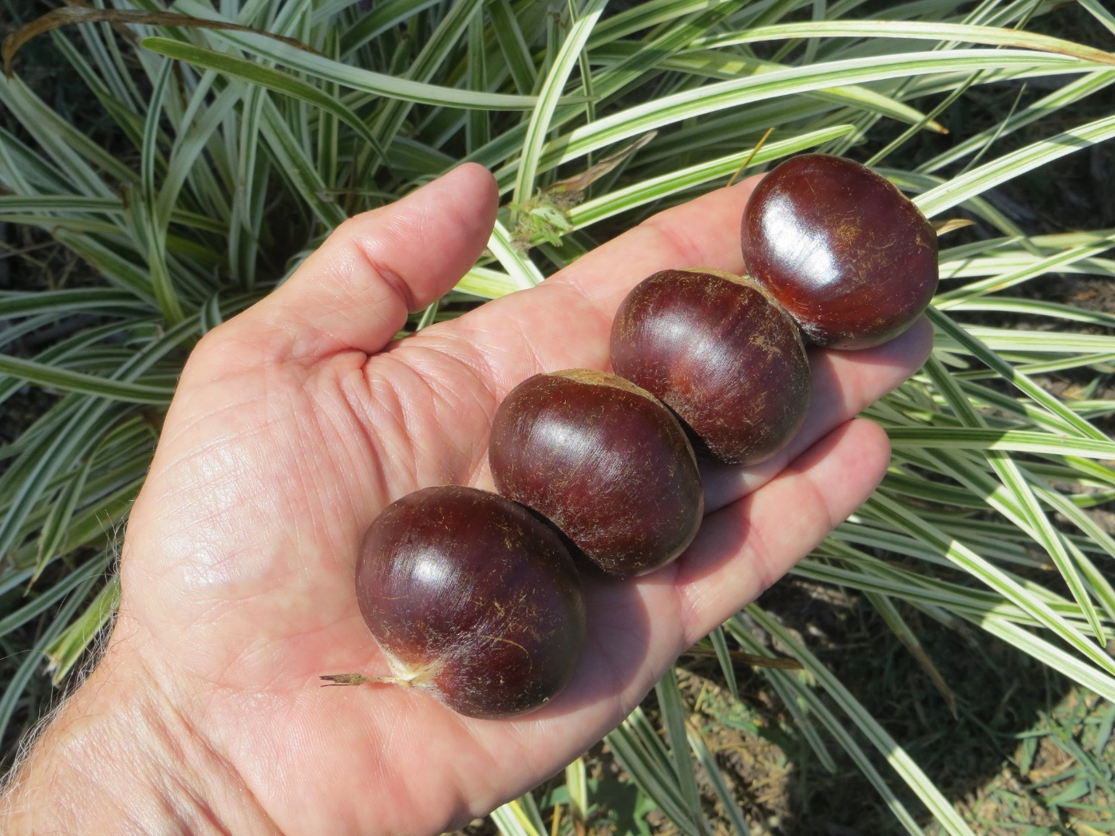
AU 4-26

Slide 42
Abbreviations used in this presentation
BF – Buzz Ferver
CAES – Connecticut Agricultural Experiment Station
HC – Hill Craddock
HH – Henry Hardmann
JMN – J. Michael Nave
MI – Max Imilian
MP – Michael Parks
NI – Naoki Ichikawa
SA – Sandra Anagnostakis
TVA – Tennessee Valley Authority
All photos by JMN unless otherwise noted

